Slide 1
Shifting from Psychotherapy to Population Mental Health: A New Paradigm for Community Change
Everett L. Worthington, Jr.
Virginia Commonwealth University
Presented as a Breakout Workshop
AACC (2025) Opryland
Session 215: Thursday 2:15 to 3:30

Slide 2
QR Code

Slide 3
Abstract
To meet increased need for therapy, the American Psychological Association recommends moving from individual intervention to population mental health. We explore how psychotherapists can include more preventive interventions without disrupting your practice. Forgiveness intervention is an example. You will learn over 10 practical ways to change people in a community.

Slide 4
Learning Objectives
By the end of this breakout workshop, the attendee will be able to:
Describe the reasons for and barriers to the recommended shift from individual-frame to systems-frame conceptualization of your treatment
Create public campaigns to promote better mental health (using forgiveness as a concrete example) without disrupting your clinical practice
Employ 10 lessons from research on forgiveness-promoting community campaigns to adapt your practice and provide population-level intervention effectively.

Slide 5
Learning Objective 1
Describe the reasons for and barriers to the recommended shift from individual-frame to systems-frame conceptualization of your treatment

Slide 6
Needs for Mental Health (MH) Services Exceed Projected Availability of Treatment
Needs that reduce needy people seeking help (even though many needy people are going untreated)
  stigma for seeking help from mental health professionals and
  costs for treatment
Reliance on remedial services (i.e., psychotherapy-like treatments) limit the number of available providers.

Slide 7
Task Force Headed by Ken Dodge Recommends Therapists Move Some Hours from Psychotherapy to Public Health
Dodge, K. A. et al. , Prinstein, M. J., Evans, A. C., Ahuvia, I. L., Alvarez, K., Beidas, R. S., Brown, A. J., Cuijpers, P., Denton, E.-g., Hoagwood, K. E., Johnson, C., Kazdin, A. E., McDanal, R., Metzger, I. W., Rowley, S. N., Schleider, J., & Shaw, D. S. (2024). Population mental health science: Guiding principles and initial agenda. American Psychologist, 79(6), 805-821. https://doi.org/10.1037/amp0001334

Slide 8
Arthur C. Evans, Jr., Chief Executive Officer of the American Psychological Association, addressed this deficit
He suggested that some alleviation could occur if MH service providers modified their identities.
“We limit our potential when we define ourselves narrowly—by the tasks we perform or the settings in which we work—rather than by the unique expertise and methods we bring. For example, identifying ourselves as an ‘expert in human behavior and mental health’ rather than a ‘clinician’ expands the lens through which we view our impact” (Evans, 2025, p. 10).
Evans, A. C., Jr. (2025). Redefining psychology: We must evolve our methods, mindset, and mission. Monitor on Psychology, 56(5), 10.

Slide 9
Barriers to Making Such Shifts
Individual Therapists
  People don’t like change
  Psychotherapy makes money. Psychoeducation models make less (i.e., groups) or make money only by indirect referrals.
  Therapists might not be familiar with psychoed groups or might be unfamiliar with public health methods.
Systemic Resistances
  The system of licensing and university and practicum training would all need to change to include other required competencies

Slide 10
Learning Objective 1
Describe the reasons for and barriers to the recommended shift from individual-frame to systems-frame conceptualization of your treatment

Slide 11
Can Positive Psychology (and in Particular Forgiveness Studies) Help Reduce the Global Mental Health Crisis?
I think so—IF psychologists (and other mental health providers) provide more growth, psychoeducational, and preventive models that were (1) palatable across communities and the globe and also (2) used some public health methods to disseminate treatments.
This would shift clinical psychology’s use of time about 10%. (Obviously, we would still treat psychopathology with psychotherapy-like treatments and counseling.)

Slide 12
Shifts in Mental Health Provision of Services
Shift toward promoting virtues.
Shift from a few remedial therapies each week to conduct, training, and supervision of growth and psychoeducational models disseminated broadly.

Slide 13
Promoting Virtues
Many character-strength and virtue-promoting interventions could be used to promote psychological (as well as spiritual) growth.

Slide 14
Specific Target Virtues
Broadly, these include treatments promoting the
  (1) cardinal Christian virtues like faith, hope, and love (and others like humility, gratitude, and forgiveness);
  (2) cardinal Greek virtues like
    (a) prudence, which includes wisdom, reason, and good judgment;
    (b) justice, which includes different types of justice (i.e., retributive, distributive, restorative, procedural, social justices; and limits on justice like mercy, grace, and forgiveness);
    (c) temperance, which includes self-control, patience, longsuffering; and
    (d) courage;
  (3) cardinal modern virtues like non-judgmentalism or toleration, mindfulness, general spirituality, fostering a growth mindset (rather than fixed mindset), grit, intellectual humility, responsibility, accountability, etc.

Slide 15
General Model
This is a general model for moving to growth, psychoeducation, and prevention interventions and training, supervision as additional modalities as a supplement to therapy.
Following: Forgiveness as an exemplar.

Slide 16
Learning Objective 2
We will now begin to address this learning objective:
Create public campaigns to promote better mental health (using forgiveness as a concrete example) without disrupting your clinical practice.

Slide 17
If these are our criteria…
Treatments that are (1) palatable across communities and the globe and also (2) use some public health methods to disseminate treatments,
THEN let’s look at the way three types of forgiveness interventions could fit the criteria.

Slide 18
Three Types of Interventions
Classroom forgiveness education (Freedman & Enright, 2020; for a meta-analysis of 20 intervention studies, see Rapp et al., 2022)
REACH Forgiveness psychoeducational groups and DIY workbooks (see Worthington, 2024, for a review of 25 randomized controlled trials on groups and review of 4 7-hour DIY workbook and mega-study of N = 4,598 worldwide RCT of a 3.34-hour workbook)
Comprehensive community campaign (Ortega Bechara et al., 2024)

Slide 19
All three …
Are palatable locally and globally (i.e., low cost and creating little stigma because they address forgiveness, even though a byproduct is fewer mental health symptoms and better flourishing, well-being, and hope)
Are scalable and can be disseminated by public health methods

Slide 20
Classroom Forgiveness Education

Slide 21
Enright’s Process Model
Two Major Uses
  Forgiveness Therapy: Almost all of his demonstration studies are relatively small N studies with one-to-one treatment of a person with a clinically relevant problem
    Note: Although this is effective and well documented and excellent for psychotherapy in which you can devote 20 sessions (Enright’s recommendation) to forgiveness therapy, for this presentation, we are looking at ways that we can use non-psychotherapeutic approaches, so this won’t be considered here.
  Forgiveness Education: 9 studies with the process model (9 studies on his story-based model); process model is much more effective and efficient

Slide 22
Enright’s Process Model (20 total units making up 4 phases)
(Uncovering Phase—Units 1-8)
In the uncovering phase, the person explores the transgression, admits to being hurt, and expresses feelings related to the transgression.
Unit 1: The person recalls and faces the offense. Defensiveness is foresworn as no longer potentially adaptive.
Unit 2: Anger is faced, admitted, and expressed.
Unit 3: Feelings of shame or guilt are addressed.
Units 4 and 5: People seek a healthy balance between the pain of the injury and understanding of the event.
Unit 6: The person considers how people usually compare themselves to an offender who is better off than they.
Unit 7: The person considers potentially permanent changes from the offense. Negative changes are admitted, but the potential for perceiving things more positively is offered.
Unit 8, the person considers their worldview and is encouraged to consider that it might change with time.

Slide 23
Enright’s Process Model (Decision Phase—Units 9-11)
The decision phase consists of units 9 to 11.
Unit 9, frank admission is encouraged that old strategies are not working.
Unit 10, the person considers forgiveness as an option; The definition of forgiveness and what it is not are considered.
Unit 11, the person commits to forgive the offender even though the person may not feel like forgiving.

Slide 24
Enright’s Process Model (Work Phase—Units 12-15)
The third phase is the work phase, in which there are four units.
Unit 12: The person seeks to understand the offender, including speculating about the person’s imperfections. This helps reframe the understanding of the offender.
Unit 13: Reframing is continued to promote empathy.
Unit 14: Reframing is continued to promote compassion.
Both are acknowledged as challenging to maintain.
Unit 15, The person is encouraged to accept and bear the pain of the injury.

Slide 25
Enright’s Process Model (Deepening Phase—Units 16-20)
Gaining a wider perspective
Unit 16: Meaning is sought in suffering and forgiving.
Unit 17: The person reflects on his or her own need for forgiveness in the past.
Unit 18: The person learns he or she is not alone in suffering.
Unit 19: The person reconsiders his or her purpose in life, hoping to find a newpurpose.
Unit 20: the person reflects on decreased negative and increased positive affect.

Slide 26
What Kind of Evidence?
Statistical aside: Effect size is the number of standard deviations a treatment is superior to a control condition. Expressed as Cohen’s d or Hedges g (which are conceptually pretty much the same) or r (usually t2 vs t1).
Perspective: 26 weeks of 1-hour per week of CBT for depression yields mean effect size of d = 1.26.
  The d / hour = 0.05

Slide 27
Effectiveness and Efficiency of Enright’s Process Model—Forgiveness Therapy and Classroom Studies
Classroom studies (later in Rapp et al., 2022, meta-analysis)—very international (Ireland, Turkey, S. Korea, Pakistan)
  Elementary School Children in Belfast, Northern Ireland (3 studies) 17 weekly 45-minutes classes = 12 hours 45 minutes
  Elementary School Children in Milwaukee, Wisconsin (17 weekly 45-minute classes) 12 hours 45 minutes
  Impoverished Fourth-Grade Students in Turkey
  Academically At-Risk Adolescents in the Midwestern United States (aged 12-14) (15 weeks)
  Female Adolescent Aggressive Victims in South Korea 12 weeks
  At-Risk Adolescents in the Midwestern United States (15 to 19) 23 hours
  Abused Adolescents in Pakistan 2x per week for four months (32 hours)
Internationally proven; mean time 17.92 hours

Slide 28
Classroom interventions (Bob Enright and Suzanne Freedman): Effectiveness versus efficiency
Process model: k = 9; g = 0.66
Story-based model: k = 9; g = 0.27
Time for Enright’s process and story-based models see previous slide: (12 h 45 m, 12 h 45 m, 15 h, 12 h, 23h, 32h) Mean = 17.92 hours
d/hr process model: 0.66/18 = 0.036
d/hr story-based model: ~ 0.012
REACH: k = 2; g = 0.29 (but time = 10 hrs); d/hr = 0.029

Slide 29
Forgiveness with school-aged children (Rapp et al., 2022)
g is effect size (number of SDs changed);
* statistical significance (note, some comparisons can be not significant merely because few studies or very unstable results of studies)
Meta-analyzed 20 studies in educational settings with children first grade (age 6) to 12th grade (age 18)
Outcomes: [Forgiveness + anger]* (g = 0.41; k = 20); Hope (g = 1.70, k = 5); Depression (g = 0.11, k = 7)
Moderators (i.e., predictors of outcomes): Grades: 1-3 (g = 0.03; k = 4), 4-6* (g = 0.45, k = 5), 6-8* (g = 0.58, k = 8), 9-12* (g = 0.44, k = 3)
Takeaway: In four studies with children 8 and under, NO Forgiveness Was Experienced

Slide 30
Psychoeducational Groups
For REACH Forgiveness, k = 25
For Enright’s process model, k = 2
For Luskin FFG groups, k = 2
For Wade group process model, k = 2

Slide 31
REACH Forgiveness
A method developed to be consistent with Christian beliefs and values and demonstrated to be helpful through science.

Slide 32
5 Steps to REACH Emotional Forgiveness —“Core” of the method—plus Decision to Forgive
These five steps are the external FORMS of forgiveness. The action happens within you.
Worthington, E. L., Jr. (1998). The Pyramid Model of Forgiveness: Some interdisciplinary speculations about unforgiveness and the promotion of forgiveness. In Worthington, E.L., Jr. (Ed.), Dimensions of forgiveness: Psychological research and theological perspectives (pp. 107-137). Templeton Foundation Press.
R=Recall the Hurt
E=Empathize (Sympathize, feel Compassion for, Love) the Transgressor
A=give an Altruistic Gift of Forgiveness
C=Commit to the Emotional Forgiveness One Experienced
H=Hold on to Forgiveness When Doubts Arise
Decision to Forgive

Slide 33
The full method
Screen participants
Get people to compete self-assessments
Introduce self and give hardest thing you’ve successfully forgiven
Lectio divina
Definitions or EF and DF
Benefits (spiritual, relational, psychological, physical)
Offer DF (will return later)
Work through Core: R, E, A, C, and H
Revisit DF (part of the Core)
Generalize through ‘12-step” program.
People complete post-group/post-workbook self-assessments

Slide 34
Running Groups
Groups take 6 hours
  They can be run on a Saturday—3 hours 9-12; 3 hours 1-4
  You can charge for them if in practice
  People can see others get better and can help others
  They draw on group universal healing factors
Groups take 6 hours
  Not everyone wants to spend that much time
  Not everyone is willing to pay
  Groups are less effective per hour than individual therapy
  Groups require coordination
  Groups require a minimum number of people (6) and a limit to how big (no more than 20)

Slide 35
Who Can Run REACH Forgiveness Groups?
YOU can!!
Undergrads were slightly less effective than post-master’s level counselors.
How?
Read the helper’s manual (alongside the participants’ manual)
Watch the training video (free on my website) of me running the group
Get supervised by a competent helper to answer your questions after reading and watching.
Preferably run the group with a co-leader (perhaps one who has run a REACH Forgiveness group before)
  Most of the talking is done by group members, not leader.
Have a supervisor available to deal with questions.

Slide 36
Christian-Accommodated REACH Forgiveness: What Were the Accommodations?
(Note: “Christian accommodated tells us little. Lots or little accommodation? What specific changes were made? Will the Christian beliefs, values, and practices resonate with the user?)
The treatment is entitled as explicitly Christian.
The REACH acronym is explained as a metaphor for forms that create the shape of a mold. The real work of forgiveness is internal, like filling the form with concrete for permanent change. The six forms (REACH and DF) can be used repeatedly.
The lectio divina reflections use Scriptures. Scriptures can help us understand forgiveness.
When forgiveness is defined as decisional and emotional, reference is made to Mt 6:12, 14-5, and it is asserted that decisional forgiveness is Scripture “required” and emotional forgiveness is God-desired.

Slide 37
Christian-Accommodated REACH Forgiveness: What Were the Accommodations?
  Spiritual benefits are explicit
  Humble forgiveness, looking to others, is emphasized. Part of the humility is (1) looking to God in prayer for empowering forgiveness and (2) praying for the one who offended you.
  Altruistic forgiveness is other-oriented, Christian undeserved (grace-motivated) forgiveness
  Commitment is needed, like commitment is needed to solidify God’s forgiveness in our lives.
  Maintenance can be aided by prayer.
  The 12-steps are aimed at character change through the work of the Holy Spirit working, again, through the “forms” of the 12 “steps” in which REACH is applied repeatedly.

Slide 38
Christian Accommodated REACH Forgiveness: What Were the Outcomes?
The “usual” effects of accommodating secular treatments to religious populations: see Captari et al., 2019
Captari, L. E., Hook, J. N., Hoyt, W. T., Davis, D. E., McElroy, S., & Worthington, E. L., Jr. (2019). Religion and spirituality. In J. Norcross and B. E. Wampold (Eds.), Psychotherapy adaptations that work: Evidence-based transdiagnostic responsiveness (pp. 212-263). Oxford University Press.
Strictly accommodated treatments have been equal in psychological outcomes but accommodated treatments have been better than secular treatments in spiritual outcomes.

Slide 39
Christian-Accommodated REACH Forgiveness: What Were the Outcomes?
There is reason to believe that this might not hold for forgiveness religiously accommodated treatments.
  Forgiveness figures heavily in Christianity. The same is not true for accommodating CBT, EFT, Behavior therapy, etc.
  Rye and Pargament (2002) found, with a Christian accommodated proto-REACH Forgiveness treatment that Christians assigned to the secular treatment still did most of the things that were recommended in the Christian-accommodated treatment: prayer, consult Scripture, talk to others in the church, etc. Therefore, empirically, their secular treatment did not differ from their Christian-accommodated treatment for Christian participants.
What did we find in reviewing all?
  REACH-Christian groups (d/hr = 0.091, k = 7) vs REACH groups (d/hr = 0.093, k = 12)

Slide 40
Secular REACH Forgiveness with Christians
(Ohio) Rye & Pargament (2002) Proto-REACH
(Ohio) Rye et al. (2005) Proto-REACH
(Philippines) (Worthington et al., 2010)
(Iowa) Toussaint, Griffin et al. (2020)
(India) Toussaint, Worthington et al. (2020) Mixed religious, mostly Hindu
(Virginia) Greer et al. (2014) 7-hr DIY Workbook
(Indonesia) (Kurniati et al., 2021) 3.34-hr DIY Workbook
(Indonesia) (Kurniati et al., 2024) 3.34-hr DIY workbook
Colombia (Chen et al., 2024) 3.34-hr DIY workbook
Did they work? YES, equally in psychological variables to Christian-accommodated versions. But spiritual side not assessed and other meta-analyses (Captari et al.) show better spiritual outcomes and more acceptance by some theologically conservative participants

Slide 41
Additional Forgiveness Interventions That Have Been Studied in Psychoeducational Groups

Slide 42
Luskin’s Forgive for Good Model (CBT)
Luskin’s (2001) model is a cognitive-behavioral approach to promoting forgiveness, used mostly to reduce anger, resentment, which put people at risk for cardiovascular malfunction. FFG suggests that forgiveness is ultimately beneficial for the person holding onto the anger.
People are helped to understand the hurt, empathize with the offender, reframe provocative situations by replacing negative with more adaptive interpretations, make a conscious decision to forgive, and use cognitive and behavioral methods to change unwanted cognition and emotion.
This has been done in groups—men’s health, college psychoeducation.

Slide 43
Luskin’s Forgive for Good Model (CBT)
A few studies have supported its effectiveness.
Harris, A. H. S., Luskin, F., Norman, S. B., Standard, S., Bruning, J., Evans, S., & Thoresen, C. E. (2006). Effects of a group forgiveness intervention on forgiveness, perceived stress, and trait-anger. Journal of Clinical Psychology, 62(6), 715-733.
Luskin, F. M. (2001). Forgive for good: A proven prescription for health and happiness. San Francisco, CA: HarperCollins.
Luskin, F., Ginzberg, K., & Thoresen, C. E. (2005). The efficacy of forgiveness intervention in college age adults: Randomized controlled study. Humboldt Journal of Social Relations, 29, 163–184.
Toussaint, L. L., Griffin, B. J., Worthington, E. L., Jr., Zoelzer, M., & Luskin, F. (2020). Promoting forgiveness at a Christian college: A comparison of REACH Forgiveness and Forgive for Good methods. Journal of Psychology and Theology, 48(2), 154-165.

Slide 44
Wade’s Yalom-Based Group Process Model
This is an interpersonal group therapy model (but a couple of studies have been done with psychoeducation in college students).
Participants were not exposed to any specific techniques for promoting forgiveness, although it was clear that forgiveness was of interest because the group is about dealing with transgressions.

Slide 45
Theory of Wade’s Yalom-Based Group Process Model
Healing occurs from therapeutic factors as the group bonds and members share themselves, struggles, and experiences with others (Yalom & Lescsz, 2005).
Group-related healing factors: universality (i.e., one is not alone in suffering), interpersonal learning, instillation of hope, imparting information, and cohesiveness.
By focusing on the group members’ experiences, the facilitators attempt to activate these therapeutic factors to help the members with their concerns.
When forgiveness arises in the group, treat as any other topic. Emphasize universality, interpersonal learning from it, hope, and cohesiveness from shared experiences.

Slide 46
Content Focused on in Wade’s Process Forgiveness Group
The group experience highlighted the interactions and emotional experiences of the group members during the group sessions (i.e., the group process).
Participants were encouraged to talk about how they view other members, experiences being in the group, and the ways that they relate to the others.
In addition to this primary focus of the group sessions, participants also discussed their lives outside the group, their experiences with others, and the past offense for which they are seeking help.

Slide 47
Wade’s Yalom-Based Group Process Model
Wade, N. G., Cornish, M. A., Tucker, J. R., Worthington, E. L., Jr., Sandage, S. J., & Rye, M. S. (2018). Promoting forgiveness: Characteristics of the treatment, the clients, and their interaction. Journal of Counseling Psychology, 65(3), 358-371.
Wade, N. G., & Meyer, J. E. (2009). Comparison of brief group interventions to promote forgiveness: A pilot outcome study. International Journal of Group Psychotherapy, Vol 59(2), 199-220. doi: 10.1521/ijgp.2009.59.2.199

Slide 48
Wade’s Yalom-Based Group Process Model: How effective and how efficient?
Wade, N. G., Cornish, M. A., Tucker, J. R., Worthington, E. L., Jr., Sandage, S. J., & Rye, M. S. (2018). Promoting forgiveness: Characteristics of the treatment, the clients, and their interaction. Journal of Counseling Psychology, 65(3), 358-371.
When compared directly with Yalom-based group therapy, REACH Forgiveness reduced rumination more, but did not differ in the other four measures.
For REACH Forgiveness groups, for pooled measures of forgiveness—revenge and benevolence—d = 0.720 at post-test (d/hr per hour = 0.06) and d = 0.43 at follow-up.
Process group therapy d = 0.53 at post-test (d/hr per hour = 0.045) and d = 0.41 at follow-up.

Slide 49
Generalizations from Comparing the Content of the Various Interventions
Almost all forgiveness treatments share more in common than they differ. Almost all use most of the same principles.

Slide 50
Similarities That All or Most Share
First, they motivate forgiving by recounting psychological, physical, relational, and (perhaps) spiritual benefits of forgiving to the forgiver.
Second, they typically have people work on forgiving a specific hurt or offense rather than forgiving more in general.
Third, they all guide people to recall and process the hurt—though they differ starkly in how much of the treatment is devoted to that.
Fourth, they invite the potential forgiver to take the perspective—cognitively, and especially, empathically—of the offender and extend compassion.
Fifth, they invite the potential forgiver to take an inventory of his or her own life and embrace a humble acceptance that they too have offended and to do so is a shared human failing calling for a generous response.
Sixth, they encourage forgiveness but all treat it as choice rather than duty.

Slide 51
Similarities Shared by Some But Not by Others
Seventh, they encourage decisional or emotional forgiveness, or both.
Eighth, most attempt to place struggles in some larger perspective.
Ninth, they encourage a long-term commitment to forgiving.
Tenth, some explicitly instruct in ways to maintain gains.
Eleventh, some seek to broaden forgiveness beyond forgiving an offense to forgivingness.
Twelfth, most encourage reflection on the gains made through the intervention.
Thirteenth, some encourage some deeper insight into subtle unconscious or contextual factors pushing people towards forgiveness or unforgiveness.
Fourteenth, some direct explicit attention to things that the offender can do to make forgiveness easier or more difficult.
Fifteenth, some refer to forgiveness as a way of restoring hope (personally or relationally), easing depression and anxiety, and promoting well-being and flourishing.
Sixteenth, some make the application specific to a particular harm (i.e., incest, couple conflict) or clientele (i.e., people in some non-US country, Christians).

Slide 52
Comparing All
Overall, looking at each of the principles, no single intervention employs all 16 of these. However, most of the interventions use most of the principles.

Slide 53
Build Your Own Adventure (in Forgiveness)
If you like the approach of extracting the forgiveness principles from
  Christian living (practical theology),
  REACH Forgiveness,
  Enright’s process model,
  10 other forgiveness interventions, and
  basic research,
Then I have a workbook for you and your clients.

Slide 54
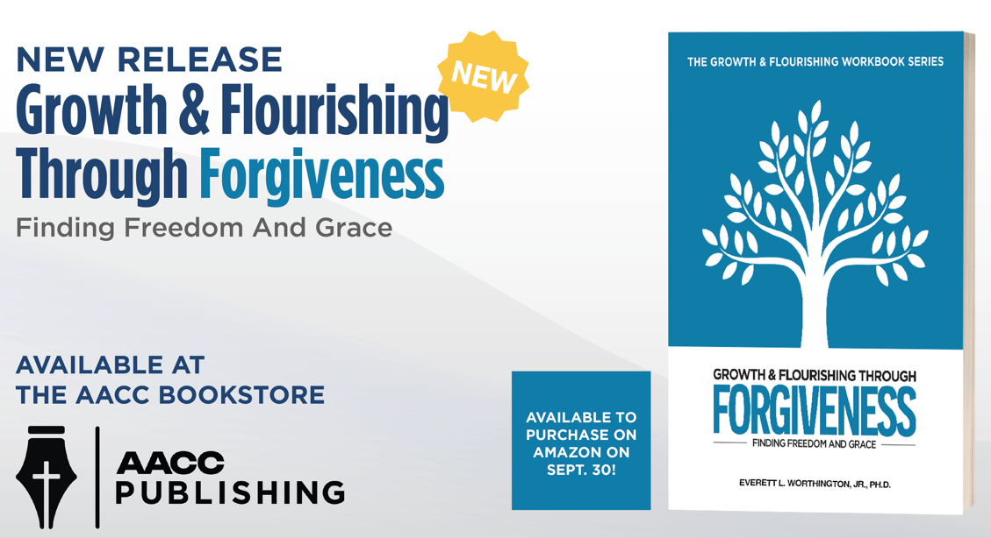
Available here for the first time

Slide 55
REACH Forgiveness Evidence-based DIY Workbooks

Slide 56
For public health application…
We need a DIY workbook that is
  Brief enough that people will use it.
  Free to all in the population
  In local languages so all people (who are literate) can use it

Slide 57
History of Efforts
7-hour workbooks (secular [n = 2] and Christian [n = 1]) and testing them at VCU
Turning the 7-hour workbook into a 7-hour open-internet study (LESSONS LEARNED)
Creating a “2-hour” that turns out to be 3.3-hour workbook for international randomized controlled trial

Slide 58
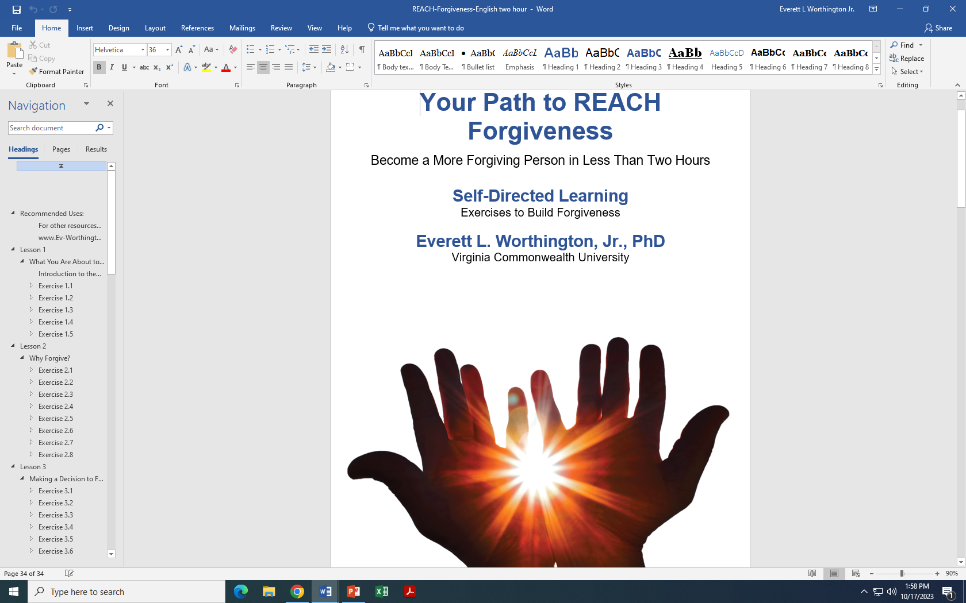
3-Hour DIY Workbook

Slide 59
Putting the Lessons to Work (A Project Funded by the Templeton World Charity Foundation [TWCF]; HO Man Yee, PI)
Hong Kong—an entire (secular) university
Indonesia—a large Christian church that had been razed by religious opponents in the past
Ukraine (two sites)—one near the Russian-Ukrainian conflict, one in a large church in Kyiv
Colombia (two projects)—war survivors; in a (secular) college
South Africa (an entire geographical section of the country, about 1/5 of the population)

Slide 60
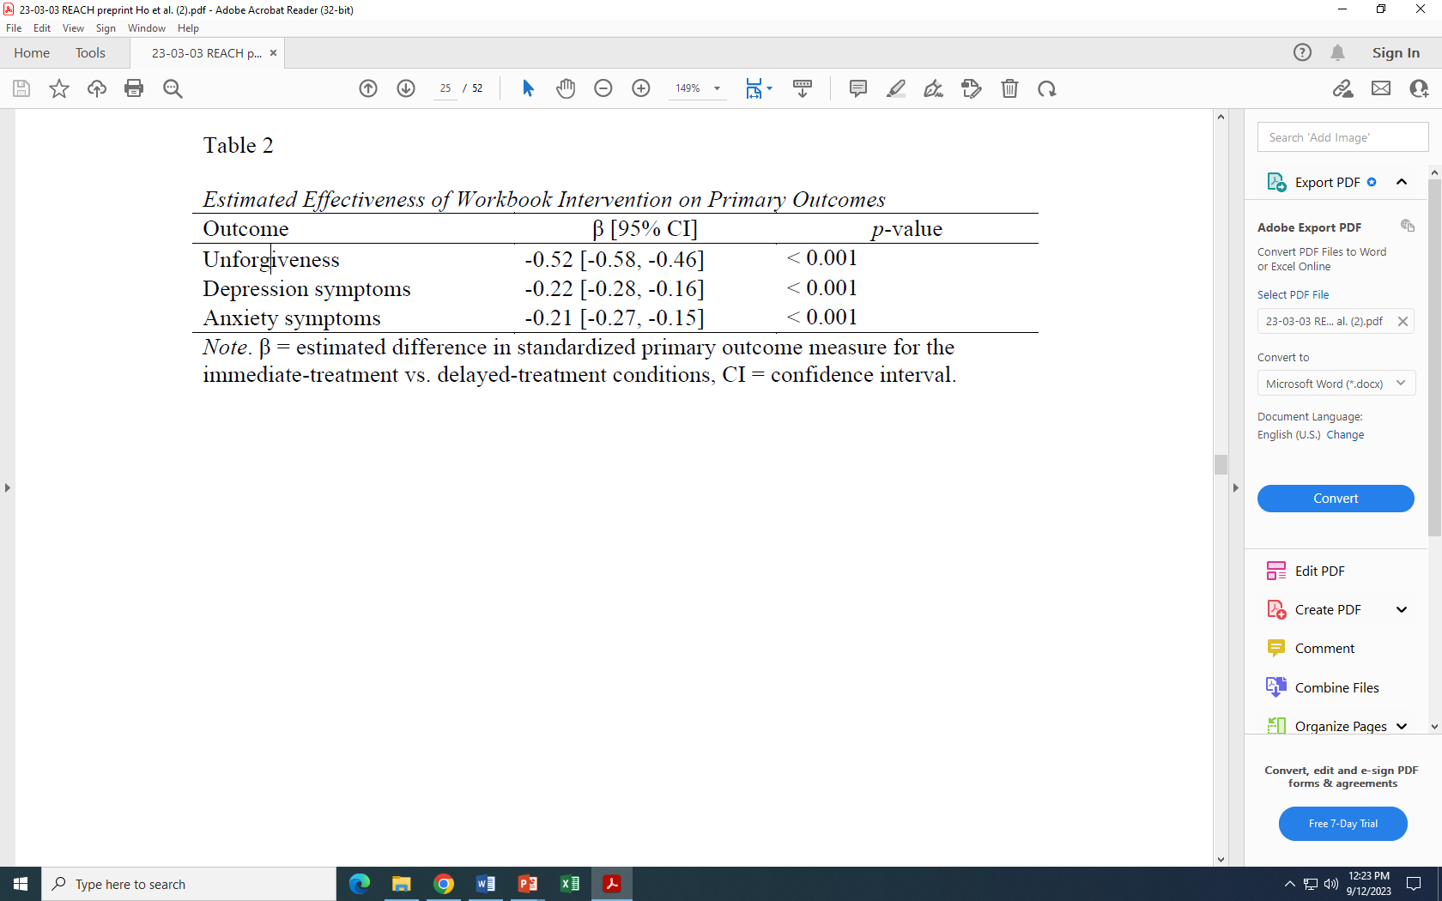
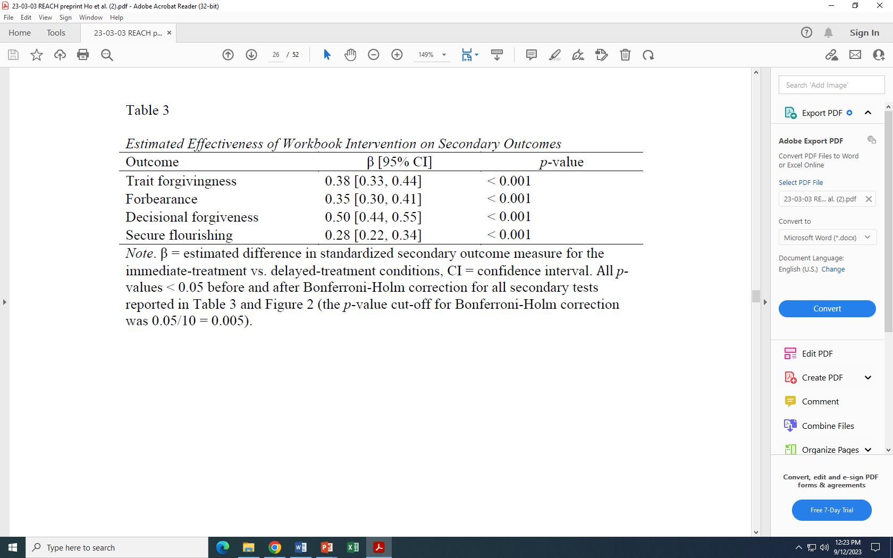
Briefer, International, N = 4,598
Only 3.34 hours to complete
Forgiveness AND MH symptoms AND flourishing
Recall: For groups (Wade et al., 2014, meta-analysis), mean time was 10 hours, mean d = 0.56, for forgiveness.
In this study (bigger N than all RCT interventions added together), d = 0.52 for a <3.34-hour DIY workbook.

Slide 61
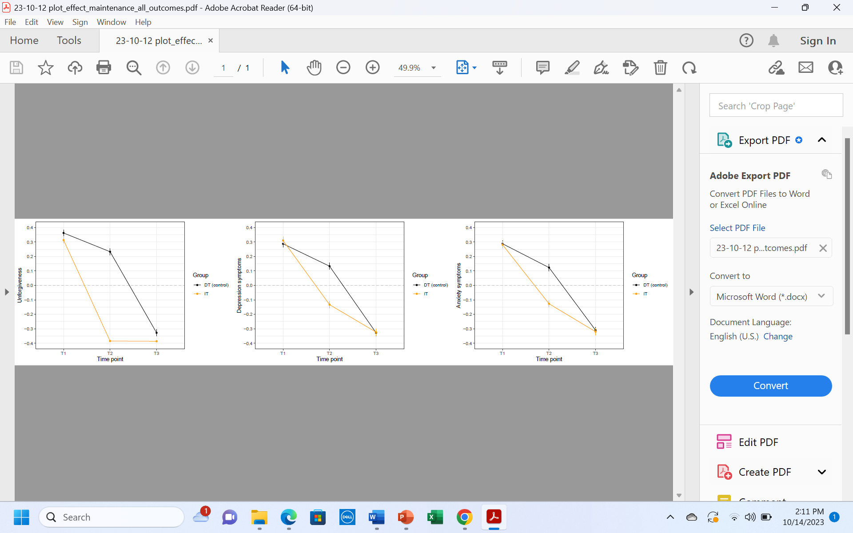
Omnibus Means over Time for Unforgiveness, Depression, and Anxiety
Unforgiveness Depression Anxiety
Take home: Immediate treatment forgave better (forgave immediately and maintained). They reduced depression and anxiety and it kept improving over time. Delayed treatment mirrored performance of IT (of course without follow-up).

Slide 62
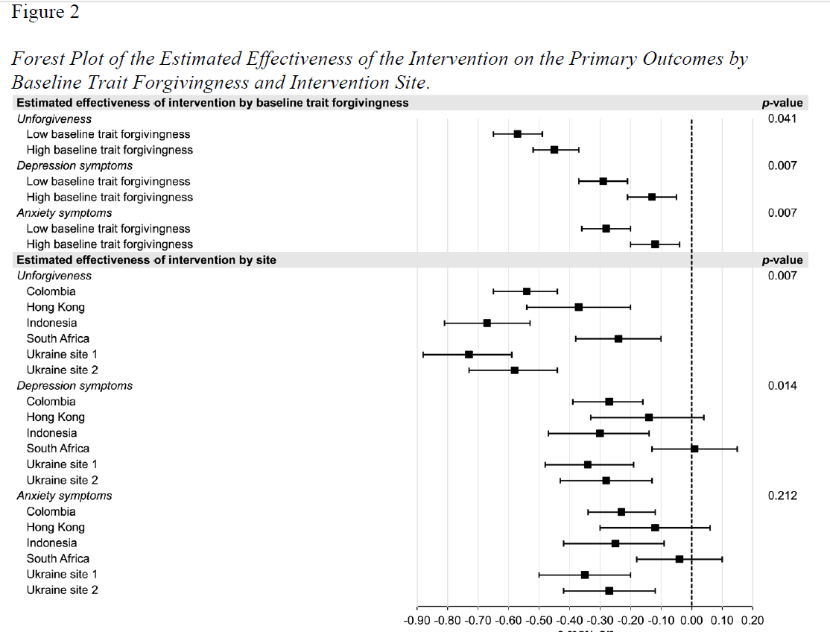
Site-by-Site Results
Sites sampled from different populations and communities.
Ukraine site 1 was Christian churches. All others were generally secular (containing religious and non-religious people).
Colombia 2 samples: university and war survivors.
Take home: Sites differ

Slide 63
We have posted, on a central website, all translations of the workbook (without cost) https://reach.discoverforgiveness.org
Thus, REACH Forgiveness brief DIY Workbooks will be available to about ¾ of the world in their first language without cost:
  English
  Spanish
  Mandarin
  Ukrainian
  Indonesian

Slide 64
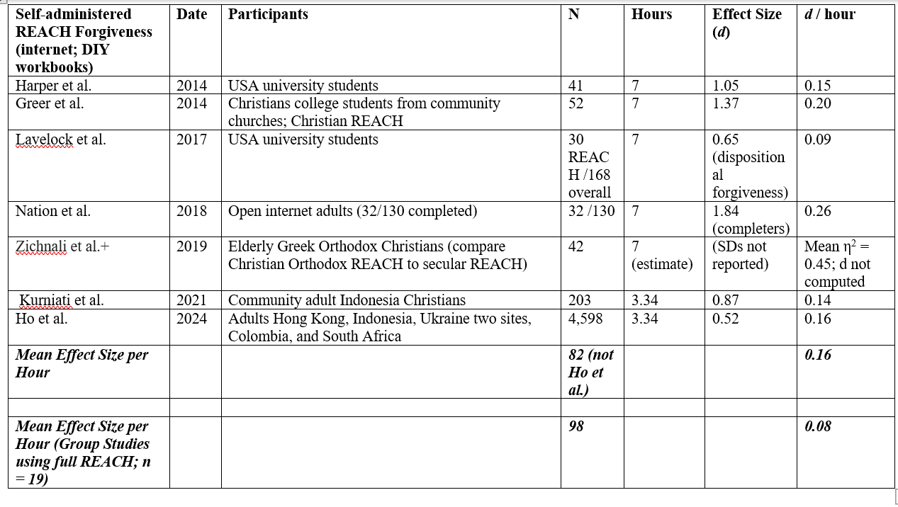
Comparing DIY Workbooks to Groups—Take Home: DIY Workbooks Twice as Effective as Groups
*
*

Slide 65
With 3.34 hour DIY Workbooks, we have a tool to help people in the public forgive in larger groups
Can community campaigns promote forgiveness?
Could an entire country be enticed to complete these workbooks and engage in other forgiveness activities?
A city?
An organizations within a city?
This is real public health intervention!

Slide 66
Comparing DIY Workbooks to Groups—Take Home: DIY Workbooks Twice as Efficient as Groups (but equal in effectiveness to 6-hour groups)
[Recall: Meta Mean ES = 0.56 for 10 hours of treatment. (d/hr ~ 0.056)]
*
*
For N=25 REACH group RCTs, d = 0.091; d/hr = 0.546

Slide 67
Effective vs Efficient
Which is more effective—a 6-hour REACH Forgiveness group or a 3.34-hour REACH Forgiveness DIY workbook?
  Group d = 0.546; DIY d = 0.52
  Conclusion: Equally effective
Which is more efficient—a 6-hour REACH Forgiveness group or a 3.34-hour DIY workbook?
  Group d/hr = 0.091; DIY workbook d/hr = 0.16
  Conclusion: DIY is about twice as efficient

Slide 68
Community Campaigns

Slide 69
Mediating Structures
Mediating structures are existing organizations that can be enlisted (and perhaps coordinated to work on forgiveness at the same time) to change a virtue that will spread to a larger structure.
So schools, colleges and universities, workplaces, community organization, etc. can run forgiveness campaigns at the same time coordinated by a political body or leader.
Harris, M., & Milofsky, C. (2019). Mediating structures: Their organization in civil society. Nonprofit Policy Forum, deGruyter, 20190017. https://doi.org/10.1515/npf-2019-0017

Slide 70
What if we tried a community program to promote forgiveness using the awareness-raising in communities that already value forgiveness (like religious communities)?

Slide 71
Awareness-Raising Forgiveness Campaigns—Christian Colleges
John Brown University (2004): Study of REACH Forgiveness groups, with awareness-raising on campus as control.
Asbury University (2007): Study of REACH Forgiveness groups and emotional writing about offenses and forgiveness; within the context of a campus-wide awareness-raising effort.
Fetzer Institute grant (2009-2011).
  Worthington, E. L., Jr. (PI). Forgiveness in Christian Colleges: A study of the community impact of forgiveness awareness raising. Fetzer Institute, $72,000 TC ($65,000 DC). 06/01/2009-05/31/2011 (extension to 07/31/2013).
  Southwest Baptist University (Baptist)
  Luther College (Lutheran)
  Bethel University (Methodist/Wesleyan)
  Indiana Wesleyan University (Methodist/Wesleyan)
  Asbury University (Methodist/Wesleyan)
  Northwestern College (Reformed)
  Biola University (Reformed)
  Bowling Green State University (Secular)
  (did not work there)
Initial thinking: Raise awareness of groups that already value forgiveness. By heightening awareness, we activate (generally Christian) forgiveness activities they are already doing.
THEN assess the effectiveness of the Campaigns scientifically. This gets science and religion working together.
Take Home: Lots of Experience Running These Campaigns

Slide 72
We Gave the Following Suggestions to the Universities. They Used about Half and about Half of Their Own
If you are interested in running campaigns—perhaps as a way of gaining visibility for your practice or as a contribution to your own congregation—these suggestions can be used in Christian universities, and some can be used in churches or communities.
NOTE: The primary objective here is to raise awareness of forgiveness in organizations in which forgiveness is already valued.

Slide 73
Examples of Awareness-Raising Activities (Active bold; Passive normal)
University-wide Interventions Requiring Substantial Coordination
Chapel talks on forgiveness, relationships, and related topics
Guest speakers from outside of the university giving lectures or chapel talks
Debates or dialogues involving clergy of different religions, people from different professional or business employment sites.

Slide 74
Examples of Awareness-Raising Activities (Active in bold)
Things Students Can Do Alone
Professors are encouraged to assign their classes projects related to forgiveness (e.g., journaling, watch forgiveness-related films, read forgiveness-related books or journal articles, participate in forgiveness discussion groups)
Books reviewed in the school newspaper
Email blasts to students
Website postings to students
Listen to and summarize or critique talks, like TED Talks, that are available on YouTube
A website is established in which students can post forgiveness stories. (The site would have to be monitored and moderated.)
“Pray for Those Who Persecute You (Romans 12:14)” campaign could appeal to students to stop at noon each day during the blitz and pray for someone that they have been struggling to forgive.

Slide 75
Examples of Awareness-Raising Activities (Active in bold)
Group Activities
Movie nights to watch and discuss forgiveness-themed movies (e.g., Les Miserables, The Unforgiven, You’ve Got Mail)
Movie nights: watch and discuss movies about tragedies that raise issues about limits of forgiveness (e.g., Schindler’s List, Hotel Rwanda)
Establish a “Forgiveness Rock Garden.” An area on campus is designated the Forgiveness Rock Garden, and the letters “F-O-R-G-I-V-E” are outlined in paint. Students are challenged to view a grudge they are holding as a heavy weight, like a rock. When they forgive, during the forgiveness blitz, they should take some rock to the Forgiveness Rock Garden as a symbolic act of forgiveness, they might place the rock in one of the letters. By the end of the blitz, the letters might be full of rocks.
A cross is set up (perhaps at the Rock Garden or some other place on campus) and students pin a small piece of paper stating the offense they are forgiving to the cross.

Slide 76
Examples of Active Awareness-Raising Activities (Active in bold)
Group Activities (cont.)
Discussion groups in the dormitories and fraternities/sororities or other existing groups on campus
Psychoeducational groups offered to students in dormitories, in fraternities, in Departments, in groups like Campus Crusade, InterVaristy Christian Fellowship, Baptist Student Union, or Newman Center, or other free-standing groups
Blogs from the site coordinator
Articles distributed via email or news outlets on topics like forgiveness and parents, forgiveness and your roommate, forgiveness and your coursework, health and forgiveness, mental health and forgiveness, spiritual issues in forgiving

Slide 77
Examples of Active Awareness-Raising Activities (Active in bold)
Group Activities (cont.)
Read and discuss Simon Wiessenthal’s The Sunflower in a class or as a university reading project
Invite local Professors to respond to The Sunflower as did others who wrote essays in the book
Groups are challenged to come up with a creative project for the group to accomplish related to forgiveness. (This might be pitched as a public service project for school clubs or fraternities/sororities.)
Midweek groups in larger groups (like InterVarsity) could take on the project of designing skits that are touching or funny for performance at the next large-group meeting.
Agreements among professors to discuss forgiveness in class.

Slide 78
Examples of Active Awareness-Raising Activities (Active in bold)
Student Competitions
Poster competition. Top 50 posters can be chosen to decorate the student commons for two weeks.
Essay contests, song-writing contests, art contests, video contests—any kinds of competitions that students can exercise creativity in and compete (low cost in terms of administering such interventions). Winners might receive some prize and might be allowed to perform or demonstrate their project at chapel.
Dorm competitions for the best forgiveness project.
One-act play-writing competition: solicit entries and the drama department perform the play in drama lab following semester.
Air-band competition: perform a song with forgiveness theme.

Slide 79
Two Positive Lessons for Awareness-Raising Campaigns
Lesson #1: Works in communities that already value forgiveness (usually religious communities); did not work well in one large state university in the USA.

Slide 80
Two Positive Lessons for Awareness-Raising Campaigns
Lesson #2: Essential to have leadership focus on clear objectives:
  Objective #1: Forgiveness is two types (1) decisional forgiveness, a decision about one’s intention to act differently (i.e., eschew revenge or pay-back and treat the person as a valued and valuable person) and (2) emotional forgiveness, emotional replacement of negative unforgiving emotions (resentment, bitterness, hate, anger, fear) with positive other-oriented emotions (empathy, sympathy, compassion, and love).
  Objective #2: Forgiveness has benefits (different for each type of forgiveness)
    Mental health (depression and anxiety decrease flourishing increases) (both decisional and emotional to the extent it curbs rumination)
    Relationship (decisional first; emotional later)
    Spirituality (mostly decisional)
    Physical health (mostly emotional; most benefits take years to show up).
  Objective #3: There are resources available, including easy-to-run REACH Forgiveness groups, DIY REACH Forgiveness workbooks, counseling, etc.

Slide 81
After-Action Review of three awareness-raising studies: Why small benefits?
Awareness-raising was emphasized over actually forgiving.
Focus on intellectual emphasis, mostly passive ways to raise awareness (chapel speakers, guest speakers, watch debates, read The Sunflower with choice to write essay, books reviewed in school paper, email blasts, walkway of banners, tabletop teepees, blog posts by leadership, forgiveness garden, email blasts sending articles on forgiveness).
Few active engagement activities done (e.g., organize concert, competitions that required judging like poster, essay, song-writing, etc.).
There was little push from leaders to engage in activities that would actually promote forgiveness (like REACH Forgiveness groups; workbooks, class projects, journaling). When leaders thought, too much work, they elected to use passive activities that required organization but not much hands-on effort.

Slide 82
Conclusion: Change Communities and Change Intervention
Change
NOT merely communities that already value forgiveness TO any “mediating community or mediating organization.”
NOT merely awareness-raising campaigns TO awareness-raising PLUS active opportunities to practice forgiving.
Harris, M., & Milofsky, C. (2019). Mediating structures: Their organization in civil society. Nonprofit Policy Forum, deGruyter, 20190017. https://doi.org/10.1515/npf-2019-0017

Slide 83
One Example: Ortega Bechara et al. (2024)—Colombia
Four-week community-wide forgiveness campaign (students, faculty, and staff; N = 2,878).
Participants assessed pre- and post-campaign at Universidad de Sinú, a private, nonreligious university, in Monteria, Colombia (student population n = 8,987).
Changes in forgiveness, mental health (depression and anxiety), and flourishing were assessed in a large sample.
Amount of time spent on, the effectiveness of, and use of each activity were evaluated.
Underlined methods strengthened prior designs.

Slide 84
Four Research Questions
Research Question 1: Was the campaign successful at fostering increased forgiveness, mental health, and flourishing?—YES (d, the ES=0.36 Forgive; 0.24 flourish; -0.18 depression; -0.10 anxiety
Research Question 2: Which types of activities effected the greatest changes? –All campaign activities improved knowledge of forgiveness. The majority improved trait forgivingness (13 out of 14), emotional forgiveness (12/14), and forbearance (12/14).
Research Question 3: What was the association of number of types of activities people did with amount of forgiveness, mental health, and flourishing?—Engagement matters. If < 3 activities, no gain; after that, increasing gains linearly 4 to 16 activities.
Research Question 4: Which types of activities were most effective at promoting forgiveness, mental health, and flourishing, popular in attracting users, and engaged the most amount of time?—If an activity took > about three hours, it was rarely used; if it took < an hour it was selected often but had little or no effect.

Slide 85
What were the 16 types of activities that people could choose among?
These included (1) a 10-item knowledge test that could be repeated multiple times (Score of 9 or 10 earns lottery ticket for a trip to Cartegena)
(2) completing a brief DIY workbook to REACH Forgiveness
(3) choice among three online activities (i.e., a confidential journal, conversations with peer counselor, watch and discuss forgiveness videos);
(4) watch three full-length movies and discuss one;
(5) watch two of four one-hour podcasts with renowned forgiveness experts;
(6) watch the other two;
(7-10) watch each of four brief animated films;
(11-14) watch any of 20 1-hour webinar topics by experts in four MH areas;
(15) sit under a forgiveness tree to reflect on forgiving an offender,
(16) write about one’s experience at a “forgiveness wall.”

Slide 86
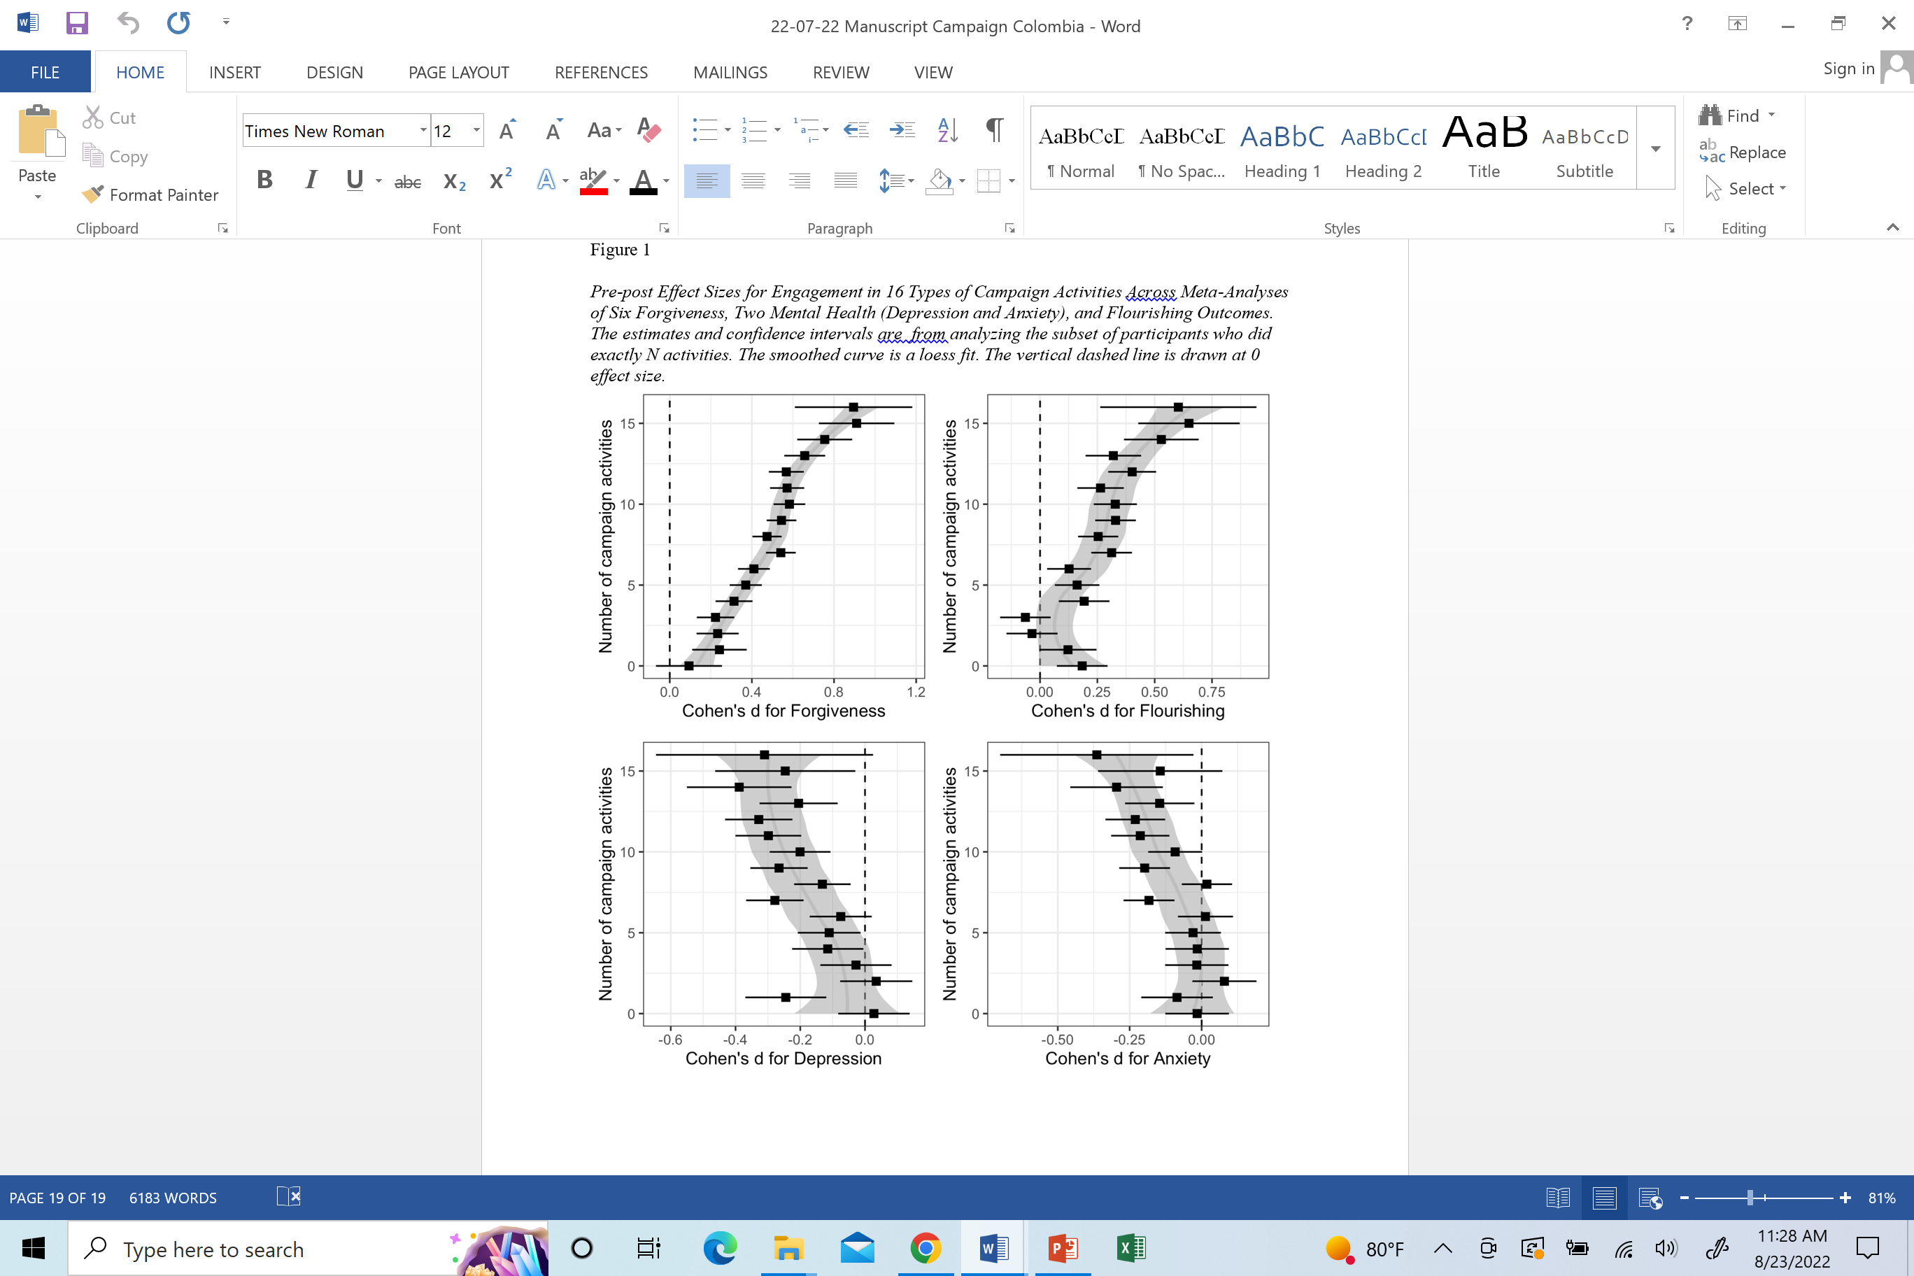
Average: 7.18 types of activities
Notice the breaks:
Fewer than four activities in producing forgiveness, flourishing, and depression (but not anxiety).
[These people who did not engage also tended to use the briefest, least effective interventions]
Also, people who did 14, 15, or 16 did substantially better than those doing fewer.
People in the middle (i.e., 4 to 13 activities) definitely benefited a lot.

Slide 87
Learning Objective 3
Employ 10 lessons from research on forgiveness-promoting community campaigns to adapt your practice and provide population-level intervention effectively.

Slide 88
A Few Practical Lessons in Designing a Forgiveness Campaign
Identify either a limited (i.e., mediating) community for intervention—ideally one that wants to become more forgiving (church, Christian college, family, work group, business, military group) or a secular but motivated one.
Engage the leaders and administrators for investment and support (not just one initial recommendation) and convince them that putting in effort yields results.
Establish different goals for (1) an awareness-raising (i.e., how to define forgiveness, know the benefits, and know where to get free interventions) and (2) the active public health campaign (i.e., forgiving plus other outcomes).

Slide 89
Practical Lessons in Designing a Forgiveness Campaign
Tailor interventions to your community.
Choose interventions that require time, but not too much; effort, but not too much; variety, but not too much.
Seek to convince people that they can forgive more if they work at it. THREE or fewer activities won’t benefit much; 4 or more has moderate effects; 14 or more has large effects.
One bottom line: These campaigns can definitely change local communities—churches, universities, schools, workplaces. But a larger question remains…

Slide 90
Additional Lessons: How to Do This without Disrupting Your Practice
Classroom forgiveness education: Teach Sunday School or youth groups
Run REACH Forgiveness psychoeducational groups.
  In a practice of four practitioners, there will likely be enough clients who have relationship conflicts to constitute a Saturday group (9-12 and 1-4) every four weeks.
DIY Workbooks
  Use as a free adjunct to psychotherapy with forgiveness
Campaigns
  Run Deep Dives at your church or (if you work at a university) your university

Slide 91
Additional Lessons: How to Do This without Disrupting Your Practice (cont.)
To do each of the activities on the previous slide, you can (a) use the volunteer activities (speaking on forgiveness, teach Sunday School or midweek; consulting pastors) as a way to promote your practice with people likely to be referred to your practice; (b) engage in training and supervision for classes offered, psychoeducational groups using REACH Forgiveness, and some campaign activities; (c) consult with others organizing campaign activities or provide volunteer (or compensated) lectures for the campaign.

Slide 92
If you do a Deep Dive at your Church, these five things are essential
Sermon series is good (time vital): 30-min not too good; 6 x 30-min great;
Speaker series (4 to 6): people like to hear great outside Christian speakers
Awareness plus practicing forgiveness
Existing groups > ad hoc forgiveness groups
Activities in the sweet-spot: 1 hour to 4 hours (Workbooks, 3.3 hours; outside speaker 1 hr; sermons 6 x 30-min)

Slide 93
Build New Skills with Public Health Methods
Public Health is a field that requires a master’s degree to become proficient at the entry level. However, you can learn and practice public mental health skills without getting a degree by pursuing continuing education to build competencies that are pertinent.

Slide 94
Build New Skills with Public Health Methods (Many clinical psychologists and other mental health providers will already have training and experience in some of these.)
Eight fundamental skills in public health:
  screening and early detection,
  surveillance,
  improving access to services,
  policies that help people engage in activities that help them,
  research in collaboration with communities,
  crisis intervention,
  cultural sensitivity, and
  helping needy populations use needed services

Slide 95

Questions and Answers

Slide 96
Appendix
Can Forgiveness contribute to peace?

Slide 97
Why UNforgiveness Is a Threat to Restoration of Peace and Public Health
One great need in the polarized world is creating tolerance, forbearance, acceptance, and forgiveness.
When differences cannot be resolved within countries or across nations, often conflict and war erupt.
The death and destruction occurring as a consequence
  cause pain and privation during the conflict
  unsettle people leading up to the conflict
  outlast the conflict in terms of unforgiveness due to perceived injustices perpetrated by the other side.
Injustices are rarely one-sided. Admitting to being a cause of injustices and moving towards reconciliation is a challenge for any political entity.

Slide 98
Promoting Forgiveness Might Help Restore Peace in a Post-Conflict Society in Transitional Justice and in Stable Societies

Slide 99

An Aside—About Societal Applications

Slide 100
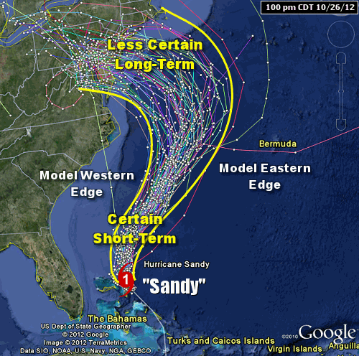
Complex Adaptive Systems
Complex: Many causes, too complex for anyone to determine. Some models have over 1000 causal variables that interact. Only probabilistic “solutions.”

Slide 101
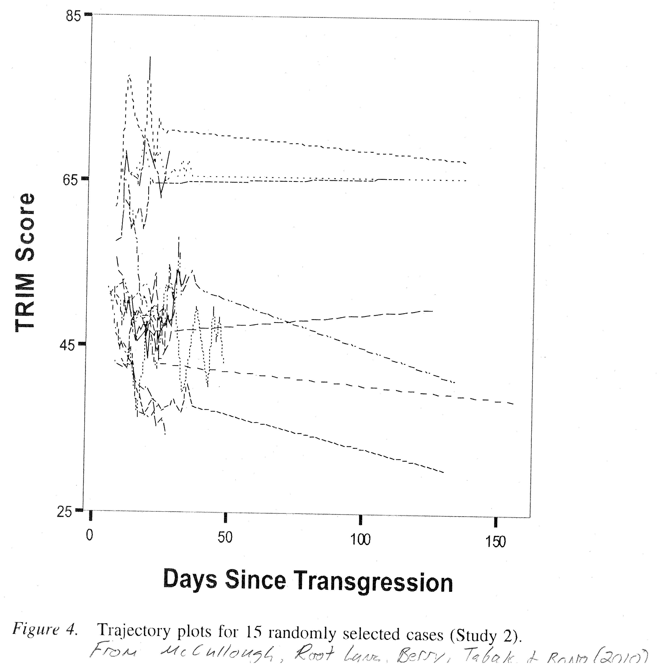
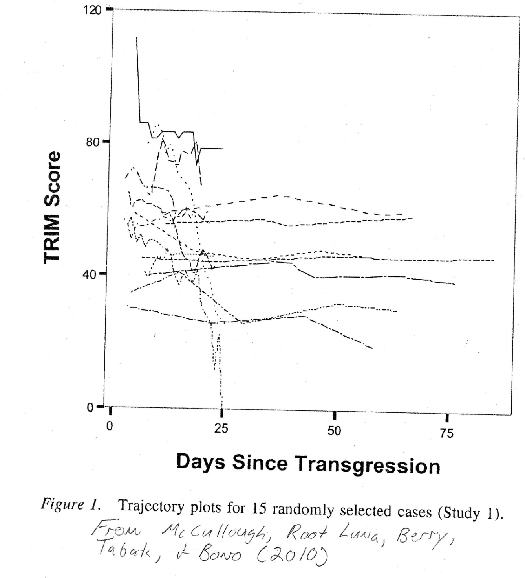
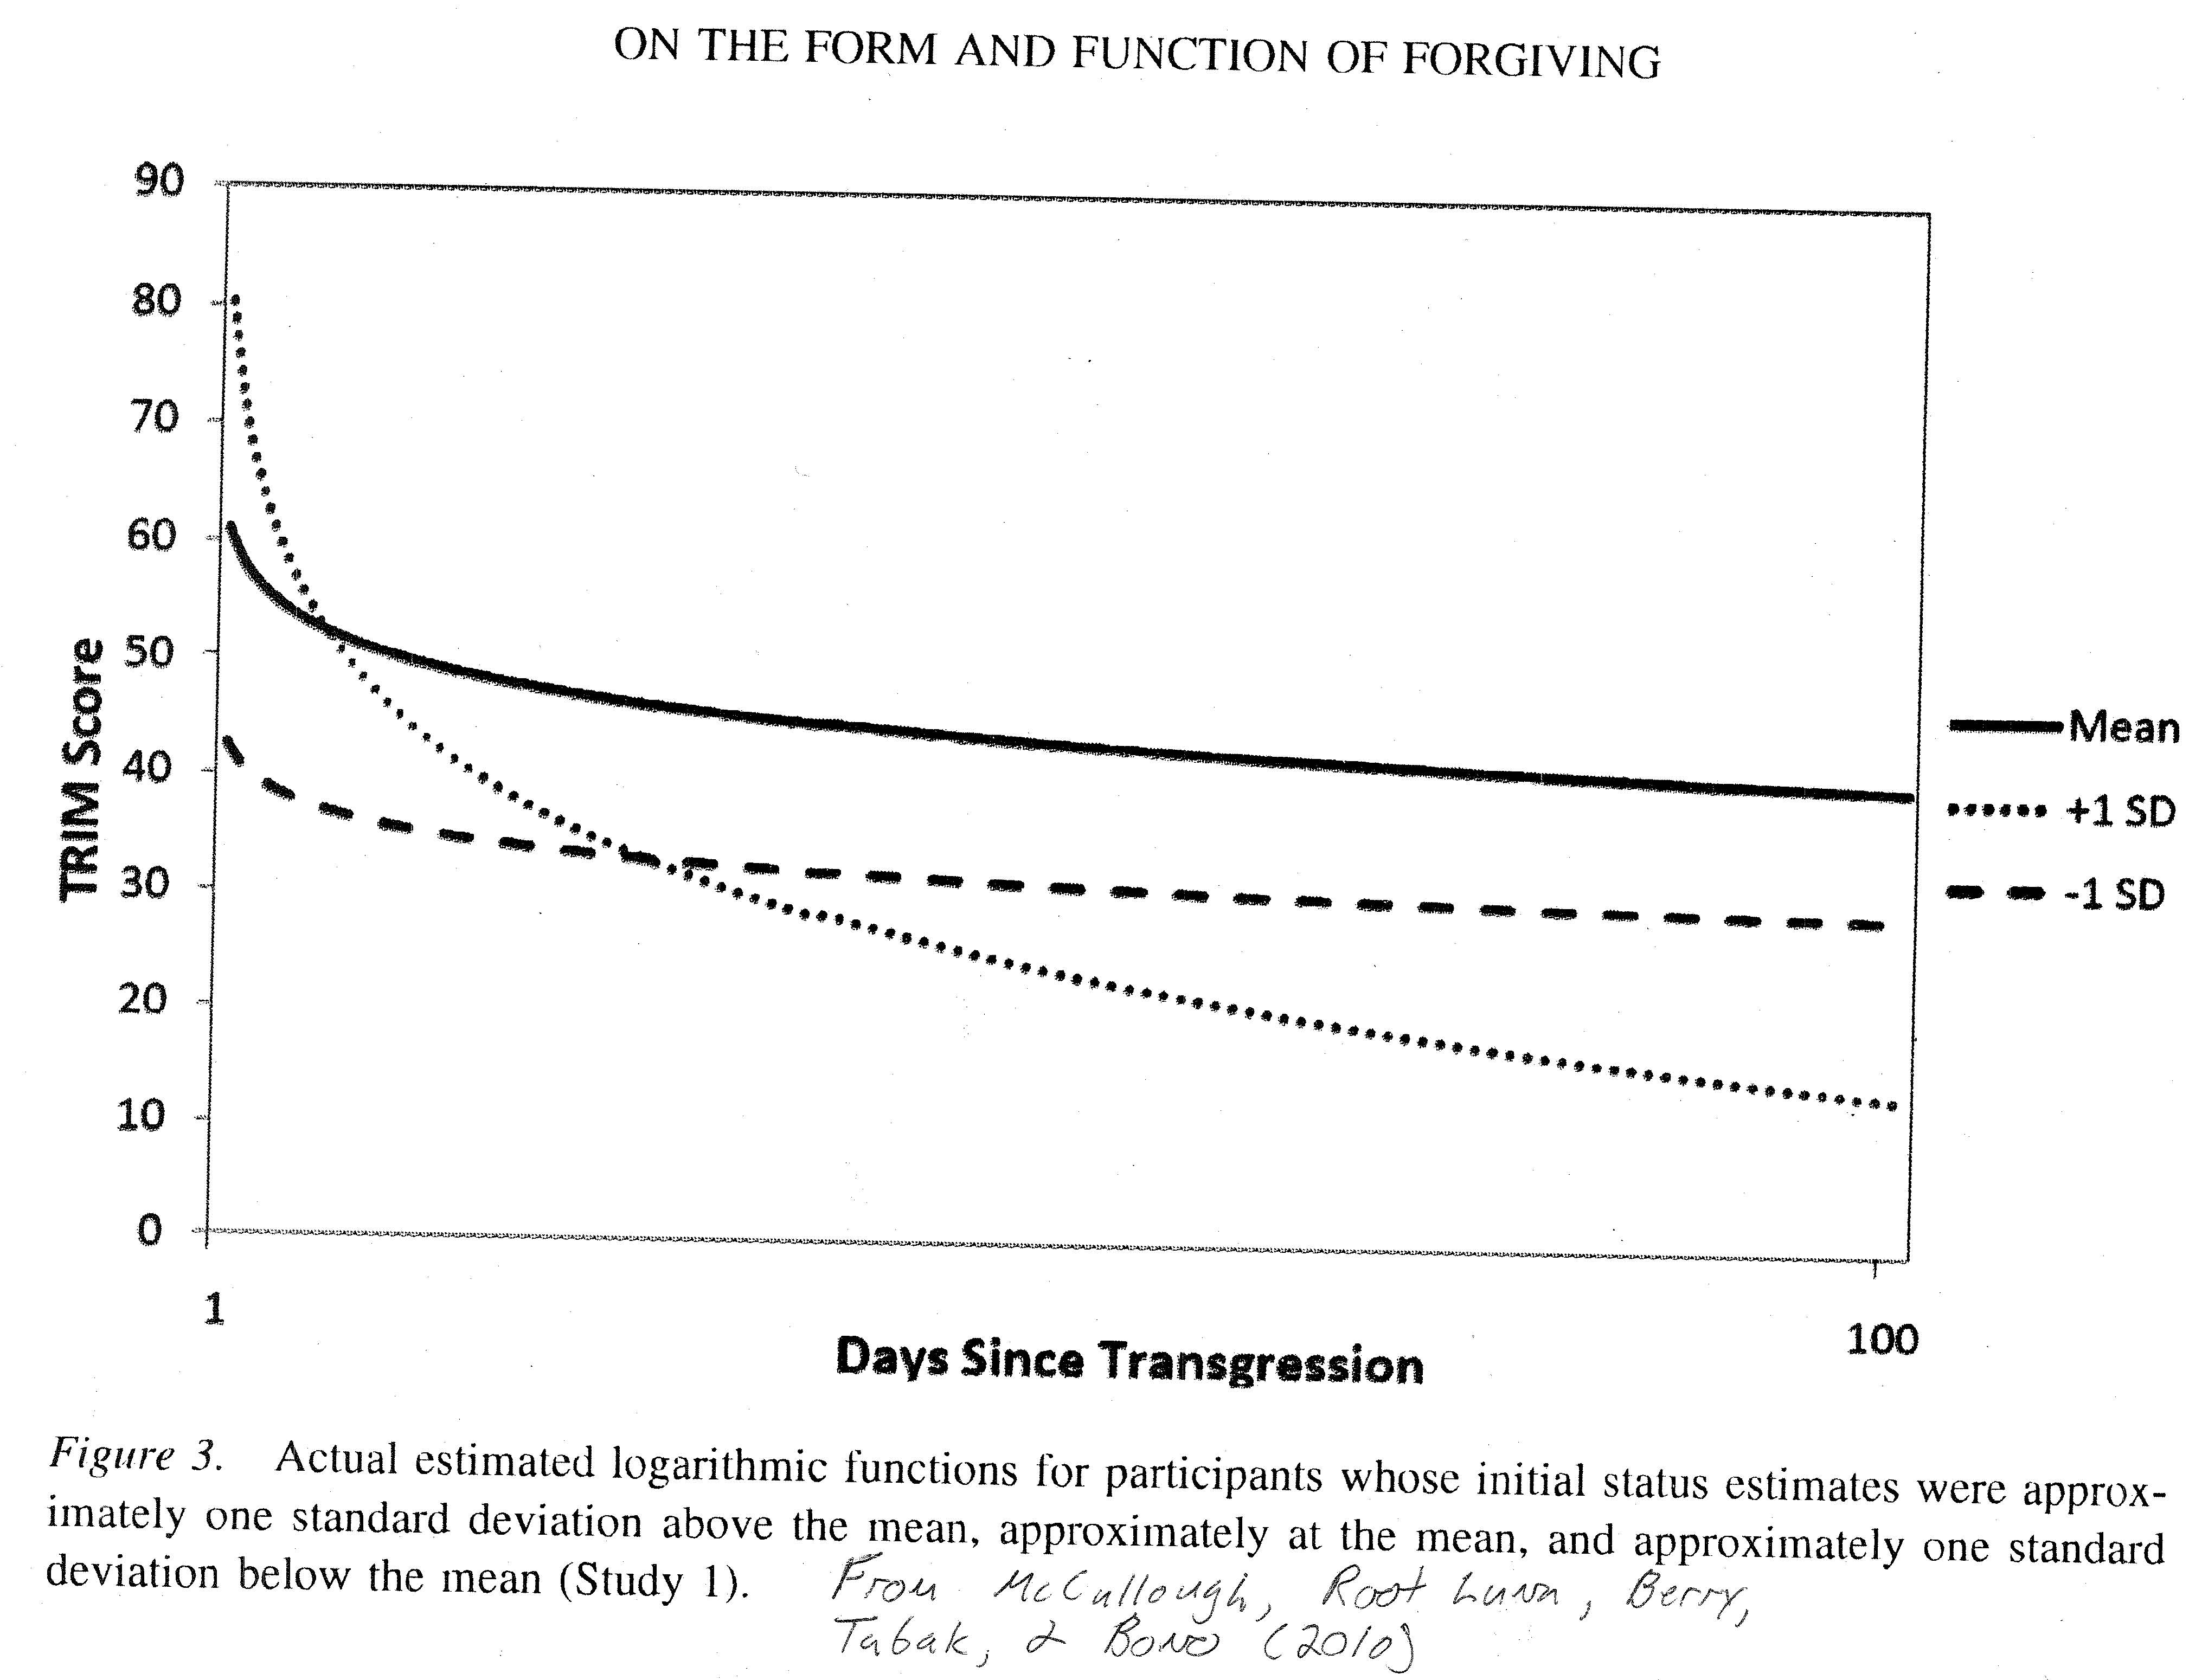
Complex Adaptive Systems
Adaptive: Systems can stabilize at many stable “solutions”
Ah, multivariate analysis provides a nice smooth power curve, with most falling off quickly and then only a gradual decrease after three days.
The world of individual responses gives a different messier picture: “Families” of trajectories (stable “solutions”: Those that decrease, stay unchanged, and a few that get worse.

Slide 102
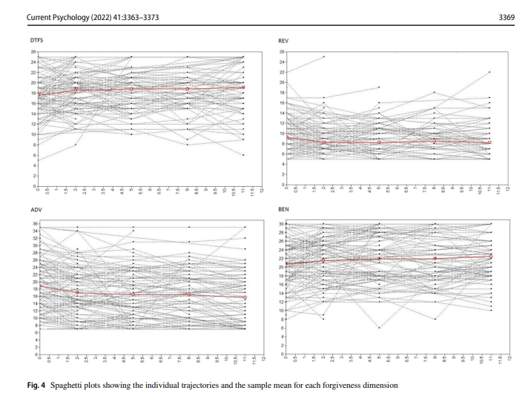
Gamiz et al. (2022)

Slide 103

Complex Adaptive Systems
System: With > 1000 interacting causal variables, they are intertwined as a system. The danger is over-simplifying by focusing on a simple solution.

Slide 104
Complex Adaptive Systems
Changes are most noticeable at the “edge of chaos” (i.e., when the system is most disrupted and yet not so disrupted that it has become a stable chaotic system).

Slide 105
So, what I’m about to do…
My emphasis is on forgiveness interventions (a potential “cobra-bounty situation” if not seen as one of many interventions to bring about stable societal peace in a transitional-justice society)
  Truth Commissions, TRCs, Truth and justice commissions
  Gacaca courts
  World court
  State courts
  Information provision
  Etc.

Slide 106
You be the judge
Unforgiveness can keep conflicts raw.
We now have evidence-based DIY workbooks in major languages free of cost that people can use to forgive https://reach.discoverforgiveness.org.
We have shown that forgiveness awareness-raising PLUS opportunities to practice forgiveness can affect mediating communities.
Mediating communities can be coordinated.
BUT in a transitional justice society, it takes a leader with courage to use political capital to advocate forgiveness.

Slide 107
A Theoretical Thought to End
Theory of Complex Adaptive Systems
  Systems that are stable are hard to change; systems in chaos are hard to reign in. Systems at the edge of chaos are ripe for making significant changes.
  Such systems (according to non-linear dynamics) have many possible outcomes. Many variables can change system operation. Which “solution” rules depends on events, often surprising, that tip the system in direction of systemic change.
Each of these is important:
    Leaders are crucial. (Recall, they must be willing to spend political capital.)
    Lay leaders who can galvanize people to move are crucial.
    Effective programs are crucial. There needs to be a program people can employ and one they want to use.
    Timing is crucial.
    Context is crucial.

Slide 108
Free Resources
www.EvWorthington-forgiveness.com
  DIY Workbooks
    In other languages: https://reach.discoverforgiveness.org
  Group Protocols (leader and participant manuals): www.EvWorthington-forgiveness.com
  Advice about running campaigns at churches or other organizations
  Other workbooks—humility, patience, self-forgiveness, positivity
Link to couples resources: www.hopecouples.com
Contact information: eworth@vcu.edu

Slide 109
Comparing DIY Workbooks to Groups—Take Home: DIY Workbooks Twice as Effective as Groups (see bottom two lines)
[Recall: Meta Mean ES = 0.56 for 10 hours of treatment. (d/hr ~ 0.056)]
*
*

