Slide 1
Forgiveness Interventions
Everett L. Worthington, Jr.
Virginia Commonwealth University
Presented as a Preconference Workshop
AACC (2025) Opryland

Slide 2
QR Code

Slide 3
Objectives of the Talk
By the end of this preconference workshop, the attendee will be able to:
Use at least three psychological models to promote forgiveness in session or as an adjunct to psychotherapy
Incorporate at least five techniques/methods for promoting forgiveness into their repertoire of interventions
Use similarities among forgiveness models to design their own intervention to promote forgiveness

Slide 4
Basic Understanding of Forgiveness from Science, Scripture, and Church Practice

Slide 5
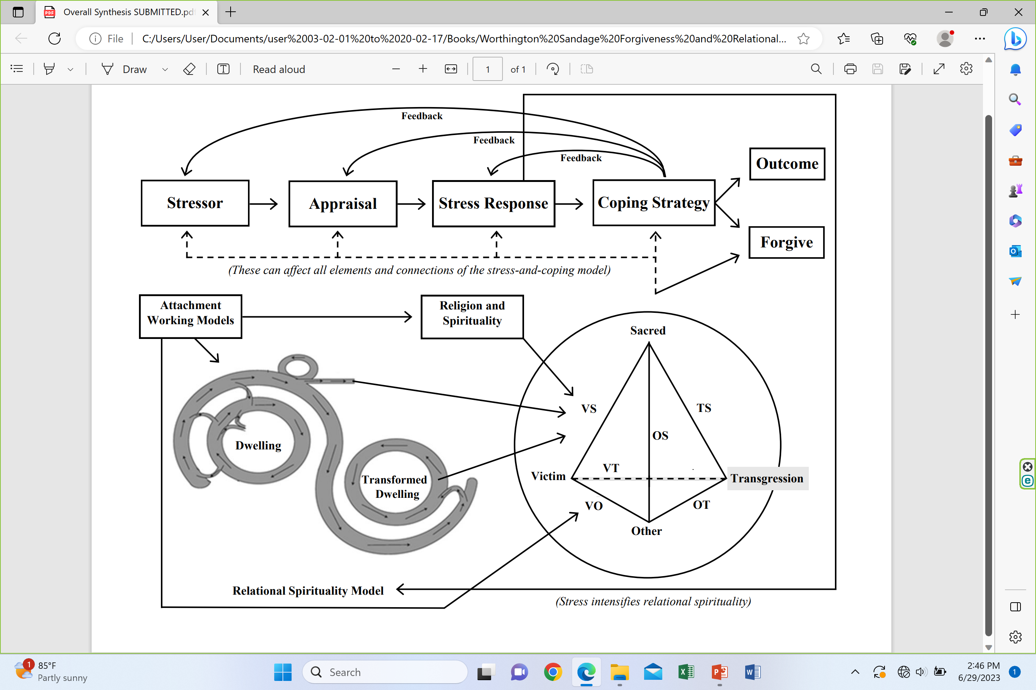
Science: In 2006, I formulated the Stress-and-Coping Theory of Forgiveness
Worthington, E. L., Jr. (2006). Forgiveness and reconciliation: Theory and application. Brunner-Routledge. (Currently under contract: revised edition with Routledge aimed at publication in 2024.)
Note: It’s a THEORY (lots of support). It builds upon Richard Lazarus’ stress-and-coping theory (Lazarus, 1999), which has a massive amount of research

Slide 6
Interpersonal Stressor (Step 1) is Appraised (Step 2) as a Threat and an Injustice
Injustice gap is NET degree of injustice experienced at present.
Severe injustices, hard to deal with; mild injustices, easier to deal with.
Keep ongoing (informal tally). Apology and making amends reduces size of injustice gap; denying responsibility or blaming the victim increases the size of injustice gap.

Slide 7
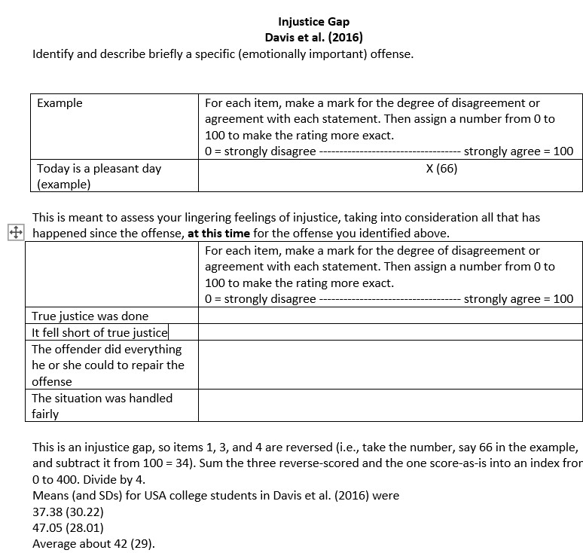
Appraisal
Injustice Gap
Davis, D. E., Yang, X., DeBlaere, C., McElroy, S. E., Van Tongeren, D. R., Hook, J. N., Worthington, E. L., Jr. (2016). The injustice gap. Psychology of Religion and Spirituality, 8(3), 175-184.

Slide 8
Unforgiveness
Unforgiveness is a stress response to appraisal of a stressor as threatening and unjust and appraisal of coping as potentially inadequate to handle the stressor without damage.
As a stress reaction, unforgiveness is a combination of physiological, emotional, motivational, and cognitive factors, and it may involve behavioral intentions.

Slide 9
Coping Can Seek to Change…
The offense
The appraisals of the offense
The stress reactions (physiological, emotional, motivational, cognitive, behavioral intentions)

Slide 10
Many Ways to Cope with Injustices
Seek or observe justice
Offender is observed to get natural consequences
Turn the matter over to God for divine justice
Relinquish it to God
Minimize importance of the harm (i.e., denial and cognitive minimization)
Tolerate (put up with it)
Forbear (put up with it for the sake of the relationship, family, group, community)
Accept (let it play in the background)
Forgive (this can transcend the gap)
People reduce the injustice gap by mixing those that work for them. Thus, forgiveness is not necessary to deal with injustice. But it can help supplement other ways or even be a solution itself.

Slide 11
Coping: What Is Forgiveness?
Coping: An attempt to lessen the impact of stress by intentionally affecting the stressor, appraisals, or stress reactions.
Worthington, E. L., Jr., & Scherer, M. (2004). Forgiveness as an emotion-focused coping strategy that can reduce health risks and promote health resilience: Theory, review, and hypotheses. Psychology and Health, 19, 385-405.

Slide 12
Forgiveness—Four types
Centered on experiences of the wrongdoer
  Divine forgiveness
  Self-forgiveness
Centered on experiences of the victim
  Person-to-person forgiveness
  Intergroup forgiveness

Slide 13
Understanding Person-to-Person Forgiveness

Slide 14
Two Types of Person-to-Person Forgiveness
Both types of forgiveness happen inside our skin.
Decisional forgiveness is a behavioral intention statement. Do not intend to get revenge. Do intend to treat person as a valued and valuable person.
  We can make a decision to forgive and carry it out consistently, but still feel emotionally upset (resentment, bitterness, hate, hostility, anger, fear) when we think of the injustice.
Emotional forgiveness is the emotional replacement of unforgiving emotions with positive other-oriented emotions (e.g., empathy, sympathy, compassion, and love)
  Both types of forgiveness are different from reconciliation, which is restoration of trust, requiring two people trying to be trustworthy.

Slide 15
In Naturally Occurring Situations, How Rapidly Does Forgiveness Occur?

Slide 16
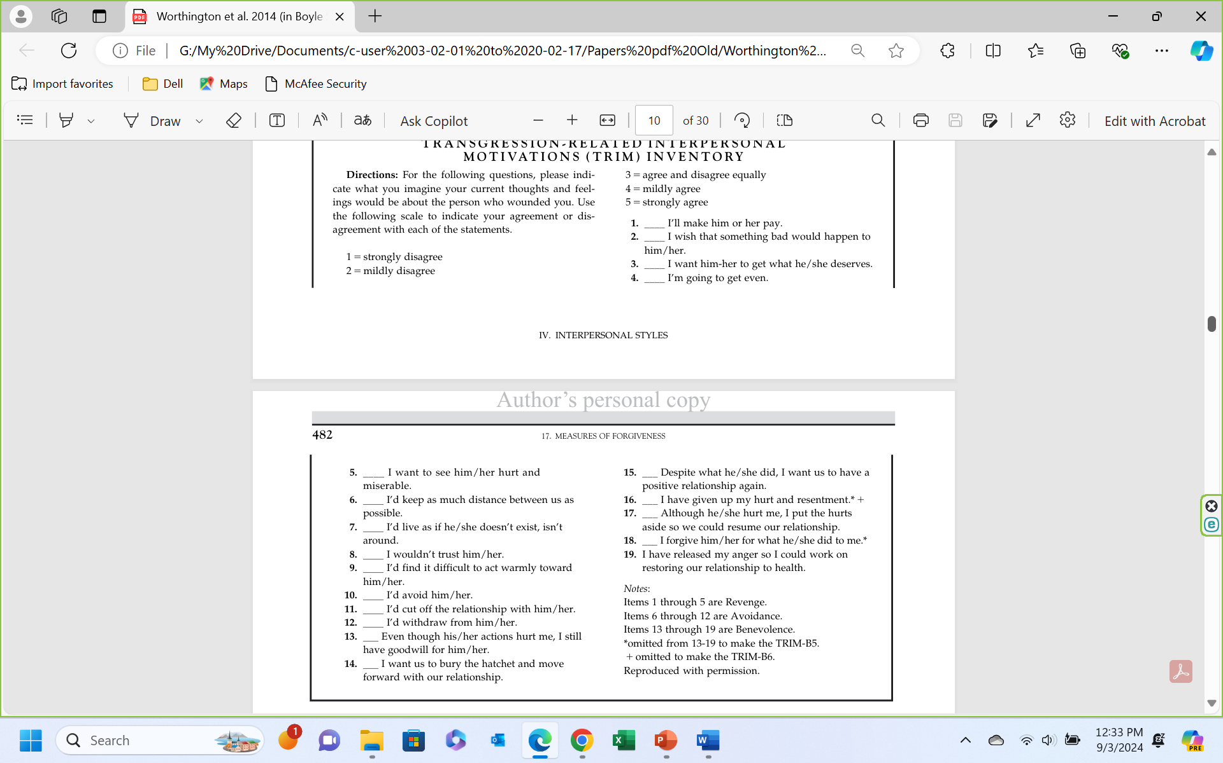
Assessing Forgiveness
Forgiveness = Benevolent motives – Revenge motives – Avoidance motives
McCullough, M. E., Rachal, K. C., Sandage, S. J., Worthington, E. L., Jr., Brown, S. W., & Hight, T. L. (1998). Interpersonal forgiveness in close relationships II: Theoretical elaboration and measurement. Journal of Personality and Social Psychology, 75, 1586-1603.

Slide 17
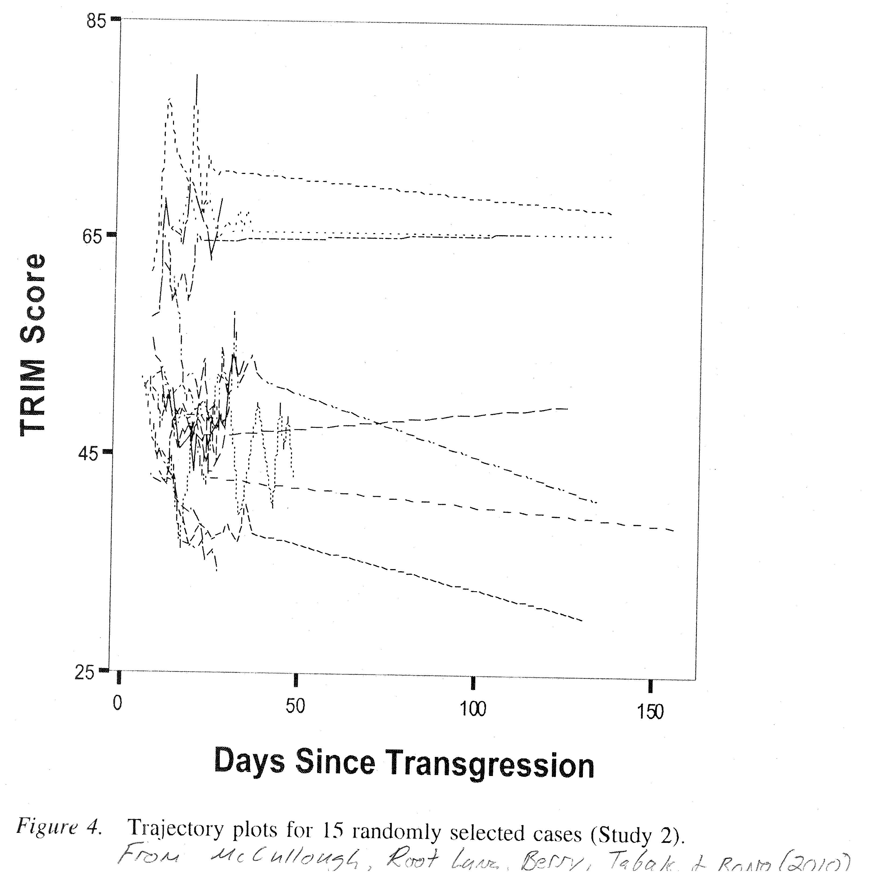
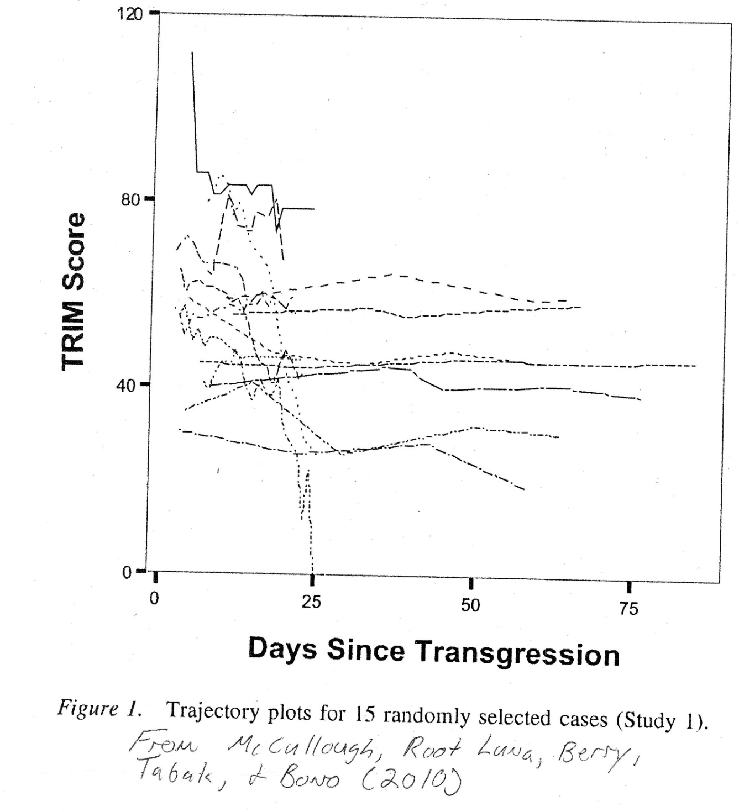
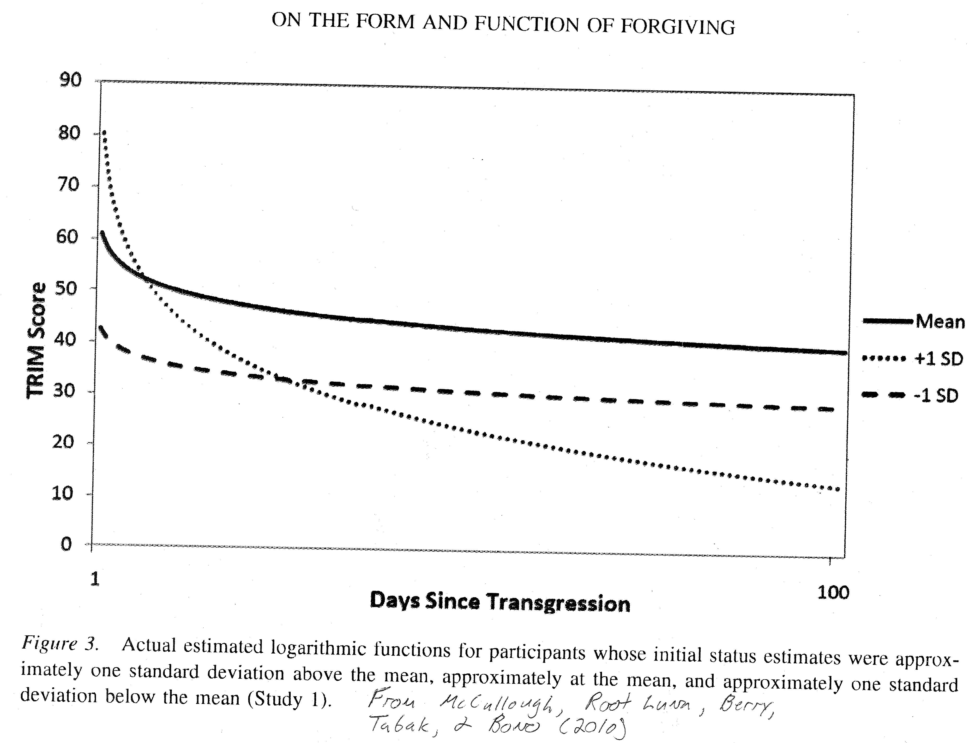
McCullough et al. (2003)
McCullough, M. E., Luna, L. R., Berry, J. W., Tabak, B. A., & Bono, G. (2010). On the form and function of forgiving: Modeling the time-forgiveness relationship and testing the valuable relationships hypothesis. Emotion, 10, 358-376.
Power curve vs individuals who made up the power curve
Ah, multivariate analysis provides a nice smooth power curve, with most falling off quickly and then only a gradual decrease after three days.
The world of individual responses gives a different messier picture: “Families” of trajectories (stable “solutions”: Those that decrease, stay unchanged, and a few that get worse.

Slide 18
Benefits of Forgiving
Note that there are benefits to the victim of forgiving. So, those provide some motivation to forgive (along with Scriptural endorsement of forgiving.)
But there are also benefits to the offender when the victim forgives. Those benefits to the offender likely also feed back to make a better relationship and more spiritually, mentally healthy, and physically healthy dyad. And there are unseen benefits—what we loose on earth is loosed in heaven (Mt 18:18-20).

Slide 19
Benefits to the Forgiver of Forgiving
Spiritual connection restored
Relationship bettered (decisional forgiveness has most immediate impact)
Mental health and well-being benefited (rumination decreased)
Physical health (stress immediately lessened, and health benefits felt later)

Slide 20
What Did Psychological Science Bring to the Table about Forgiveness?
Study of Divine Forgiveness and Self-Forgiveness
Begins with injustice gap
Many things (other than forgiveness) can reduce the injustice gap, so they can be used to make forgiveness easier.
Forgiveness is defined: what it is not and what it is.
Two types of forgiveness: Decisional and Emotional—both seen in Scripture but Decisional is required (emotional is desired)
Forgiveness is not equal to reconciliation.
There are many benefits (to the forgiver) of forgiving.

Slide 21
A Christian Theology of Forgiveness: Biblical Theology and Practical Theology
Worthington, E. L., Jr. (2003). Forgiving and reconciling: Bridges to wholeness and hope. InterVarsity Press.
Worthington, E. L., Jr., Rueger, S. Y., Davis, E. B., & Wortham, J. (2019). “Mere” Christian forgiveness: An ecumenical Christian conceptualization of forgiveness through the lens of stress-and-coping theory. Religions, 10(1), 13; [open access, https://www.mdpi.com/2077-1444/10/1/44]

Slide 22
Biblical Theology of Forgiveness: How Does Christian Scripture Tell Us to Forgive?
Just do it: Matthew 6:14-15 NIV For if you forgive men when they sin against you, your heavenly Father will also forgive you. But if you do not forgive men their sins, your Father will not forgive your sins. Mark 11:25: And when you stand praying, if you hold anything against anyone, forgive them, so that your Father in heaven may forgive you your sins.”
Repeatedly and potentially infinitely: Matt 18: 21-22 NIV Then Peter came to Jesus and asked, “Lord, how many times shall I forgive my brother when he sins against me? Up to seven times? “Jesus answered, “I tell you, not seven times, but seventy-seven times.”
As the Lord forgave you: Col 3:13 NIV “Bear with each other and forgive one another if any of you has a grievance against someone. Forgive as the Lord forgave you.” Eph 4:32: “Be kind and compassionate to one another, forgiving each other, just as in Christ God forgave you.” How did the Lord forgive us? Unilaterally, without condition, every time. (We humans either do or don’t accept forgiveness.)
From the heart (which is not the way we understand the phrase today): Matt 18:35: “… you forgive your brother or sister from your heart.“ (The parable of the unforgiving steward has no mention or implication of emotional forgiveness. It’s all about deciding about how you intend to behave—i.e., decisional forgiveness.)
BASICALLY, WE ARE TOLD TO FORGIVE BUT NOT HOW TO FORGIVE

Slide 23
Christian Scripture is clear that we should forgive, but its purpose is NOT to instruct us on how to do it.
We learn this through practical theology

Slide 24
Content of Christian Practical Theology Interventions
Pray: for the offender, for God’s help in your forgiveness efforts, for God’s power in forgiving, for justice, for divine justice, for discernment, for the intervention of the Holy Spirit
Seek: Scripture, models from local congregation, people you know, Scripture, history
Restraint: Relinquish the offense to God, tolerate the injustice, forbear, accept and move on
Count your blessings: Find benefits to you for forgiving
Encourage: God forgives us first, Tell or imply that God requires decisional forgiveness from us (so that God will forgive us)
Use God’s general revelation (science, philosophy, clinical science, arts, humanities)
USE ANY or ALL (They take time)

Slide 25
Practical Implications
To practice forgiveness YOURSELF or teach to YOUR CLIENTS,
you must spend time on it while using tried and true (evidence-based) methods.

Slide 26
To Preach (or Speak) Effectively about Forgiveness
Three things make sermons more effective:
(1) recount benefits of forgiving to you and your offender;
(2) direct people to DIY workbooks or groups;
(3) discuss prayer, empowerment by God, visualizing, relying on God.

Slide 27
Forgiveness Interventions

Slide 28
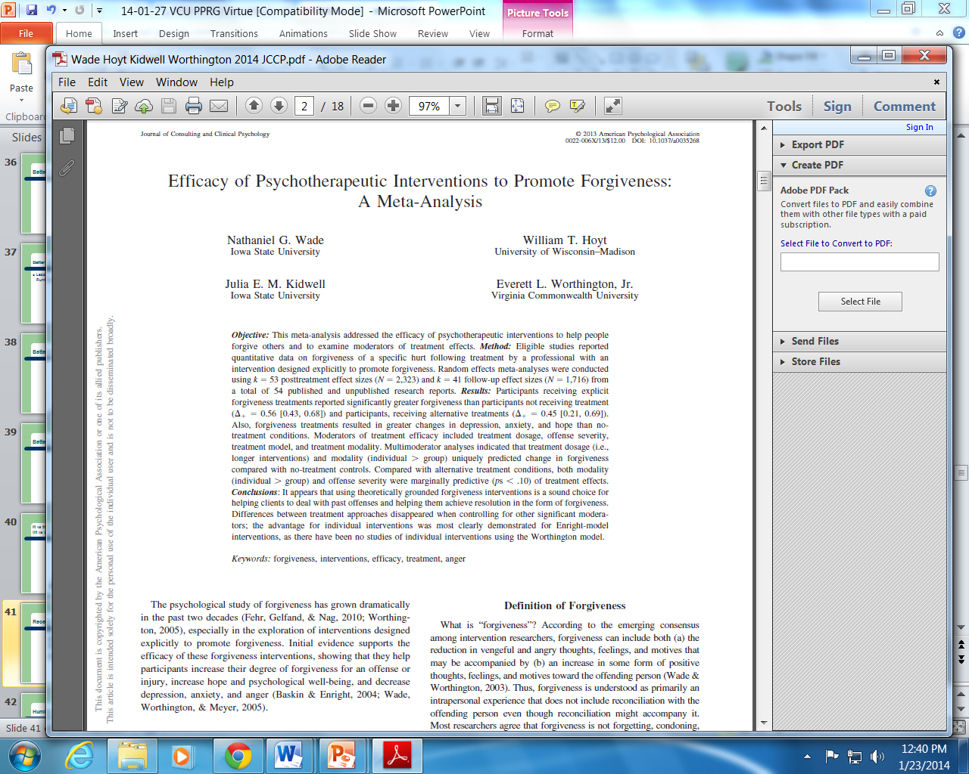

Developments in Helping Others Forgive: 1990 to 2013
Meta-Analysis of Interventions (k=54; k = 53 Pre-post means; 41-Pre-Follow means.
2014, JCCP
Take Home These Four Findings:
(1) REACH Forgiveness (k=18) and Process model (k=21) each equal in use to all others (k=14);
(2) all equally effective per hour;
(3) the more time you spend trying, the more you’ll forgive (linear dose-response relationship);
(4) you not only increase forgiveness, but also hope, and decrease both depression and anxiety.
Mean ES = 0.56
Wade, N. G., Hoyt, W. T., Kidwell, J. E. M., & Worthington, E. L., Jr. (2014). Efficacy of psychotherapeutic interventions to promote forgiveness: A meta-analysis. Journal of Consulting and Clinical Psychology, 82(1), 154-170.

Slide 29
REACH Forgiveness
A method developed to be consistent with Christian beliefs and values and demonstrated to be helpful through science.

Slide 30
5 Steps to REACH Emotional Forgiveness —“Core” of the method—plus Decision to Forgive
These five steps are the external FORMS of forgiveness. The action happens within you.
Worthington, E. L., Jr. (1998). The Pyramid Model of Forgiveness: Some interdisciplinary speculations about unforgiveness and the promotion of forgiveness. In Worthington, E.L., Jr. (Ed.), Dimensions of forgiveness: Psychological research and theological perspectives (pp. 107-137). Templeton Foundation Press.
R=Recall the Hurt
E=Empathize (Sympathize, feel Compassion for, Love) the Transgressor
A=give an Altruistic Gift of Forgiveness
C=Commit to the Emotional Forgiveness One Experienced
H=Hold on to Forgiveness When Doubts Arise
Decision to Forgive

Slide 31
The full method
Screen participants
Get people to compete self-assessments
Introduce self and give hardest thing you’ve successfully forgiven
Lectio divina
Definitions or EF and DF
Benefits (spiritual, relational, psychological, physical)
Offer DF (will return later)
Work through Core: R, E, A, C, and H
Revisit DF (part of the Core)
Generalize through ‘12-step” program.
People complete post-group/post-workbook self-assessments

Slide 32
Running Groups
Groups take 6 hours (www.EvWorthington-forgiveness.com)
  They can be run on a Saturday—3 hours 9-12; 3 hours 1-4
  You can charge for them if in practice
  People can see others get better and can help others
  They draw on group universal healing factors
Groups take 6 hours
  Not everyone wants to spend that much time
  Not everyone is willing to pay
  Groups are less effective per hour than individual therapy
  Groups require coordination
  Groups require a minimum number of people (6) and a limit to how big (no more than 20)

Slide 33
Who Can Run REACH Forgiveness Groups?
YOU can!!
Undergrads were slightly less effective than post-master’s level counselors.
How? Use Resources on www.EvWorthington-forgiveness.com
  Read the helper’s manual (beside the participants’ manual)
  Watch the training video (free on my website) of me running the group
Get supervised by a competent helper to answer your questions after reading and watching.
Preferably run the group with a co-leader (perhaps one who has run a REACH Forgiveness group before)
  Most of the talking is done by group members, not leader.
Have a supervisor available to deal with questions.

Slide 34
What Kind of Evidence?
Statistical aside: Effect size is the number of standard deviations a treatment is superior to a control condition. Expressed as Cohen’s d or Hedges g (which are conceptually pretty much the same) or r (usually t2 vs t1).
Perspective: 26 weeks of 1-hour per week of CBT for depression yields mean effect size of d = 1.26.
  The d / hour = 0.05

Slide 35
Summary of Effect Sizes

Slide 36
What Kind of Evidence?
Statistical aside: Effect size is the number of standard deviations a treatment is superior to a control condition. Expressed as Cohen’s d, Hedges g (essentially the same), or r.
Perspective: 26 weeks of 1-hour per week of CBT for depression yields mean effect size of d = 1.26. (This suggests reducing depression about 0.05 per hour.)

Slide 37
Effective vs Efficient
Which is more effective—a 6-hour REACH Forgiveness group or a 3.34-hour REACH Forgiveness DIY workbook?
  Group d = 0.546; DIY d = 0.52
  Conclusion: Equally effective
Which is more efficient—a 6-hour REACH Forgiveness group or a 3.34-hour DIY workbook?
  Group d/hr = 0.091; DIY workbook d/hr = 0.16
  Conclusion: DIY is about twice as efficient

Slide 38
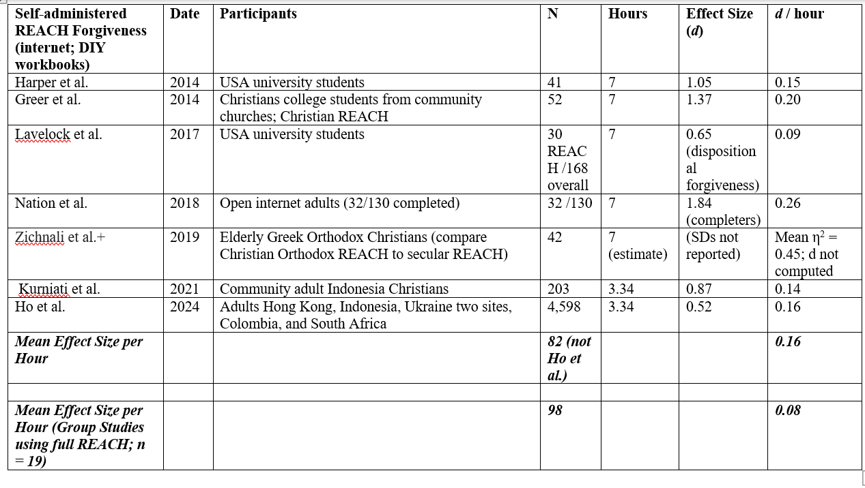
Comparing DIY Workbooks to Groups—Take Home: DIY Workbooks Twice as Efficient as Groups (but equal in effectiveness to 6-hour groups)
[Recall: Meta Mean ES = 0.56 for 10 hours of treatment. (d/hr ~ 0.056)]
*
*
For N=25 REACH group RCTs, d = 0.091; d/hr = 0.546

Slide 39
Enright’s Process Model
Two Major Uses
  Forgiveness Therapy: Almost all of his demonstration studies are relatively small N studies with one-to-one treatment of a person with a clinically relevant problem
  Forgiveness Education: 9 studies with the process model (9 studies on his story-based model); process model is much more effective and efficient

Slide 40
Enright’s Process Model (20 total units making up 4 phases)
(Uncovering Phase—Units 1-8)
In the uncovering phase, the person explores the transgression, admits to being hurt, and expresses feelings related to the transgression.
Unit 1: The person recalls and faces the offense. Defensiveness is foresworn as no longer potentially adaptive.
Unit 2: Anger is faced, admitted, and expressed.
Unit 3: Feelings of shame or guilt are addressed.
Units 4 and 5: People seek a healthy balance between the pain of the injury and understanding of the event.
Unit 6: The person considers how people usually compare themselves to an offender who is better off than they.
Unit 7: The person considers potentially permanent changes from the offense. Negative changes are admitted, but the potential for perceiving things more positively is offered.
Unit 8, the person considers their worldview and is encouraged to consider that it might change with time.

Slide 41
Enright’s Process Model (Decision Phase—Units 9-11)
The decision phase consists of units 9 to 11.
Unit 9, frank admission is encouraged that old strategies are not working.
Unit 10, the person considers forgiveness as an option; The definition of forgiveness and what it is not are considered.
Unit 11, the person commits to forgive the offender even though the person may not feel like forgiving.

Slide 42
Enright’s Process Model (Work Phase—Units 12-15)
The third phase is the work phase, in which there are four units.
Unit 12: The person seeks to understand the offender, including speculating about the person’s imperfections. This helps reframe the understanding of the offender.
Unit 13: Reframing is continued to promote empathy.
Unit 14: Reframing is continued to promote compassion.
Both are acknowledged as challenging to maintain.
Unit 15, The person is encouraged to accept and bear the pain of the injury.

Slide 43
Enright’s Process Model (Deepening Phase—Units 16-20)
Gaining a wider perspective
Unit 16: Meaning is sought in suffering and forgiving.
Unit 17: The person reflects on his or her own need for forgiveness in the past.
Unit 18: The person learns he or she is not alone in suffering.
Unit 19: The person reconsiders his or her purpose in life, hoping to find a newpurpose.
Unit 20: the person reflects on decreased negative and increased positive affect.

Slide 44
Effectiveness and Efficiency of Enright’s Process Model—Forgiveness Therapy and Classroom Studies
“Forgiveness Therapy” studies
Almost all are one-on-one multiple sessions studies (cf. early group studies; Hebl & Enright, 1993; Al-Mabuk et al., 1995).
The individual therapy (“forgiveness therapy”) studies are typically long (12 to 60 sessions; recommended at least 20 sessions). Effect sizes are strong (i.e., high effectiveness) but effect size per hour is modest (d/hr ~ 0.05).
Forgiveness therapy has tackled serious mental health and physical health issues.
Forgiveness therapy is flexible. It is aimed at “success” at forgiving, so treatment is extended in to the number of sessions individuals are willing to attend for the outcomes they desire.

Slide 45
Effectiveness and Efficiency of Enright’s Process Model—Forgiveness Therapy and Classroom Studies
Classroom studies (later in Rapp et al., 2023, meta-analysis)—very international (Ireland, Turkey, S. Korea, Pakistan)
Elementary School Children in Belfast, Northern Ireland (3 studies) 17 weekly 45-minutes classes = 12 hours 45 minutes
Elementary School Children in Milwaukee, Wisconsin (17 weekly 45-minute classes) 12 hours 45 minutes
Impoverished Fourth-Grade Students in Turkey
Academically At-Risk Adolescents in the Midwestern United States (aged 12-14) (15 weeks)
Female Adolescent Aggressive Victims in South Korea 12 weeks
At-Risk Adolescents in the Midwestern United States (15 to 19) 23 hours
Abused Adolescents in Pakistan 2x per week for four months (32 hours)

Slide 46
Classroom interventions (Bob Enright and Suzanne Freedman): Effectiveness versus efficiency [k=# studies; g=effect size]
Process model: k = 9; g = 0.66
Story-based model: k = 9; g = 0.27
Time see previous slide: (12 h 45 m, 12 h 45 m, 15 h, 12 h, 23h, 32h) Mean t = 17.92 hours
d/hr process model: 0.66/18 = 0.036
d/hr story-based model: ~ 0.012

Slide 47
Forgiveness with school-aged children (Rapp et al., 2022)
g is effect size (number of SDs changed);
* statistical significance (note, some comparisons can be not significant merely because few studies or very unstable results of studies)
Meta-analyzed 20 studies in educational settings with children first grade (age 6) to 12th grade (age 18)
Outcomes: [Forgiveness + anger]* (g = 0.41; k = 20); Hope (g = 1.70, k = 5); Depression (g = 0.11, k = 7)
Moderators (i.e., predictors of outcomes): Age (older is better*); Grades: 1-3 (g = 0.03; k = 4), 4-6* (g = 0.45, k = 5), 6-8* (g = 0.58, k = 8), 9-12* (g = 0.44, k = 3); Program: Enright process model* (g = 0.66; k = 9); Enright story-based* (g = 0.27; k = 9); REACH (g = 0.29; k = 2); No. sessions (more is better*)

Slide 48
Compare REACH Forgiveness and Enright’s Process Model

Slide 49
Comparing REACH Forgiveness and Enright’s Process Model Head-to-Head
The process model is more flexible than is the REACH Forgiveness model.
For psychotherapy with people targeted by Enright’s many studies, the process model has more empirical support than REACH Forgiveness.
Total effectiveness can be extended by increasing the duration of the intervention. (Of course, the same is true of REACH Forgiveness and other interventions.)
The process model can still be used in classrooms (more support than REACH Forgiveness).
The process model is less efficient (i.e., d per hour of intervention) than REACH Forgiveness.

Slide 50
Comparing REACH Forgiveness and Enright’s Process Model Head-to-Head
REACH Forgiveness became more effective and efficient since 2013.
REACH Forgiveness is effective for adult psychoeducation with any transgressions (untargeted). Far more evidence. Studies from Colombia, Ghana, South Africa, Ukraine, Indonesia, China, Philippines, Australia.
REACH Forgiveness has lots of support for small-group applications: training video, leader and participant manual.
REACH Forgiveness group therapy with borderline- (Sandage et al., 2015) and depressed- and anxiety-diagnosed patients (Wade et al., 2018).
Group durations now standard at six hours. Worthington’s (2024b) review of 25 group studies found a mean d of 0.56; d/hr = 0.093.
Massive cross-cultural evidence. More people have participated in REACH Forgiveness DIY than all other intervention studies combined. Ho et al. (2024) with N = 4,598 participants found a mean d/hr = 0.16 (mean d = 0.52; mean time = 3.34 hours). All non-USA samples.

Slide 51
Additional Forgiveness Interventions

Slide 52
Luskin’s Forgive for Good Model (CBT)
Luskin’s (2001) model is a cognitive-behavioral approach to promoting forgiveness, used mostly to reduce anger, resentment, which put people at risk for cardiovascular malfunction. FFG suggests that forgiveness is ultimately beneficial for the person holding onto the anger.
People are helped to understand the hurt, empathize with the offender, reframe provocative situations by replacing negative with more adaptive interpretations, make a conscious decision to forgive, and use cognitive and behavioral methods to change unwanted cognition and emotion.

Slide 53
Luskin’s Forgive for Good Model (CBT)
A few studies have supported its effectiveness.
Harris, A. H. S., Luskin, F., Norman, S. B., Standard, S., Bruning, J., Evans, S., & Thoresen, C. E. (2006). Effects of a group forgiveness intervention on forgiveness, perceived stress, and trait-anger. Journal of Clinical Psychology, 62(6), 715-733.
Luskin, F. M. (2001). Forgive for good: A proven prescription for health and happiness. San Francisco, CA: HarperCollins.
Luskin, F., Ginzberg, K., & Thoresen, C. E. (2005). The efficacy of forgiveness intervention in college age adults: Randomized controlled study. Humboldt Journal of Social Relations, 29, 163–184.
Toussaint, L. L., Griffin, B. J., Worthington, E. L., Jr., Zoelzer, M., & Luskin, F. (2020). Promoting forgiveness at a Christian college: A comparison of REACH Forgiveness and Forgive for Good methods. Journal of Psychology and Theology, 48(2), 154-165.

Slide 54
Luskin’s Forgive for Good Model (CBT)
Similarities between FFG and REACH Forgiveness and Enright’s process model are several—including all three using recalling the hurt, empathizing, and making a decision to forgive although the person does not deserve it.
FFG focuses
  less on maintenance and generalization than does REACH Forgiveness
  less on contextualizing forgiveness into meaning and purpose than does the process model.

Slide 55
Greenberg’s Emotion-Focused Couple Therapy for Forgiveness
Greenberg's EFT approach to forgiveness stresses confronting emotions attending offenses and hurts (Greenberg & Meneses, 2020).
The participant seeks to transform emotions from anger and hate to acceptance and compassion. Those are thought to eventually lead to forgiveness.
Relevant to the name of the intervention, emotional focus—processing and transforming emotions—is key.

Slide 56
Greenberg’s Emotion-Focused Couple Therapy for Forgiveness
The key theoretical understanding is derived from Gestalt therapy, which assumes that emotions are on a two-pole continuum. Anger is one end when resentments occur, but the person might be feeling and expressing anger to block the other end—more vulnerable emotions like shame or fear.
The therapist is crucial, creating a space that is safe to explore emotions. Clients are guided to identify the emotional wound, express the emotions, especially the vulnerable ones, cultivate self-compassion, and value the self by integrating both emotional poles. The therapist helps the client identify the unmet needs that contributed to their negative emotions.

Slide 57
Greenberg’s Emotion-Focused Couple Therapy for Forgiveness
EFT may be used in couple therapy or in individual therapy. The most important tool in EFT for forgiveness is the empty chair technique. Participants express their feelings to a chair that they imagine to be occupied by the transgressor. This has been found, in itself, to produce some forgiveness (Greenberg et al., 2008).
This has been supported by two studies and a book.
  Greenberg, L. S., & Meneses, C. W. (2020). Forgiveness and letting go in emotion-focused therapy. American Psychological Association.
  Greenberg, L. S., Warwar, S., Malcolm, W. (2008). Differential effects of emotion-focused therapy and psychoeducation in facilitating forgivenes and letting go of emotional injuries. Journal of Counseling Psychology, 55(2), 185-196. doi: 10.1037/0022-0167.55.2.185
  Greenberg, L. S., Warwar, S., Malcolm, W. (2010). Emotion-focused couples therapy and the facilitation of forgiveness. Journal of Marital and Family Therapy, 36(1), 28-42. doi: 10.1111/j.1752-0606.2009.00185.x

Slide 58
Wade’s Yalom-Based Group Process Model
This is an interpersonal group therapy model.
Participants were not exposed to any specific techniques for promoting forgiveness, although it was clear that forgiveness was of interest because the group is about dealing with transgressions.

Slide 59
Theory of Wade’s Yalom-Based Group Process Model
Healing occurs from therapeutic factors as the group bonds and members share themselves, struggles, and experiences with others (Yalom & Lescsz, 2005).
Group-related healing factors: universality (i.e., one is not alone in suffering), interpersonal learning, instillation of hope, imparting information, and cohesiveness.
By focusing on the group members’ experiences, the facilitators attempt to activate these therapeutic factors to help the members with their concerns.
When forgiveness arises in the group, treat as any other topic. Emphasize universality, interpersonal learning from it, hope, and cohesiveness from shared experiences.

Slide 60
Content Focused on in Wade’s Process Forgiveness Group
The group experience highlighted the interactions and emotional experiences of the group members during the group sessions (i.e., the group process).
Participants were encouraged to talk about how they view other members, experiences being in the group, and the ways that they relate to the others.
In addition to this primary focus of the group sessions, participants also discussed their lives outside the group, their experiences with others, and the past offense for which they are seeking help.

Slide 61
Wade’s Yalom-Based Group Process Model
Wade, N. G., Cornish, M. A., Tucker, J. R., Worthington, E. L., Jr., Sandage, S. J., & Rye, M. S. (2018). Promoting forgiveness: Characteristics of the treatment, the clients, and their interaction. Journal of Counseling Psychology, 65(3), 358-371.
Wade, N. G., & Meyer, J. E. (2009). Comparison of brief group interventions to promote forgiveness: A pilot outcome study. International Journal of Group Psychotherapy, Vol 59(2), 199-220. doi: 10.1521/ijgp.2009.59.2.199
Wade, N. G., Worthington, E. L., Jr., & Haake, S. (2009). Promoting forgiveness: Comparison of explicit forgiveness interventions with an alternative treatment. Journal of Counseling and Development, 87,143-151.

Slide 62
Wade’s Yalom-Based Group Process Model: How effective and how efficient?
Wade, N. G., Cornish, M. A., Tucker, J. R., Worthington, E. L., Jr., Sandage, S. J., & Rye, M. S. (2018). Promoting forgiveness: Characteristics of the treatment, the clients, and their interaction. Journal of Counseling Psychology, 65(3), 358-371.
When compared directly with Yalom-based group therapy, REACH Forgiveness reduced rumination more, but did not differ in the other four measures.
For REACH Forgiveness groups, for pooled measures of forgiveness—revenge and benevolence—d = 0.720 at post-test (d/hr per hour = 0.060) and d = 0.43 at follow-up.
Process group therapy d = 0.53 at post-test (d/hr per hour = 0.045) and d = 0.41 at follow-up.

Slide 63
Baucom, Snyder, and Gordon Treatment of Unforgiveness after Affairs
Baucom et al. (2009) have sought to develop an approach to help troubled couples in therapy who are dealing with a sexual infidelity.
Their approach integrates CBT and psychodynamic principles.

Slide 64
Baucom, Snyder, and Gordon Treatment of Unforgiveness after Affairs
There are three phases to the therapy.
  1. Dealing with the initial impact of the affair. Most attention to reducing enormous emotional impacts of both faithful and unfaithful partner, to weather the crisis and keep talking.
  2. Exploring contributing factors and finding meaning. Most of this draws on CBT methods to understand and contextualize the affair within the relationship.
  3. Reaching an informed decision about how to move ahead—whether apart or together. Methods are from insight-oriented and psychodynamic approaches. Insights into the conscious and unconscious aspects of the couple’s behavior are explored. Forgiveness comes into play in phase 3.

Slide 65
Baucom, Snyder, and Gordon Treatment of Unforgiveness after Affairs
Baucom et al.’s approach shares commonalities with Greenberg’s (EFT) , DiBlasio’s (decision-based forgiveness) couple therapy, and Worthington and Ripley’s, 2024, hope-focused couple approach) in dealing with reconciliation of partners. The approach to therapy differs, but the forgiveness portion of the intervention blends an emphasis on CBT methods (similar to FFG) and insight-oriented methods (similar to EFT), therefore differing in emphasis to REACH Forgiveness and the process model. Uniquely, Baucom et al.’s approach integrates trauma treatment within the blend of insight and CBT methods.
They have supported their approach with several studies and books.

Slide 66
Webb (2021): Webb, J. R. (2021). Understanding forgiveness and addiction: Theory, research, and clinical application. Routledge.
(Webb’s Findings re Treating Forgiveness within Alcohol and Drug Misuse Population)
This book is very balanced between theory, research, and clinical application (so it is aptly named). Pages 116 to 188 tackle various treatment modalities in separate chapters.
Ch 8: Models of forgiveness intervention (Enright’s process model; REACH Forgiveness; Others [Luskin, interdependence theory, forgiveness of self])
Ch 9: 12-Step model and 12-step facilitation (These are compared to both REACH and Enright’s process models, see following slide.)
Ch 10: Motivational interviewing and stages of change.
Ch 11: Cognitive-behaviorism (covers REBT, CBT, meta-cognition, CB coping-skills training (compared to both REACH and Process, see second subsequent slide.)
Ch 12: Other modalities and processes (includes ACT, DBT, Mindfulness-based; Systemic-based like structural family therapy, internal family systems, alcohol-focused behavioral couple therapy; psychodynamic-based)

Slide 67
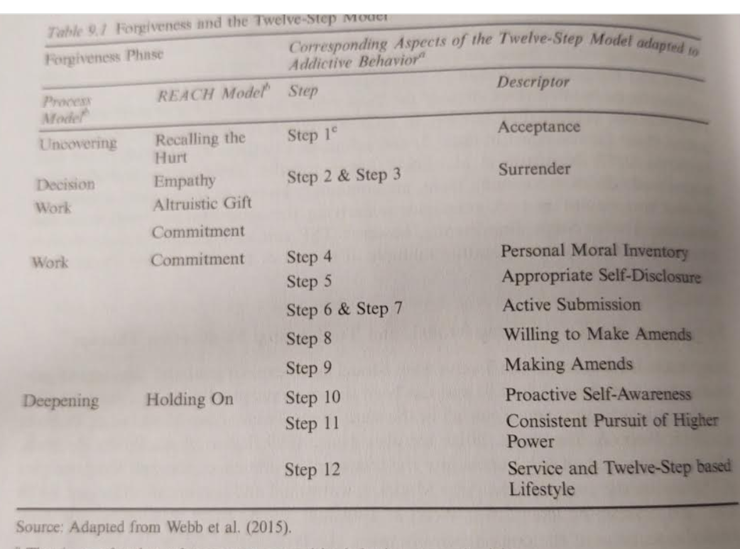
Webb (2021)
Ch 9: 12-Step and 12=Step Facilitation Models
Webb, J. R. (2021). Understanding forgiveness and addiction: Theory, research, and clinical application. Routledge.
Includes ways that the Process model and REACH Forgiveness model parallel with the 12 steps

Slide 68
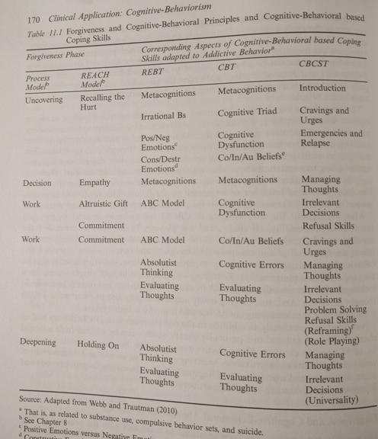
Webb (2021)
Ch 11: Three types of CBT Models
Webb, J. R. (2021). Understanding forgiveness and addiction: Theory, research, and clinical application. Routledge.
Includes ways that the Process model and REACH Forgiveness model parallel three types of CBT

Slide 69
Worthington and Anderson’s (2024) Treating Unforgiveness in the Army
Worthington, E. L., Jr., & Anderson, W. (2024). Strength to forgive: Soldiers forgiving others, forgiving themselves. Department of Defense.
This religion-compatible book for Army chaplains is framed to be not off-putting for people in armed services (i.e., strength to forgive). Its intervention is REACH Forgiveness. Forgiveness is described from 7 religious perspectives.
Also, this might be applicable to inform interventions with other armed services, veterans, and police.

Slide 70
Christian-Accommodated REACH Forgiveness: What Were the Accommodations?
(Note: “Christian accommodated tells us little. Lots or little accommodation? What specific changes were made? Will the Christian beliefs, values, and practices resonate with the user?)
The treatment is entitled as explicitly Christian.
The REACH acronym is explained as a metaphor for forms that create the shape of a mold. The real work of forgiveness is internal, like filling the form with concrete for permanent change. The six forms (REACH and DF) can be used repeatedly.
The lectio divina reflections use Scriptures. Scriptures can help us understand forgiveness.
When forgiveness is defined as decisional and emotional, reference is made to Mt 6:12, 14-5, and it is asserted that decisional forgiveness is Scripture “required” and emotional forgiveness is God-desired.

Slide 71
Christian-Accommodated REACH Forgiveness: What Were the Accommodations?
  Spiritual benefits are explicit
  Humble forgiveness, looking to others, is emphasized. Part of the humility is (1) looking to God in prayer for empowering forgiveness and (2) praying for the one who offended you.
  Altruistic forgiveness is other-oriented, Christian undeserved (grace-motivated) forgiveness
  Commitment is needed, like commitment is needed to solidify God’s forgiveness in our lives.
  Maintenance can be aided by prayer.
  The 12-steps are aimed at character change through the work of the Holy Spirit working, again, through the “forms” of the 12 “steps” in which REACH is applied repeatedly.

Slide 72
Christian Accommodated REACH Forgiveness: What Were the Outcomes?
The “usual” effects of accommodating secular treatments to religious populations: see Captari et al., 2019
Captari, L. E., Hook, J. N., Hoyt, W. T., Davis, D. E., McElroy, S., & Worthington, E. L., Jr. (2019). Religion and spirituality. In J. Norcross and B. E. Wampold (Eds.), Psychotherapy adaptations that work: Evidence-based transdiagnostic responsiveness (pp. 212-263). Oxford University Press.
Strictly accommodated treatments have been equal in psychological outcomes but accommodated treatments have been better than secular treatments in spiritual outcomes.

Slide 73
Christian-Accommodated REACH Forgiveness: What Were the Outcomes?
There is reason to believe that this might not hold for forgiveness religiously accommodated treatments.
  Forgiveness figures heavily in Christianity. The same is not true for accommodating CBT, EFT, Behavior therapy, etc.
  Rye and Pargament (2002) found, with a Christian accommodated proto-REACH Forgiveness treatment that Christians assigned to the secular treatment still did most things recommended in the Christian-accommodated treatment: prayer, consult Scripture, talk to others in the church, etc. Therefore, empirically, their secular treatment did not differ from their Christian-accommodated treatment for Christian participants.
What did we find in reviewing all: For Christians?
  REACH-Christian groups (d/hr = 0.091, k = 7) vs REACH-secular groups (d/hr = 0.093, k = 12)

Slide 74
Secular REACH Forgiveness with Christians
(Ohio) Rye & Pargament (2002) Proto-REACH
(Ohio) Rye et al. (2005) Proto-REACH
(Philippines) (Worthington et al., 2010)
(Iowa) Toussaint, Griffin et al. (2020)
(India) Toussaint, Worthington et al. (2020) Mixed religious, mostly Hindu
(Virginia) Greer et al. (2014) 7-hr DIY Workbook
(Indonesia) (Kurniati et al., 2021) 3.34-hr DIY Workbook
(Indonesia) (Kurniati et al., 2024) 3.34-hr DIY workbook
Colombia (Chen et al., 2024) 3.34-hr DIY workbook
Did they work? YES, equally in psychological variables to Christian-accommodated versions. But spiritual side not assessed and other meta-analyses (Captari et al.) show better spiritual outcomes and more acceptance by some theologically conservative participants

Slide 75
Hope-Focused Couple Approach (with Christians)
Numerous studies, including
Hook et al. (2009) Survey AACC members
Ripley et al. (2015) Compare HFCA Christian vs HFCA Secular
Hook et al. (2016) Assess patients at sessions 1 to 6
Ripley et al. (2023) Assess patients at sessions 1 to 5
Ripley et al. (2023) Long-term follow-up vs short-term.

Slide 76
Hope-Focused Couple Approach (Secular)
Worthington et al. (1997)
Ripley & Worthington (2002)
Burchard et al. (2005)
Worthington et al. (2015) HOPE vs FREE vs control

Slide 77
DiBlasio’s Decision-Based Forgiveness with Couples
DiBlasio's (2000) decision-based forgiveness is designed for couple therapy.
Unlike all other interventionists, it is conducted in a separate 3-hour session prior to couple therapy proper.
DiBlasio suggests that forgiveness is a decision—let go of resentment and negative emotions after the decision. Treatment aimed at DF, not EF/.
Decision-based forgiveness uses reframing and is more focused on reconciliation than most other approaches, presumably because in couple therapy, the therapist is generally coaching both partners about how to behave. Often involves reframing the offense to reduce its emotional impact, helping facilitate partners’ decision to forgive.
Approach differs from standard CBT, but it is focused more on changing behaviors and cognition than on changing emotions. Partners are encouraged to manage their cognition, feelings, and motivations.

Slide 78
DiBlasio’s Decision-Based Forgiveness with Couples
Two studies support the effectiveness with couples (DiBlasio & Benda, 2008).
DiBlasio, F. A., & Benda B. B. (2002). The effect of forgiveness treatment on self-esteem of spouses: Initial experimental results. Marriage and Family: A Christian Journal, 5, 511–523.
DiBlasio, F. A., & Benda B. B. (2008). Forgiveness intervention with married couples: Two empirical analyses. Journal of Psychology and Christianity, 27(2), 150-158.

Slide 79
Generalizations from Comparing the Content of the Various Interventions
Almost all forgiveness treatments share more in common than they differ. Almost all use most of the same principles.

Slide 80
Similarities That All or Most Share—Based on Narrative Review of 14 Secular Forgiveness Interventions
First, they motivate forgiving by recounting psychological, physical, relational, and (perhaps) spiritual benefits of forgiving to the forgiver.
Second, they typically have people work on forgiving a specific hurt or offense rather than forgiving more in general.
Third, they all guide people to recall and process the hurt—though they differ starkly in how much of the treatment is devoted to that.
Fourth, they invite the potential forgiver to take the perspective—cognitively, and especially, empathically—of the offender and extend compassion.
Fifth, they invite the potential forgiver to take an inventory of his or her own life and embrace a humble acceptance that they too have offended and to do so is a shared human failing calling for a generous response.
Sixth, they encourage forgiveness but all treat it as choice rather than duty.

Slide 81
10 Similarities Shared by Some But Not by Others
Seventh, they encourage decisional or emotional forgiveness, or both.
Eighth, most attempt to place struggles in some larger perspective.
Ninth, they encourage a long-term commitment to forgiving.
Tenth, some explicitly instruct in ways to maintain gains.
Eleventh, some seek to broaden forgiveness beyond forgiving an offense to forgivingness.
Twelfth, most encourage reflection on the gains made through the intervention.
Thirteenth, some encourage some deeper insight into subtle unconscious or contextual factors pushing people towards forgiveness or unforgiveness.
Fourteenth, some direct explicit attention to things that the offender can do to make forgiveness easier or more difficult.
Fifteenth, some refer to forgiveness as a way of restoring hope (personally or relationally), easing depression and anxiety, and promoting well-being and flourishing.
Sixteenth, some make the application specific to a particular harm (i.e., incest, couple conflict) or clientele (i.e., people in some non-US country, Christians).

Slide 82
Comparing All
Overall, looking at each of the principles, no single intervention employs all 16 of these. However, most of the interventions use most of the principles.

Slide 83
Overview of Amount of Empirical Support for Interventions to Promote Forgiving (# studies; does not address effectiveness or efficiency)
General psychoeducational groups: REACH Forgiveness >> Enright Process >> Luskin = Greenberg = Wade
DIY workbook psychoeducation: REACH
Psychoeducational group to supplement psychotherapy and make it more efficient: REACH >> Enright >> Luskin
Couples: REACH (within HFCA); Emotionally focused couple therapy (Greenberg); affairs (Baucom, Snyder, Gordon); decisions (DiBlasio)
Targeted at particular problems) long-term psychotherapy: Enright >> REACH
Education (pre-college): Enright >> REACH (see next)

Slide 84
Advances in International Use and in Health
Overall, international applications of forgiveness-groups and DIY-workbooks have multiplied.
Health applications have greatly multiplied from 2015 edited book, Forgiveness and Health (Toussaint, Worthington, & Williams, Eds.) to 2020 review in Handbook of Forgiveness, 2nd ed. (Toussaint, Worthington, Williams, & Webb) to today.
Today, forgiveness is an international public mental health concern due to its strong connection with bettering depression, anxiety, flourishing, and well-being.

Slide 85
Applications in Public Mental Health
Creating a valid treatment that can be used in public mental health
Creating forgiveness campaigns that can promote forgiveness in “mediating organizations” to change societies.

Slide 86
Creating a valid Intervention that can be used in public mental health

Slide 87
History of Efforts
7-hour workbooks (secular [n = 2] and Christian [n = 1]) and testing them at VCU
Turning the 7-hour workbook into a 7-hour open-internet study (LESSONS LEARNED)
Creating a “2-hour” that turns out to be 3.3-hour workbook for international randomized controlled trial

Slide 88
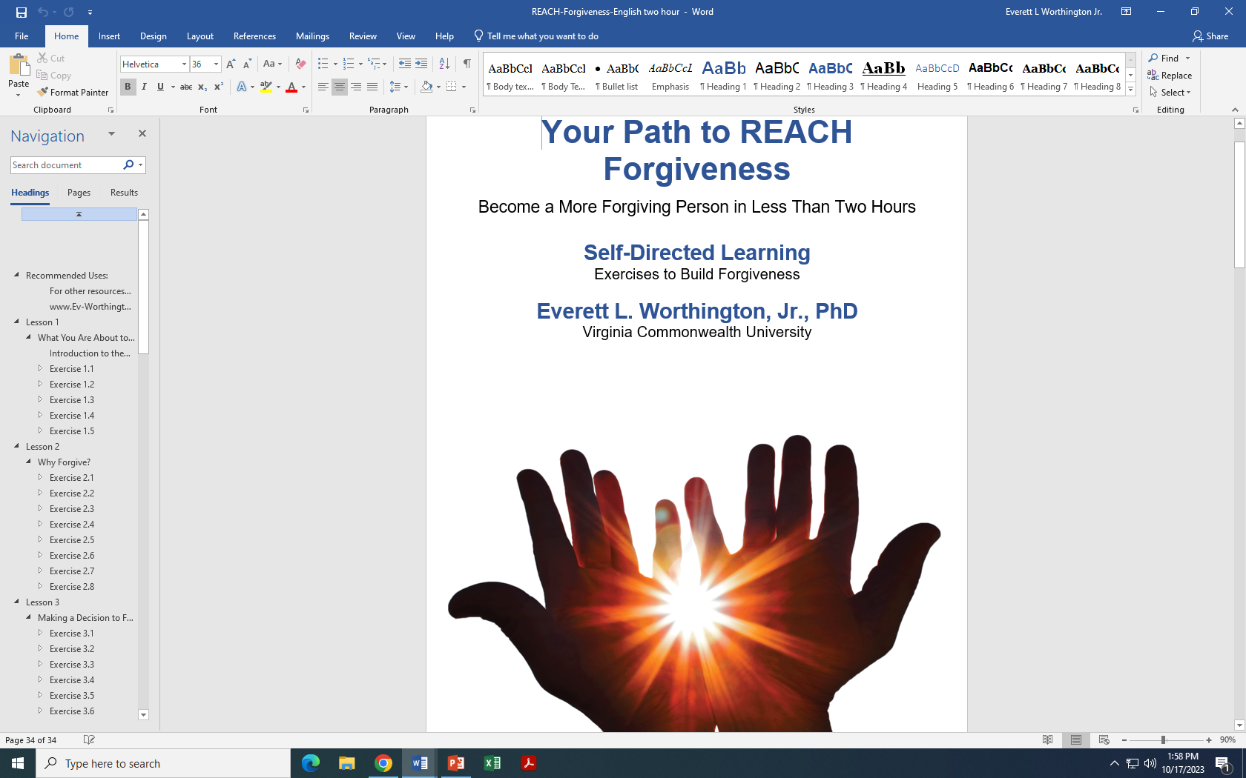
3-Hour DIY Workbook

Slide 89
Putting the Lessons to Work (A Project Funded by the Templeton World Charity Foundation [TWCF]; HO Man Yee, PI)
Hong Kong—an entire (secular) university
Indonesia—a large Christian church that had been razed by religious opponents in the past
Ukraine (two sites)—one near the Russian-Ukrainian conflict, one in a large church in Kyiv
Colombia (two projects)—war survivors; in a (secular) college
South Africa (an entire geographical section of the country, about 1/5 of the population)

Slide 90
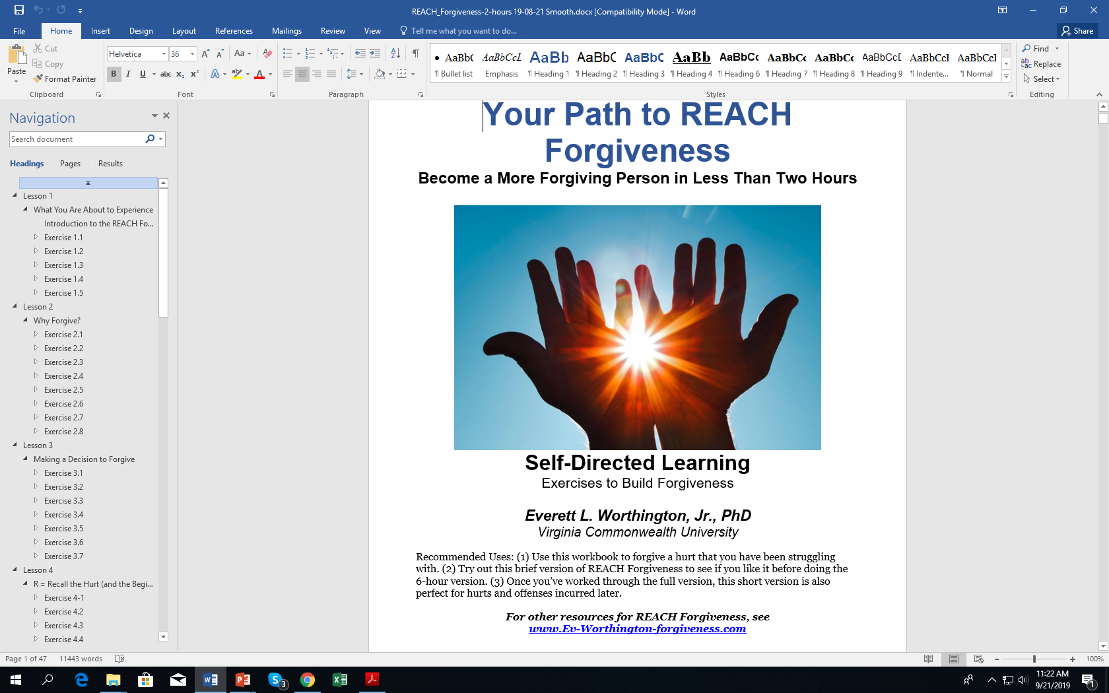
Forgiveness can change your world by helping you to forgive faster and more thoroughly.
HO et al. (2023) is a Cross-Cultural Experimental (Wait-List cross-over Design) Test of Effectiveness of a Two- or Three-Hour Workbook of (Secular) REACH Forgiveness in highly stressed people.
Available in English, Spanish, Chinese, Indonesian, Ukrainian at https://reach.discoverforgiveness.org

Slide 91
Wade et al. (2014) vs HO et al. (2023)
Our Study
6 sites at >500 per site; most people are retained at follow-up; total N = 4,598
N ~ 2300 all studies up to 2013 and N = 1800 all studies 2013-2020.
“Dose” = 3.34 hours (depending on reading level)
All Randomized controlled trials from the beginning to 2013
53 studies (N = 2,323) at post-test
41 studies (N = 1,716) at follow-up
(“Dose” = 1 hour to 60 hours)

Slide 92
We have posted, on a central website, all translations of the workbook (without cost) https://reach.discoverforgiveness.org
Thus, REACH Forgiveness brief DIY Workbooks will be available to about ¾ of the world in their first language without cost:
  English
  Spanish
  Mandarin
  Ukrainian
  Indonesian

Slide 93
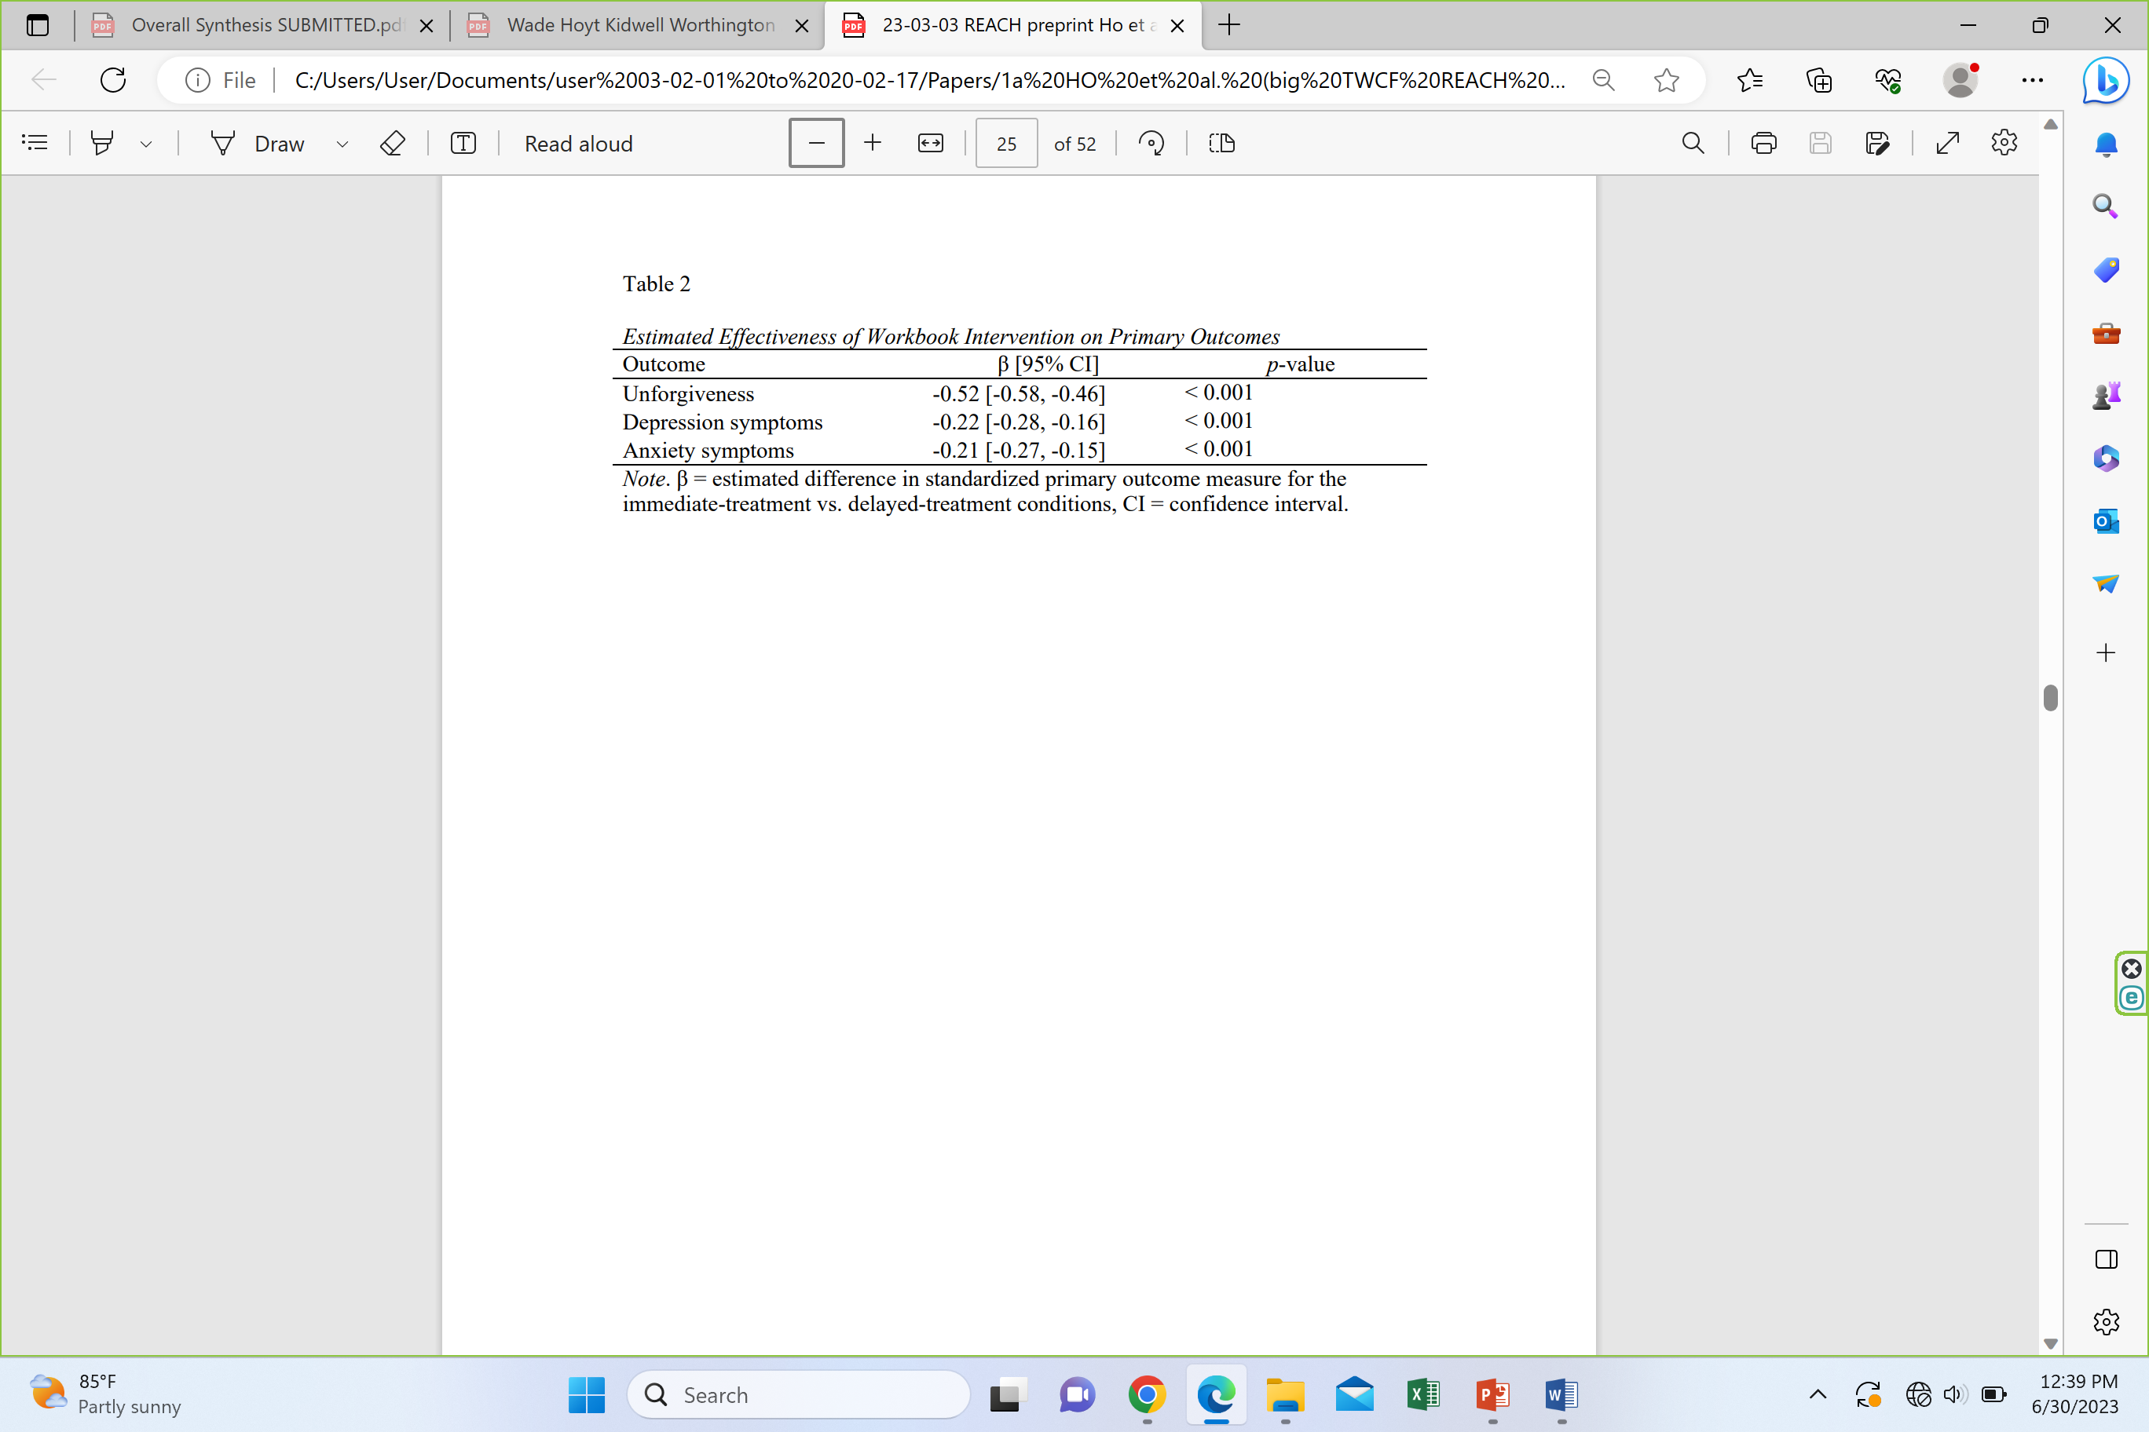
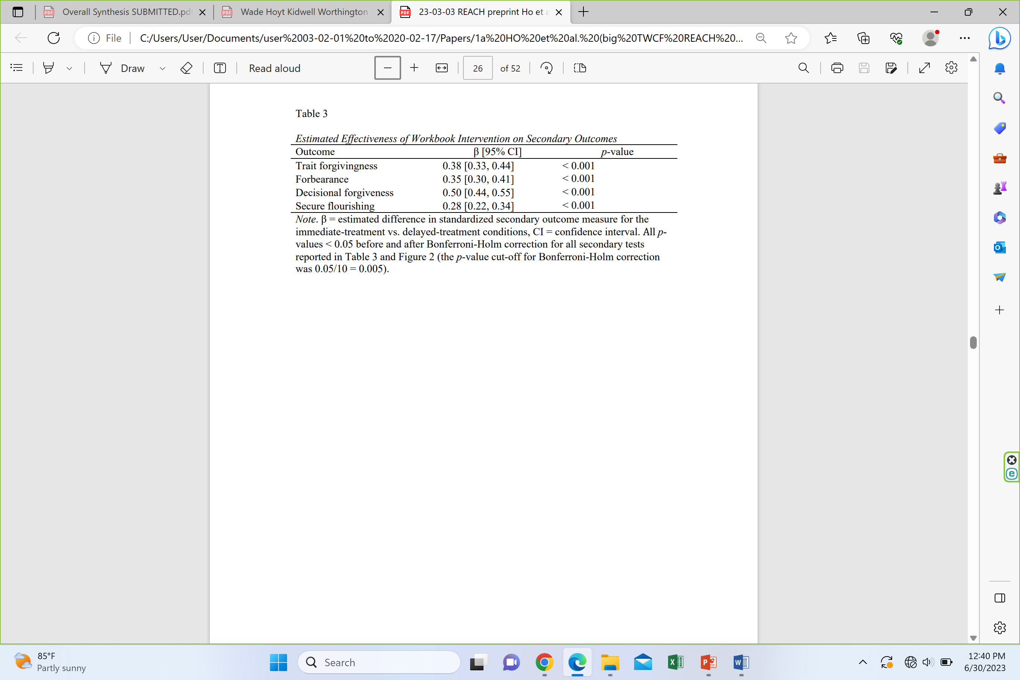
Results of HO et al. (2023) Study
Remember: 26 hrs of CBT for depression, d = 1.26. This is 2.5 hrs of forgive treatment, yet for depression, d = 0.22.
Take home: Completing a two- to three-hour DIY workbook yields increases in forgiveness, disposition to forgive, forbearance, and flourishing. ALSO decreases in unforgiving motives, depression, and anxiety.

Slide 94
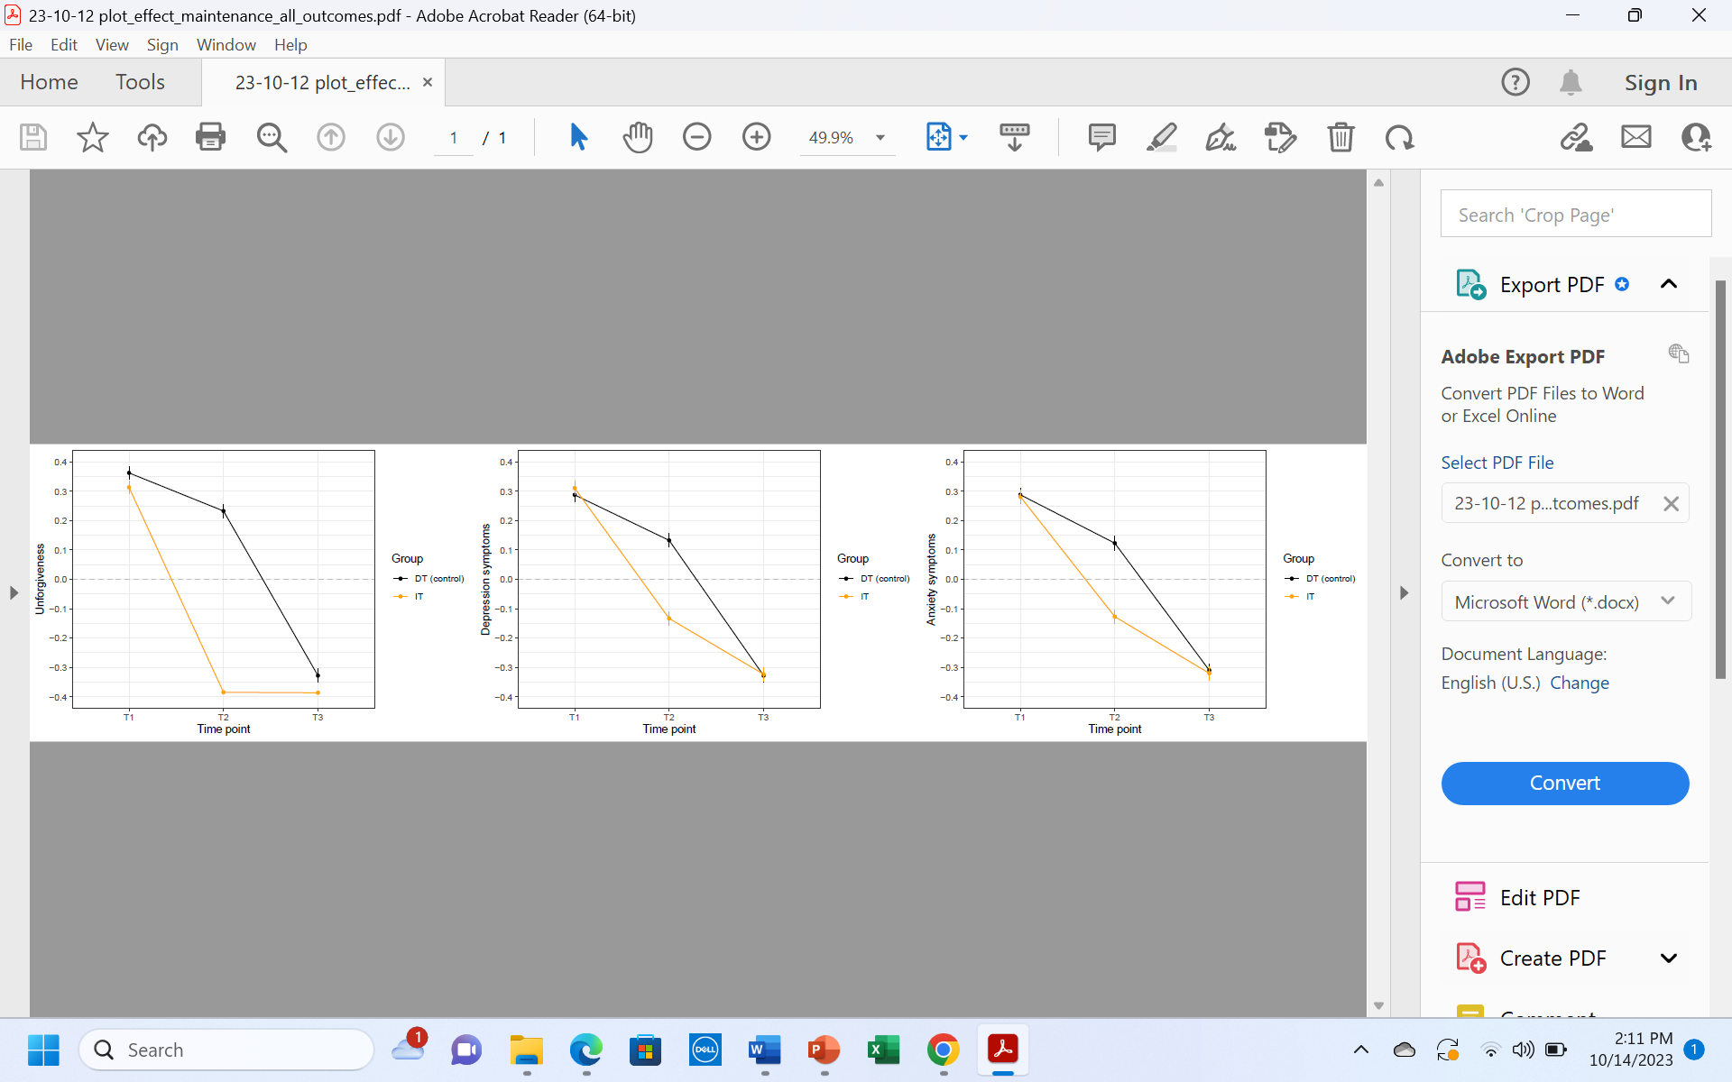
Omnibus Means over Time for Unforgiveness, Depression, and Anxiety
Unforgiveness Depression Anxiety
Take home: Immediate treatment forgave better (forgave immediately and maintained). They reduced depression and anxiety and it kept improving over time. Delayed treatment mirrored performance of IT (of course without follow-up).

Slide 95
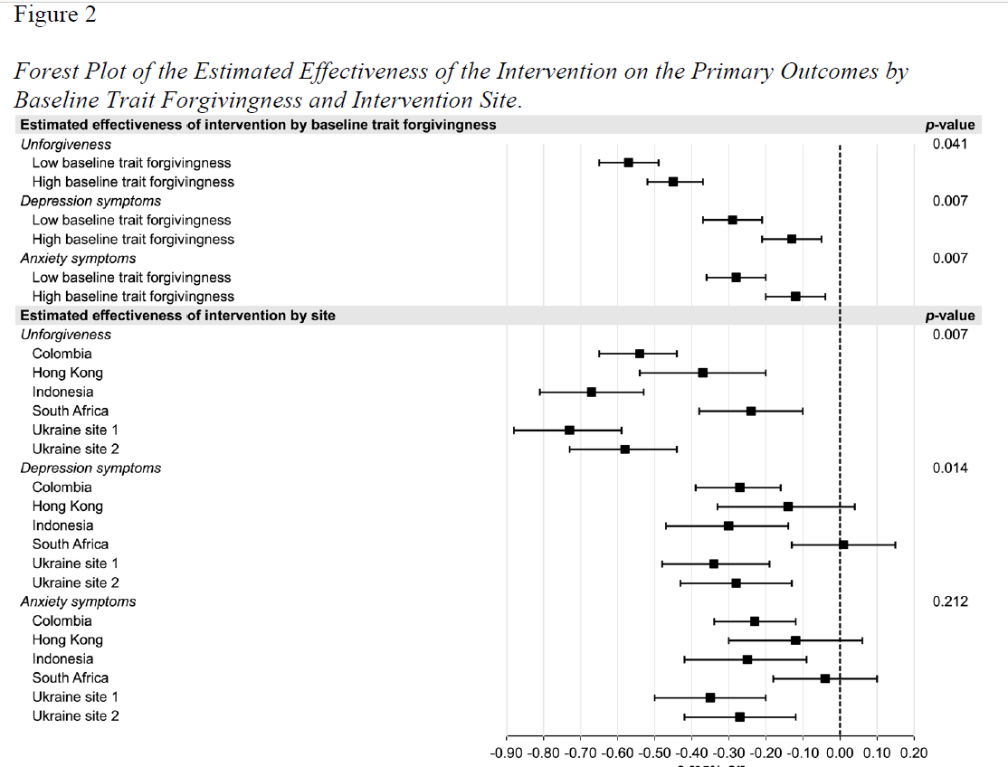
Site-by-Site Results
Sites sampled from different populations and communities.
Ukraine site 1 was Christian churches. All others were generally secular (containing religious and non-religious people).
Colombia 2 samples: university and war survivors.
Take home: Sites differ

Slide 96
Comparing DIY Workbooks to Groups—Take Home: DIY Workbooks Twice as Effective as Groups (see bottom two lines)
[Recall: Meta Mean ES = 0.56 for 10 hours of treatment. (d/hr ~ 0.056)]
*
*

Slide 97
Advances Beyond the Therapy Hour
Beyond the therapy hour, the APA convened a task force to identify ways that psychology can meet a growing deficit between need for therapy and number of providers (Dodge et al., 2024). Deficit will grow starkly in future.
Forgiveness treatments can help. Forgiveness interventions have been related to reduced depression and anxiety, increased flourishing and well-being. DIY interventions and internet-delivered interventions have been shown to be effective.
Delivery by other providers needed: classroom, church, pastoral counseling, workplaces, and counseling/therapy with individuals and couples.
A DIY workbook psychoeducational REACH Forgiveness model (Ho et al., 2024; N=4,598; 5 countries) showed great promise for adults.
A meta-analysis of k = 20 studies (N = 1,472; 10 countries) by Rapp et al. (2022) showed that Enright’s process model of forgiveness (Enright & Fitzgibbons, 2024) can be taught in middle and high schools.

Slide 98
With 3.34-hour DIY Workbooks, we have a tool to help people in the public forgive.
Can community campaigns promote forgiveness?
Could an entire country be enticed to complete these workbooks and engage in other forgiveness activities?
A city?
An organization within a city?
A church
Note: I’m just presenting a few slides on this.

Slide 99
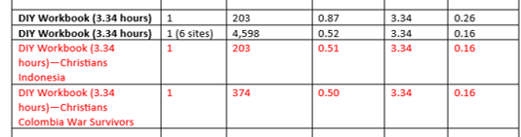
General Summary
Outperforms (efficiency, not effectiveness) CBT (d/hr 0.05) and General Forgiveness Interventions in 2013 (d/hr = 0.056)
Secular and Christian versions equal (d/hr = 0.16)
DIY Workbooks (d/hr = 0.16) > Groups (d/hr = 0.08)

Slide 100
Mediating Structures
Mediating structures are existing organizations that can be enlisted (and perhaps coordinated to work on forgiveness at the same time) to change a virtue that will spread to a larger structure.
So schools, colleges and universities, workplaces, community organization, etc. can run forgiveness campaigns at the same time coordinated by a political body or leader.
Berger, Peter, & Neuhaus, R. (1977). To empower people: The role of mediating structures in public policy. American Enterprise Institute for Public Policy Research.
Harris, M., & Milofsky, C. (2019). Mediating structures: Their organization in civil society. Nonprofit Policy Forum, deGruyter, 20190017. https://doi.org/10.1515/npf-2019-0017

Slide 101
What We Did
We tried awareness-raising interventions in organizations that already valued forgiveness:
  Two Christian colleges*
  Grant-funded seven Christian colleges**
  Three Christian churches
We found, in all places, small positive effects across the entire communities. Why small?
  Focused entirely on increasing awareness that emphasized (1) two types of forgiveness; (2) benefits of forgiveness; (3) awareness of local resources.
  Most participants already forgave, so ceiling effect for what campaign could do.
  Interventions were mostly intellectual and passive; leadership not heavily invested; all were in Christian settings.
*Both studies published
**One representative university study published

Slide 102
Making It Even Briefer
For Wheaton College psych majors, mean time was ~ 2 hours.
For the Ho et al. (2023) samples, the mean time was 3.34 hours
We are completing an App. The 3.34-hour DIY workbook was reduced from 72 exercises to 30 exercises that people can do one daily for a month as a “forgiveness challenge.” Total time, about 2 hours (really) (this time).

Slide 103
Advances
We have pulled out Christians from the Indonesian and Colombian (war survivors) samples and found that the 3.34-hour secular DIY worked with Christians.
We have pulled out Muslims from the Indonesian sample. It works there.
Mohammed Abu-Nimer and Illham Nasser are testing it on a grant-funded project on an Arab sample from multiple sites in two (or three) Arab countries.

Slide 104
Workshop: Adapting Your Approach to Include Forgiveness Intervention

Slide 105
Answer These Questions
What approach do you typically use in counseling individuals (i.e., therapy or pastoral counseling or lay counseling) or in psychoeducation with individuals (i.e., community intervention, teaching classes or workshops, Christian education classes)?
  For most people, this is “eclectic” or “it depends on the person and the problem.” Other people will have a definite preference that they use most of the time.
If you said, CBT→Luskin
If you said, EFT→Greenberg
If you said, mostly in affairs—Baucom, Snyder, Gordon
If you said couples, Hope-focused, DiBlasio, Greenberg, Baucom et al.

Slide 106
Answer These Questions
In your practice do you see people with the sole focus on forgiveness, or do you see people who have a variety of problems and forgiveness pops up within those problems?
Sole focus on forgiveness: Enright for psychotherapy; REACH for psychoeducation
If forgiveness pops up: groups (Wade process groups; REACH Forgiveness; Enright’s process model for classroom adapt to adult education)

Slide 107
Drawing from Secular Interventions
In comparing (earlier) we found 6 commonly shared principles and 10 that were shared among some but not all interventions.

Slide 108
Here are the 16 principles: The 6 shared by all. How important is each one? 10=absolutely crucial; 0= don’t include
Motivate forgiving by recounting psychological, physical, relational, and spiritual benefits of forgiving to the forgiver. (Recounting benefits is essential.)
Use a specific hurt or offense in general, then later broaden to other offenses.
Guide people to recall and process the hurt. (But how much time on this varies.)
Invite the potential forgiver to empathize with and extend compassion to the offender.
Invite humble examination of how person has offended others.
Encourage forgiveness as choice, not a duty.

Slide 109
Here are 16 principles; The 10 shared by some. How important is each one? 10=absolutely crucial; 0= don’t include
Work is tailored throughout to a specific harm (i.e., incest) or clientele.
Encourage decisional or emotional forgiveness, or both.
Attempt to place struggles in some larger perspective.
Encourage a long-term commitment to forgiving.
Encourage reflection on the gains made.
Explicit instruction in ways to maintain gains.
Broaden forgiveness beyond forgiving an offense to trait forgivingness.
Encourage some deeper insight into subtle unconscious or contextual factors pushing people towards forgiveness or unforgiveness.
Explicit attention to things that the offender can do to make forgiveness easier.
Refer to forgiveness as a way of restoring hope, easing depression and anxiety, and promoting well-being and flourishing.

Slide 110
Drawing from Practical Theology
To what degree would you include each of these actions from practical theology (i.e., the way the church has treated forgiveness over the years).
  Note: “The church” differs with different theologies and church practices (i.e., progressive theologies and church polities may differ markedly from more mid-level evangelical, which may also differ markedly from very conservative and fundamentalist churches)
10=absolutely crucial; 0= don’t include

Slide 111
Content of Christian Practical Theology Interventions
Pray: for the offender, for God’s help in your forgiveness efforts, for God’s power in forgiving, for justice, for divine justice, for discernment, for the intervention of the Holy Spirit
Seek: Scripture, models from local congregation, people you know, Scripture, history
Restraint: Relinquish the offense to God, tolerate the injustice, forbear, accept and move on
Count your blessings: Find benefits to you for forgiving
Encourage: God forgives us first, Tell or imply that God requires decisional forgiveness from us (so that God will forgive us)
Use God’s general revelation (science, philosophy, clinical science, arts, humanities)
USE ANY or ALL (They take time)

Slide 112
Other Questions about Your Approach
To what degree will you rely on:
In-session counseling vs out-of-session adjunctive work (YouTube look ups, workbooks, psychoeducational groups, assigned reading)?
Do you believe that time spent sincerely trying to forgive is strongly related to amount of forgiveness experienced?

Slide 113
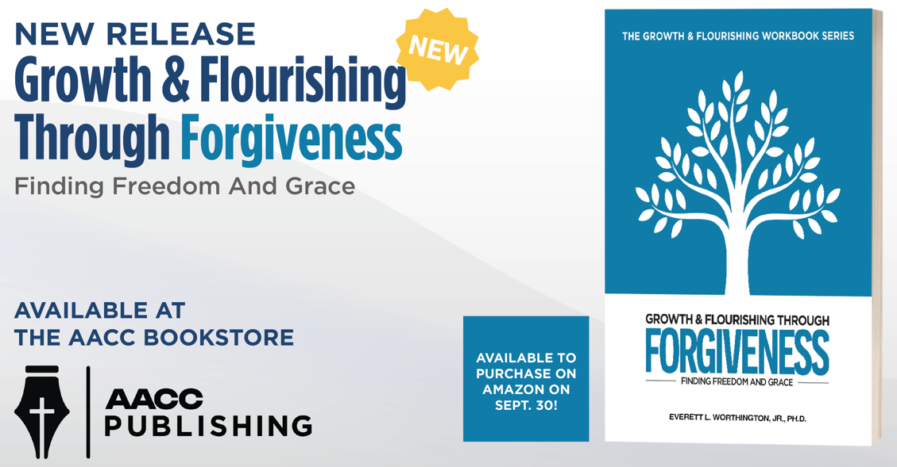
If you want more on integrating evidence-based aspects into your own approach

Slide 114
Objectives of the Talk
By the end of this preconference workshop, the attendee will be able to:
Use at least three psychological models to promote forgiveness in session or as an adjunct to psychotherapy
Incorporate at least five techniques/methods for promoting forgiveness into their repertoire of interventions
Use similarities among forgiveness models to design their own intervention to promote forgiveness

Slide 115
Conclusion
The field of forgiveness studies is well-developed but still has lots of interesting unanswered questions.
You can promote forgiveness in clients and more broadly (contributing to public mental health). Use:
REACH Forgiveness model or Enright’s process-based model.
Or, adapt either of those.
Adapt your favorite approach by including shared principles from secular interventions, Biblical theology and practical theology.

Slide 116
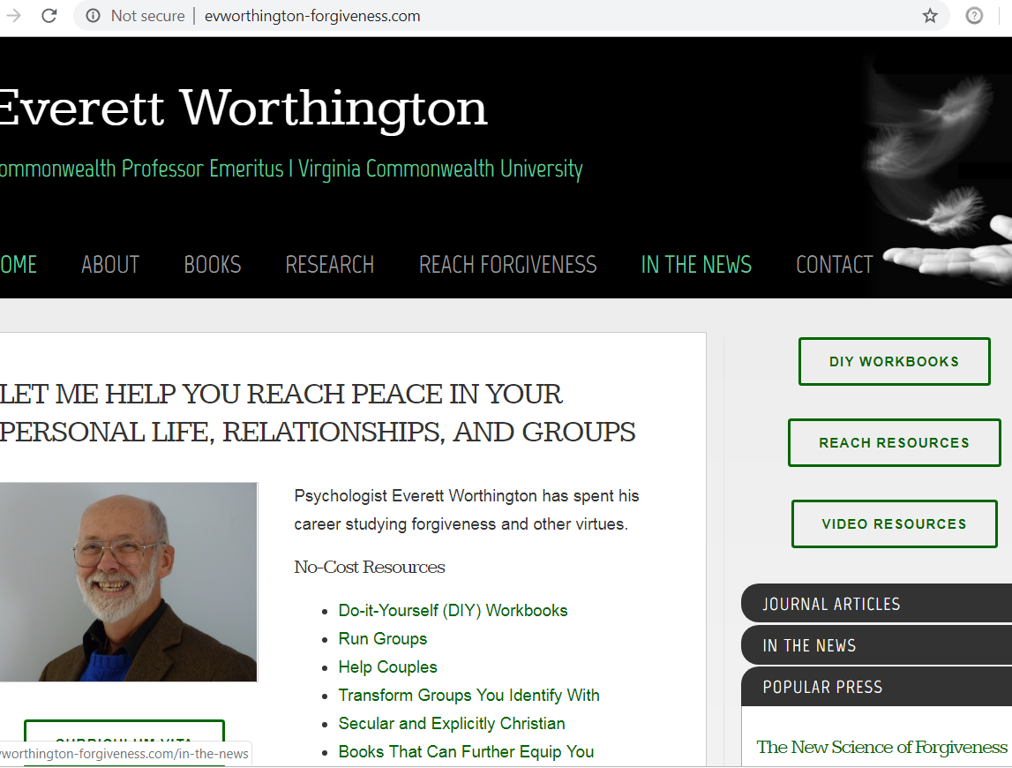
Group Manuals and DIY Workbooks Are Free
Group and couple manuals →
←

Slide 117
Free Resources
www.EvWorthington-forgiveness.com
  DIY Workbooks
    In other languages: https://reach.discoverforgiveness.org
  Group Protocols (leader and participant manuals): www.EvWorthington-forgiveness.com
  Advice about running campaigns at churches or other organizations
  Other workbooks—humility, patience, self-forgiveness, positivity
Link to couples resources: www.hopecouples.com
Contact information: eworth@vcu.edu

Slide 118
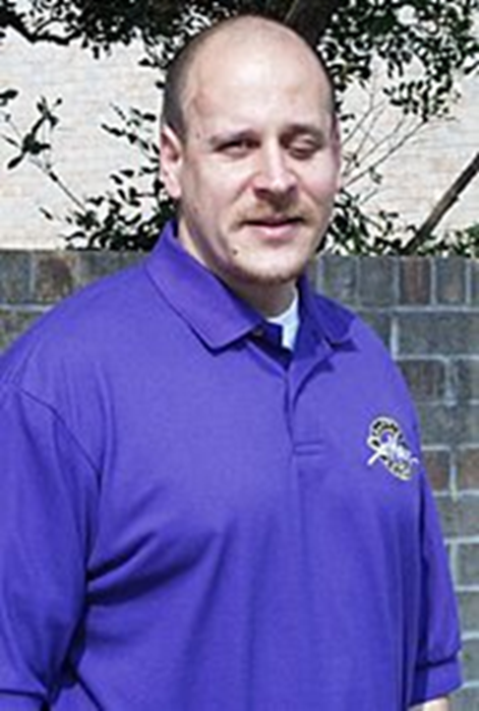
A Thought to End

Slide 119

Questions and Answers

Slide 120
Bonus Material

Slide 121
Self-Forgiveness
You’ll note that intentionally I did not include self-forgiveness interventions in my learning objectives. That’s because I don’t know how long we’ll spend on our Make-Your-Own-Adventure model-making. So, if we have time, we’ll do this.
Two therapeutic models
Cornish and Wade’s 4-F model for use in psychotherapy
Griffin et al.’s psychoeducational model to treat self-condemnation and moral injury

Slide 122
There are TWO established evidence-based treatments for self-condemnation
Cornish and Wade’s 4-R Model for Self-forgiveness in Psychotherapy
Worthington’s (2013) and Griffin et al.’s (2015) Six Steps to Self-Forgiveness (psychoeducational model used as DIY workbook or group in the VAMC system)
Brandon.griffin2@va.gov

Slide 123
Cornish and Wade (2015)
The Four-R Method of Self-Forgiveness
Responsibility
Own the hurt to others; recognize pain others felt; avoid minimizing or explaining away
Remorse
Often comes naturally as the person accepts responsibility
Restoration
Person tries to repair the damage and reconnect with one’s values one violated by the offense
Renewal
Release self-condemnation; replace it by renewed self-respect, self-compassion, and self-acceptance

Slide 124
Cornish and Wade (2015) JCP: The Treatment
Grounded in EFT (Greenberg, 2002) with specific adjustments for self-forgiveness (Worthington, 2001)
Task 1: Help cl accept responsibility: (a) discuss offense including needs, wants, motives; (b) explore consequences of events; (c) empty chair to explore different reactions to the hurt inflicted like minimize, blame shift, etc. vs self-compassion with appropriate responsibility; (d) Tt helps cl realize doing a bad thing is not same as being a bad person.
Task 2: Remorse should happen naturally
Task 3: Restoration: empty chair to offer apology; cl identifies ways to make amends; cl discusses progress on amends-making in future sessions; empty-chair dialogue to help reconnect with the values they violated in wrongdoing
Task 4: Renewal: replace negative emotions with self-forgiving feelings; cl encouraged to focus on growth achieved; imagery exdercise to imagine bitter feelings of self-condemnation replaced by self-forgiveness and self compassion; Tt acts with non-judgmental caring throughout to help cl copy that; cl writes a letter to self expressing self-forgiveness.

Slide 125
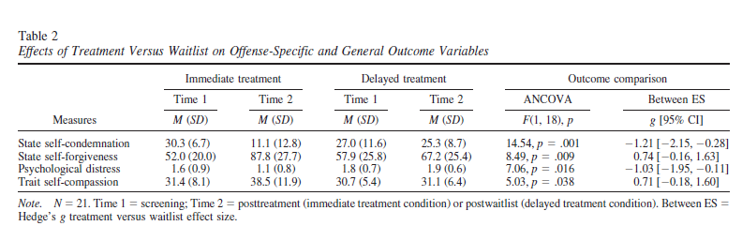
Cornish and Wade (2015)
Results (N = 26; 8 50-minute individual therapy sessions)
IT: gains at time 2 all four variables
DT: no change on any of the four variables
d = -1.21* (self-condemnation)
d = 0.74 (ns) (self-forgiveness)
d = -1.03* (psych distress)
d = 0.71 (ns) (trait self-compassion)

Slide 126
Using REACH Forgiveness in Dealing with Self-Condemnation

Slide 127
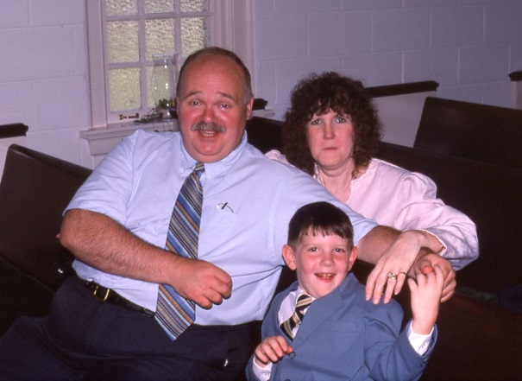
My Brother Mike’s Suicide in 2005
Lest you mistakenly think the road of character formation and the development of Christian virtue, is straight, it has not been all that straight for me (and I suspect also not for people who have lived any amount of time)

Slide 128
Self-condemnation versus Self-Forgiveness
Our psychological experience is more a struggle with self-condemnation than a focus on forgiving ourselves.
Self-forgiveness is not in Scripture per se, but it is implied that it is needed because God’s divine forgiveness takes care of all our moral guilt, but does not change natural consequences.

Slide 129
January 2008:
Life Includes Times of Religious Dwelling versus Seeking
Robert Wuthnow, Princeton University Sociologist

Slide 130
We did a couple of intervention studies—pre-six-step model—in the mid-2000s
Scherer et al. with inpatients for alcohol misuse.
Scherer, M., Worthington, E. L., Jr., Hook, J. N., & Campana, K. L. (2011). Forgiveness and the bottle: Promoting self-forgiveness in individuals who abuse alcohol. Journal of Addictive Diseases, 30, 382–395.
(Four-hour group treatment with in-patients.)
Campana with women who experienced a romantic relationship dissolution.
Campana, K. (2010). Self-forgiveness interventions for women experiencing a breakup. Unpublished Doctoral Dissertation, Virginia Commonwealth University.
(A hurried dissertation using a DIY workbook, but with inadequate post-treatment sample-size)

Slide 131
In 2006, I had formulated the Stress-and-Coping Theory of Forgiveness
Note: It’s a THEORY (lots of support). Builds upon Richard Lazarus’ stress-and-coping theory (Lazarus, 1999), which has massive research support.

Slide 132
I created a Stress-and-Coping-Theory-based intervention to help people REACH self-forgiveness. The intervention developed slowly.
First, I wrote a Christian book outlining the model
Worthington, E. L., Jr. (2013). Moving forward: Six steps to forgiving yourself and breaking free from the past. WaterBrook/Multnomah.
Then Brandon Griffin and I created a DIY workbook intervention (6- to 7-hr) to convert the 2013 model into an intervention
Griffin, B. J., Worthington, E. L., Jr., Lavelock, C. R., Greer, C. L., Lin, ., Davis, D. E., & Hook, J. N. (2015). Efficacy of a self-forgiveness workbook: A randomized controlled trial with interpersonal offenders. Journal of Counseling Psychology, 62(2), 124-136.
Here’s another stress-and-coping based model: self-forgiveness and health: Toussaint, L. L., Webb, J. R., & Hirsch, J. K. (2017). Self-forgiveness and health: A stress-and-coping model. In L. Woodyatt, E. L. Worthington, Jr., M. Wenzel, & B. J. Griffin (Eds.), Handbook of the psychology of self-forgiveness (pp. 87-100). Springer.

Slide 133
Six Steps to Self-Forgiveness and Decisional Plus Emotional Self-Forgiveness: Dual Process Model
Worthington, E. L., Jr. (2013). Moving Forward: Six Steps to Self-Forgiveness and Breaking Free from the Past. WaterBrook/Multnomah.
Griffin, B. J., Worthington, E. L., Jr., Lavelock, C. R., Greer, C. L., Lin, ., Davis, D. E., & Hook, J. N. (2015). Efficacy of a self-forgiveness workbook: A randomized controlled trial with interpersonal offenders. Journal of Counseling Psychology, 62(2), 124-136.
Responsibility
  Step 1: Receive God’s Forgiveness (or Humanity, or Nature)—Moral repair (Decisional)
  Step 2: Repair Relationships—Moral repair (Decisional)
  Step 3: Reduce Rumination (Rumination, Expectations, Standards)—Internal condemnation (Emotional)
REACH Emotional Self-Forgiveness
  Step 4: Explicit Decision plus REACH Emotional Self-forgiveness)—Moral Repair (Decisional) plus Internal condemnation (Emotional)
Repair of Self
  Step 5: Realize Self-Acceptance—Internal condemnation (Emotional)
  Step 6: Resolve to Live Virtuously—Moral Repair (Decisional)
Davis, D. E., Ho, M. Y., Griffin, B. J., Bell, C., Hook, J. N., Van Tongeren, D. R., Worthington, E. L., Jr.. DeBlaere, C., & Westbrook, C. (2015). Forgiving the self and physical and mental health correlates: A meta-analytic review. Journal of Counseling Psychology, 62(2), 329-335.

Slide 134
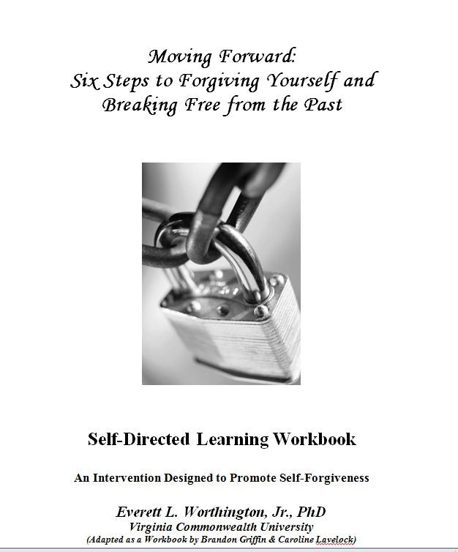
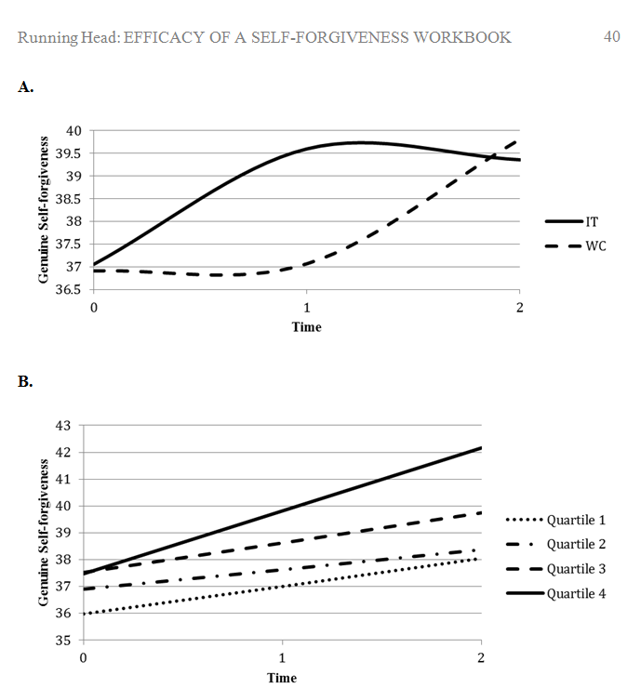
We Tested in a RCT, a Workbook to Promote Self-Forgiveness

Slide 135
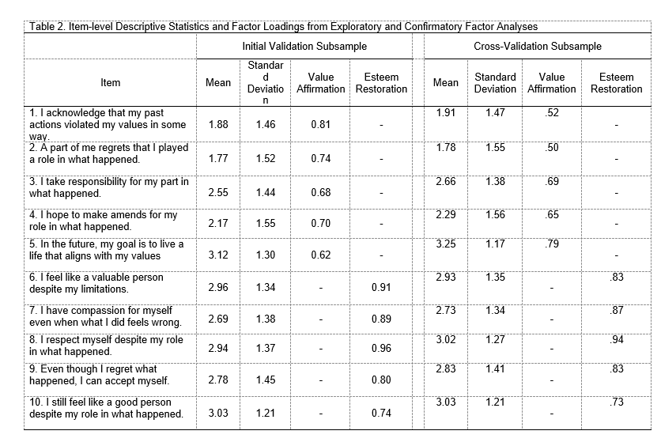
Assessing Self-Forgiveness: The Dual Process Self-Forgiveness Scale--Revised
Griffin, B. J., Norman, S. B., Weber, M., Hinkson, K. D., Jendro, A. M., Pyne, J. M., Worthington, E. L., Jr., & Maguen, S. (2024). Properties of the modified Self-Forgiveness Dual-Process Scale in populations at risk for moral injury. Stress and Health, in press.

Slide 136
Treating Moral Injury with Self-Forgiveness Intervention
Appendix

Slide 137
Questions and Answers

Slide 138
We Have Used the Six Steps to Treat Moral injury
Most PMIEs demand we attend to them. They are stressors.
Evidence shows that when PMIEs are experienced, they are often thought of as stressors (i.e., stressful), are appraised, initiate and sustain stress reactions (physically, emotionally, cognitively, and interpersonally), and are coped with.
Thus, they may be conceptualized in a stress-and-coping model.

Slide 139
Stress-and-Coping Model of Moral Injuries
I’m making two analogies here.
Potentially Morally Injurious Events (PMIEs) are like Potentially Traumatic Events. (a) They are stressful, and can be modeled using stress-and-coping theory. (b) They are not always responded to with moral injury). So, many people might be resilient to PMIEs.
There is good support for (a).
There is no evidential support for (b). Undaunted by lack of evidence, l’lI move on (trusting that research will be forthcoming).

Slide 140
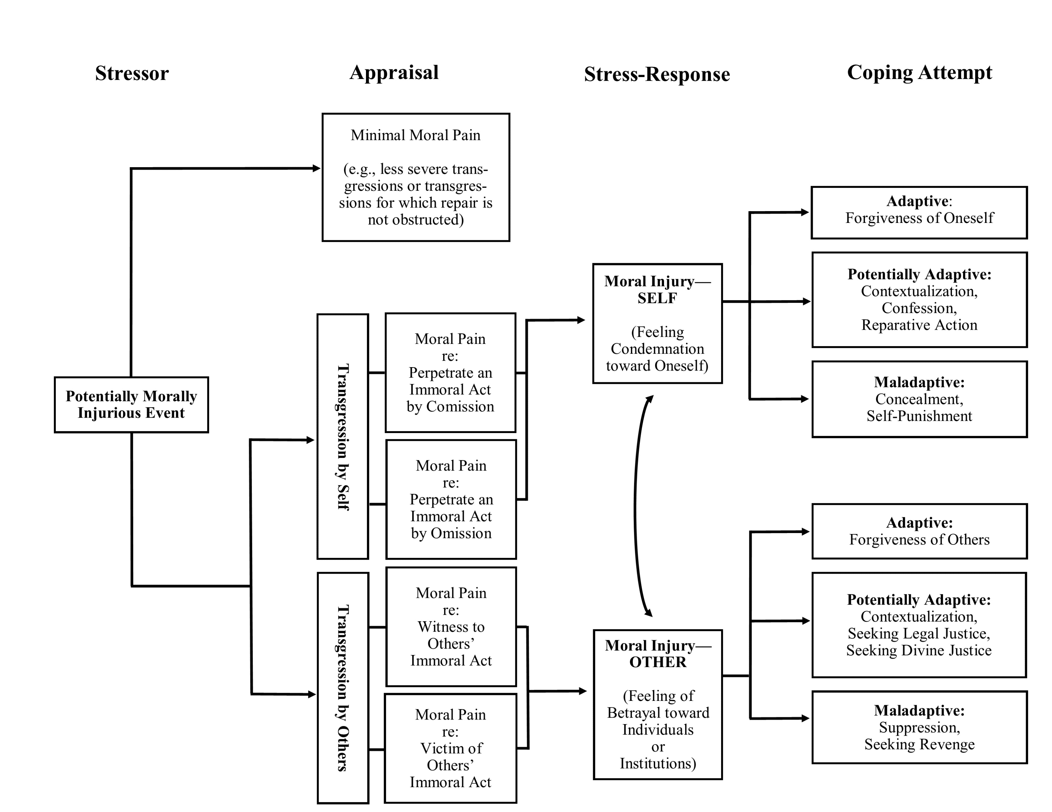
The stress-and-coping model of moral injury
Griffin, B. J., Cornish, M. A., Maguen, S., & Worthington, E. L., Jr. (2021). Forgiveness as a mechanism of recovery from moral injury. In Currier, J. M., Drescher, K. D., & Nieuwsma, J. (Eds.), Addressing moral injury in clinical practice (pp. 71-86). American Psychological Association.
Both Self-Forgiveness
and
Forgiving Others
Can Play a Role in Healing from Moral Injury

Slide 141
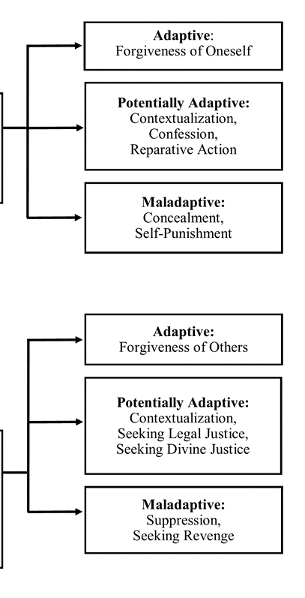
Coping with Self-Condemnation
Self-condemnation may be felt in cases of one’s own moral failures→ Self-forgiveness is a primary way (but not the only way) to treat self-condemnation. It may be adaptive or maladaptive.
Alternative adaptive ways
  Work toward a just solution; relinquish suffering to God; acceptance; mindful meditation; cognitive coping; psychotherapy
Potentially adaptive ways of treating self-condemnation
  Attempts to contextualize (perspective or explain it away)
  Attempts to undo or make up for the wrong or mitigate the negative consequences to those harmed (i.e., confession and reparative action—each of which may be over-used (shame- or guilt-driven) or under-used (justifying “I’ve done enough”).
Unambiguously maladaptive ways
  Concealment; self-punishment; substance misuse

Slide 142
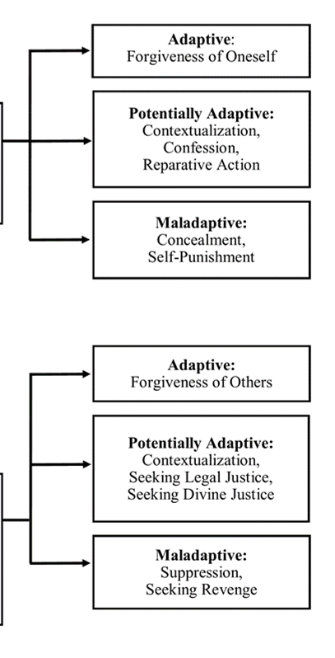
Coping with Injustice and Unforgiveness of Others
Condemnation of others may be felt when one feels betrayed by individuals or institutions.
Alternative adaptive ways
  Seek justice; turn it over to God (i.e., relinquish it); forbearance; acceptance; psychotherapy/forgiveness therapy
Potentially adaptive ways
  Contextualization; tolerance; pursuing legal justice; appealing to God for divine justice
Unambiguously maladaptive ways
  revenge; suppression

Slide 143
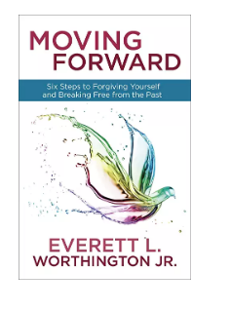
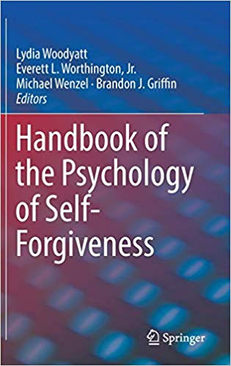
Books and Workbook
www.forgiveself.com
Worthington, E. L., Jr. (2013). Moving forward: Six steps to forgiving yourself and breaking free from the past. WaterBrook/Multnomah.
Woodyatt, L., Worthington, E. L., Jr., Wenzel, M., & Griffin, B. J. (Eds.). (2017). Handbook of the psychology of self-forgiveness. Springer Nature.
Griffin, B. J., Worthington, E. L., Jr., Lavelock, C. R., Greer, C. L., Lin, Y., Davis, D. E., & Hook, J. N. (2015). Efficacy of a self-forgiveness workbook: A randomized controlled trial with interpersonal offenders. Journal of Counseling Psychology, 62(2), 124-136.
  Get the workbook free at www.EvWorthington-forgiveness.com (DIY Workbooks)
Griffin, B. J., Cornish, M. A., Maguen, S., & Worthington, E. L., Jr. (2021). Forgiveness as a mechanism of recovery from moral injury. In Currier, J. M., Drescher, K. D., & Nieuwsma, J. (Eds.), Addressing moral injury in clinical practice (pp. 71-86). Washington, DC: American Psychological Association.
Forthcoming: John M. McConnell & Everett L. Worthington, Jr. (2025, under contract, in process of revising). Promoting Self-Forgiveness in Mental Health Practice: A Principle-Driven, Patient-Responsive, Science-Supported Clinical Approach. Oxford University Press.

Slide 144
Five Clinical Principles of Promoting Self-Forgiveness to Guide Ongoing Assessment, Conceptualization, Treatment Planning, Intervention, and Modification of Interventions and Their Implications for Psychotherapists
Principle 1: Self-(un)forgiveness Is an Etiology, Symptom, or Co-morbidity of Psychopathology and Suboptimal Human Functioning
  Implication: SF is complicated and can be cause or effect.
Principle 2: Self-Forgiveness Is Not a Panacea for Self-Condemnation—But It Helps
  Implication: There are many ways to treat self-condemnation.
Principle 3: Self-Forgiveness Depends on a Patient’s Development
  Implication: There is no one way to help people.
Principle 4: Self-forgiveness Has Many Milestones and Pathways
  Implication: there is not one way to experience Self-Forgiveness.
Principle 5: Individual Differences and Situational Factors Can Ease and Complicate the Journey to Self-Forgiveness
  Implication: Stay open to external and internal factors and stay humble about whether you have the last word on treating the person.

Slide 145
Review of the Six Steps to Self-Forgiveness
Responsibility
  Step 1: Receive ________
  Step 2: Repent and Repair R______
  Step 3: Reduce R________
Reaching Peace
  Step 4: D____ plus R____
Realistic Living
  Step 5: Realize Self-A______
  Step 6: Resolve to _____

Slide 146
Review of the Six Steps to Self-Forgiveness
Responsibility
  Step 1: Receive God’s Forgiveness
  Step 2: Repent and Repair Relationships
  Step 3: Reduce Rumination
Reaching Peace
  Step 4: Decision plus REACH Emotional Self-forgiveness
Realistic Living
  Step 5: Realize Self-Acceptance
  Step 6: Resolve to Live Virtuously

