Slide 1
Treating Christian Patients Who Want to Forgive
Everett L. Worthington, Jr.
Virginia Commonwealth University
Presented as a Breakout Workshop
AACC (2026) Arlington, Texas

Slide 2
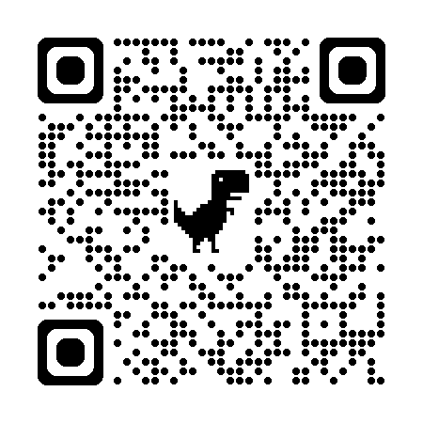
QR Code (This talk and two previous AACC presentations, one of which is more detailed than the present)

Slide 3
Abstract
Psychotherapy, couple therapy, and family therapy often require that clinicians help people forgive. The problem can be clinical (e.g., in instances of abuse, recovery from injuries and illnesses, couple or family therapy, or chronic health and mental health problems) or subclinical but integral to treating diagnosable disorders.
Options for treatment include Enright’s process forgiveness therapy or integration of evidence-based principles into one’s treatment as usual (TAU). Adjunctive treatments can involve REACH Forgiveness psychoeducational groups and evidence-based DIY workbooks and integration into couple and family treatment protocols. Some of these may be explicitly accommodated to Christian values, beliefs, and practices, and others secular.
We look at the effectiveness of secular forgiveness for Christians and compare it to explicitly Christian accommodated treatments. Christianity values forgiveness, and clients often come to therapy having tried many practical ways of forgiving.
It is helpful to know the varieties of treatments from Christian practice over the ages to know what has and has not been tried and thus tailor treatment for Christians.

Slide 4
Some Personal Disclosure about This Presentation
I have written some books about forgiveness on which this presentation is based.
  Worthington, E. L., Jr. (2025). Growth and flourishing through forgiveness: Finding freedom and grace. American Association of Christian Counselors (AACC) Publishing.
  Ripley, J. S., & Worthington, E. L., Jr. (2027). Couple therapy: A new Hope-Focused Approach, 2nd ed. IVP Academic.
  Worthington, E. L., Jr. (2027). Forgiveness and reconciliation: Theory and application, 2nd ed. Routledge.
  Worthington, E. L., Jr. (2027). Reaching for forgiveness: The science and practice of healing and reconciliation. InterVarsity Press.

Slide 5
Objectives of the Talk
By the end of this preconference workshop, the attendee will be able to:
Use at least some major approaches in therapy or as adjuncts to it;
Identify six evidence-based principles abstracted from 14 evidence-based secular forgiveness interventions;
Employ knowledge of five categories of forgiveness methods used by Christian churches to help people forgive to effectively plan treatments.

Slide 6
Basic Understanding of Forgiveness from Science, Scripture, and Church Practice

Slide 7
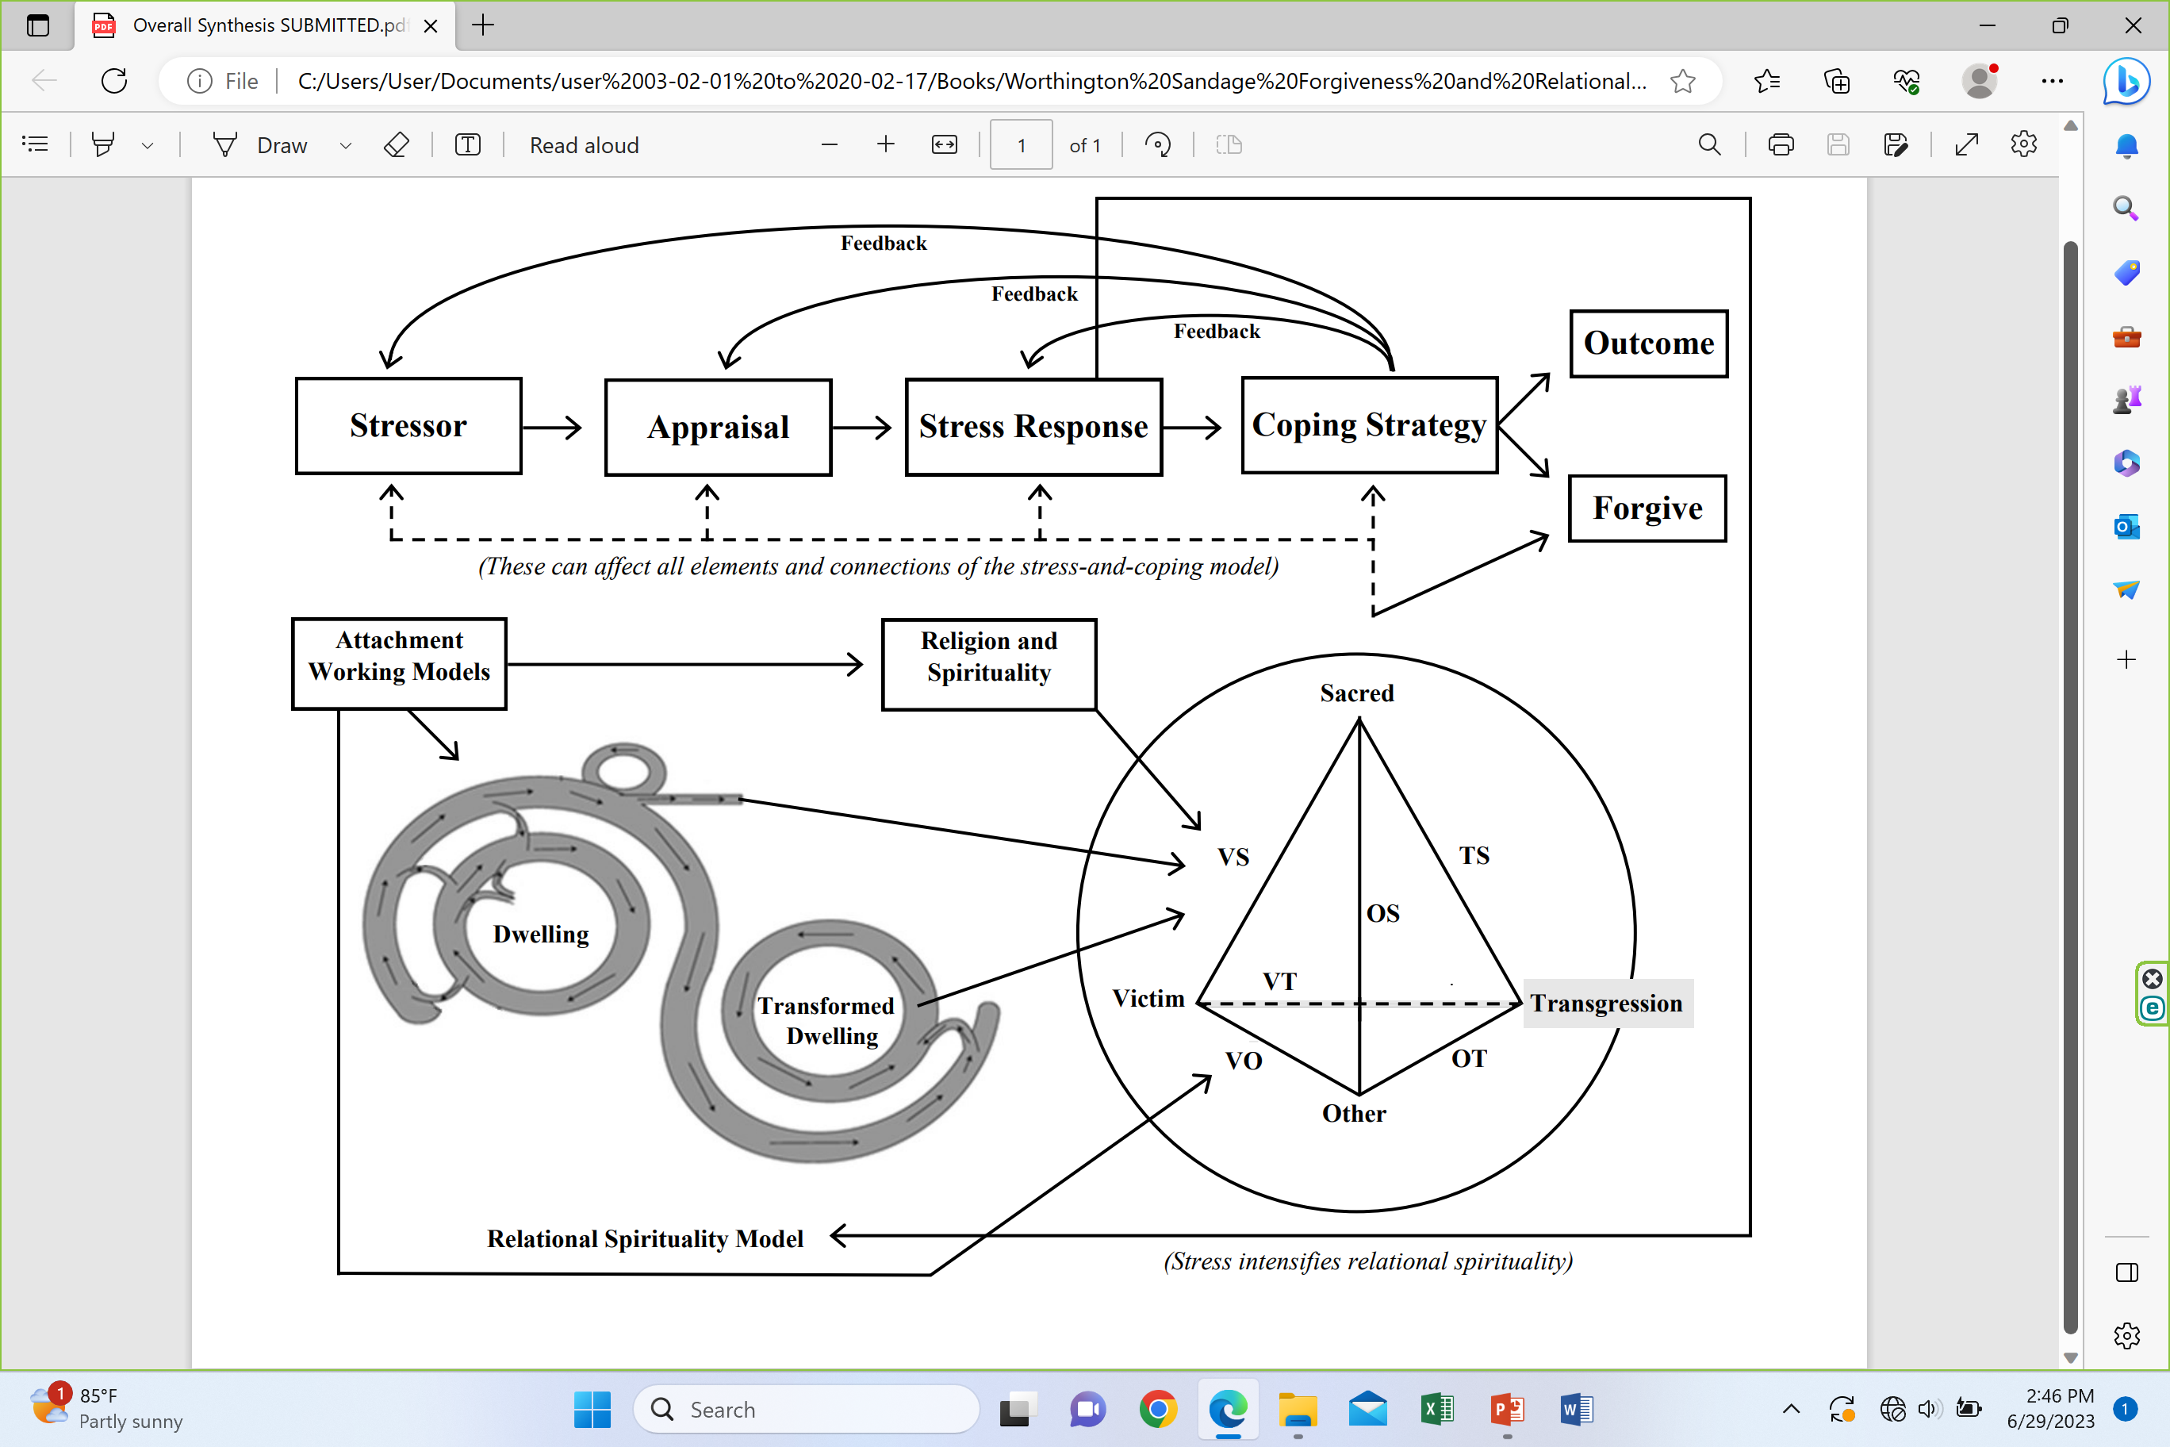
Science: In 2006, I formulated the Stress-and-Coping Theory of Forgiveness
Worthington, E. L., Jr. (2006). Forgiveness and reconciliation: Theory and application. Brunner-Routledge. (Currently under contract: revised edition with Routledge aimed at publication in 2024.)
Note: It’s a THEORY (lots of support). It builds upon Richard Lazarus’ stress-and-coping theory (Lazarus, 1999), which has a massive amount of research

Slide 8
Interpersonal Stressor (Step 1) is Appraised (Step 2) as a Threat and an Injustice
Injustice gap is NET degree of injustice experienced at present.
Severe injustices, hard to deal with; mild injustices, easier to deal with.
Keep ongoing (informal tally). Apology and making amends reduces size of injustice gap; denying responsibility or blaming the victim increases the size of injustice gap.
Assessment in Appendix 1

Slide 9
Unforgiveness
Unforgiveness is a stress response to appraisal of a stressor as threatening and unjust and appraisal of coping as potentially inadequate to handle the stressor without damage.
As a stress reaction, unforgiveness is a combination of physiological, emotional, motivational, and cognitive factors, and it may involve behavioral intentions.

Slide 10
Coping Can Seek to Change…
The offense
The appraisals of the offense
The stress reactions (physiological, emotional, motivational, cognitive, behavioral intentions)

Slide 11
Many Ways to Cope with Injustices
Seek or observe justice
Offender is observed to get natural consequences
Turn the matter over to God for divine justice
Relinquish it to God
Minimize importance of the harm (i.e., denial and cognitive minimization)
Tolerate (put up with it)
Forbear (put up with it for the sake of the relationship, family, group, community)
Accept (let it play in the background)
Forgive (this can transcend the gap)
People reduce the injustice gap by mixing those that work for them. Thus, forgiveness is not necessary to deal with injustice. But it can help supplement other ways or even be a solution itself.

Slide 12
Coping: What Is Forgiveness?
Coping: An attempt to lessen the impact of stress by intentionally affecting the stressor, appraisals, or stress reactions.
Worthington, E. L., Jr., & Scherer, M. (2004). Forgiveness as an emotion-focused coping strategy that can reduce health risks and promote health resilience: Theory, review, and hypotheses. Psychology and Health, 19, 385-405.

Slide 13
Forgiveness—Four types
Centered on experiences of the wrongdoer
  Divine forgiveness
  Self-forgiveness
Centered on experiences of the victim
  Person-to-person forgiveness
  Intergroup forgiveness

Slide 14
Understanding Person-to-Person Forgiveness

Slide 15
Two Types of Person-to-Person Forgiveness
Both types of forgiveness happen inside our skin.
Decisional forgiveness is a behavioral intention statement. Do not intend to get revenge. Do intend to treat person as a valued and valuable person.
  We can make a decision to forgive and carry it out consistently, but still feel emotionally upset (resentment, bitterness, hate, hostility, anger, fear) when we think of the injustice.
Emotional forgiveness is the emotional replacement of unforgiving emotions with positive other-oriented emotions (e.g., empathy, sympathy, compassion, and love)
  Both types of forgiveness are different from reconciliation, which is restoration of trust, requiring two people trying to be trustworthy.

Slide 16
Benefits of Forgiving
Note that there are benefits to the victim of forgiving. So, those provide some motivation to forgive (along with Scriptural endorsement of forgiving.)
But there are also benefits to the offender when the victim forgives. Those benefits to the offender likely also feed back to make a better relationship and more spiritually, mentally healthy, and physically healthy dyad. And there are unseen benefits—what we loose on earth is loosed in heaven (Mt 18:18-20).

Slide 17
Benefits to the Forgiver of Forgiving
Spiritual connection restored
Relationship bettered (decisional forgiveness has most immediate impact)
Mental health and well-being benefited (rumination decreased)
Physical health (stress immediately lessened, and health benefits felt later)

Slide 18
What Did Psychological Science Bring to the Table about Forgiveness?
Study of Divine Forgiveness and Self-Forgiveness
Begins with injustice gap
Many things (other than forgiveness) can reduce the injustice gap, so they can be used to make forgiveness easier.
Forgiveness is defined: what it is not and what it is.
Two types of forgiveness: Decisional and Emotional—both seen in Scripture but Decisional is required (emotional is desired)
Forgiveness is not equal to reconciliation.
There are many benefits (to the forgiver) of forgiving.

Slide 19
A Christian Theology of Forgiveness: Biblical Theology and Practical Theology
Worthington, E. L., Jr. (2003). Forgiving and reconciling: Bridges to wholeness and hope. InterVarsity Press.
Worthington, E. L., Jr., Rueger, S. Y., Davis, E. B., & Wortham, J. (2019). “Mere” Christian forgiveness: An ecumenical Christian conceptualization of forgiveness through the lens of stress-and-coping theory. Religions, 10(1), 13; [open access, https://www.mdpi.com/2077-1444/10/1/44]

Slide 20
Biblical Theology of Forgiveness: How Does Christian Scripture Tell Us to Forgive?
Just do it: Matthew 6:14-15 NIV For if you forgive men when they sin against you, your heavenly Father will also forgive you. But if you do not forgive men their sins, your Father will not forgive your sins. Mark 11:25: And when you stand praying, if you hold anything against anyone, forgive them, so that your Father in heaven may forgive you your sins.”
Repeatedly and potentially infinitely: Matt 18: 21-22 NIV Then Peter came to Jesus and asked, “Lord, how many times shall I forgive my brother when he sins against me? Up to seven times? “Jesus answered, “I tell you, not seven times, but seventy-seven times.”
As the Lord forgave you: Col 3:13 NIV “Bear with each other and forgive one another if any of you has a grievance against someone. Forgive as the Lord forgave you.” Eph 4:32: “Be kind and compassionate to one another, forgiving each other, just as in Christ God forgave you.” How did the Lord forgive us? Unilaterally, without condition, every time. (We humans either do or don’t accept forgiveness.)
From the heart (which is not the way we understand the phrase today): Matt 18:35: “… you forgive your brother or sister from your heart.“ (The parable of the unforgiving steward has no mention or implication of emotional forgiveness. It’s all about deciding about how you intend to behave—i.e., decisional forgiveness.)
BASICALLY, WE ARE TOLD TO FORGIVE BUT NOT HOW TO FORGIVE

Slide 21
Christian Scripture is clear that we should forgive, but its purpose is NOT to instruct us on how to do it.
We learn this through practical theology
From Biblical theology, though, we are prepared to forgive and can help motivate people to forgive

Slide 22
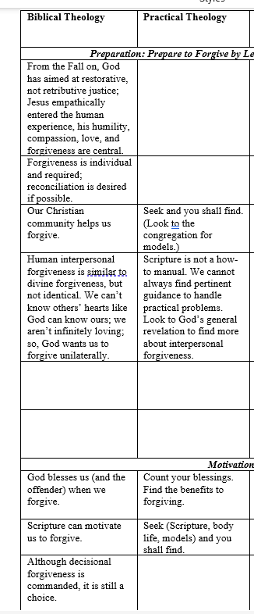
Christian Theology

Slide 23
Content of Christian Practical Theology Interventions
Pray: for the offender, for God’s help in your forgiveness efforts, for God’s power in forgiving, for justice, for divine justice, for discernment, for the intervention of the Holy Spirit
Seek: Scripture, models from local congregation, people you know, Scripture, history
Restraint: Relinquish the offense to God, tolerate the injustice, forbear, accept and move on
Count your blessings: Find benefits to you for forgiving
Encourage: God forgives us first, Tell or imply that God requires decisional forgiveness from us (so that God will forgive us)
Use God’s general revelation (science, philosophy, clinical science, arts, humanities)

Slide 24
Secular Forgiveness Interventions

Slide 25
REACH Forgiveness
A method developed to be consistent with Christian beliefs and values and demonstrated to be helpful through science.

Slide 26
5 Steps to REACH Emotional Forgiveness —“Core” of the method—plus Decision to Forgive
These five steps are the external FORMS of forgiveness. The action happens within you.
Worthington, E. L., Jr. (1998). The Pyramid Model of Forgiveness: Some interdisciplinary speculations about unforgiveness and the promotion of forgiveness. In Worthington, E.L., Jr. (Ed.), Dimensions of forgiveness: Psychological research and theological perspectives (pp. 107-137). Templeton Foundation Press.
R=Recall the Hurt
E=Empathize (Sympathize, feel Compassion for, Love) the Transgressor
A=give an Altruistic Gift of Forgiveness
C=Commit to the Emotional Forgiveness One Experienced
H=Hold on to Forgiveness When Doubts Arise
Decision to Forgive

Slide 27
The full method
Screen participants (groups)
Get people to compete self-assessments on target transgression
Introduce self and tell hardest thing you’ve successfully forgiven
Lectio divina or reflection on inspirational quotes
Definitions or EF and DF
Benefits (spiritual, relational, psychological, physical)
Work through Core: R, E, A, C, and H
Revisit DF (part of the Core)
Generalize through ‘12-step” program.
People complete post-group/post-workbook self-assessments

Slide 28
Running Groups: Pros and Cons
Groups take 6 hours (www.EvWorthington-forgiveness.com)
  They can be run on a Saturday—3 hours 9-12; 3 hours 1-4
  You can charge for them if in practice
  People can see others get better and can help others
  They draw on group universal healing factors
Groups take 6 hours
  Not everyone wants to spend that much time
  Not everyone is willing to pay
  Groups are less effective per hour than individual therapy
  Groups require coordination
  Groups require a minimum number of people (6) and a limit to how big (no more than 20)

Slide 29
Who Can Run REACH Forgiveness Groups?
YOU can!!
Undergrads were slightly less effective than post-master’s level counselors.
How? Use Resources on www.EvWorthington-forgiveness.com
  Read the helper’s manual (beside the participants’ manual)
  Watch the training video (free on my website) of me running the group
Get supervised by a competent helper to answer your questions after reading and watching.
Preferably run the group with a co-leader (perhaps one who has run a REACH Forgiveness group before)
  Most of the talking is done by group members, not leader.
Have a supervisor available to deal with questions.

Slide 30
Creating a brief intervention (DIY Workbook)

Slide 31
History of Efforts
7-hour workbooks (secular [n = 2] and Christian [n = 1]) and testing them at VCU
Turning the 7-hour workbook into a 7-hour open-internet study (LESSONS LEARNED)
Creating a “2-hour” that turns out to be 3.3-hour workbook for international randomized controlled trial

Slide 32
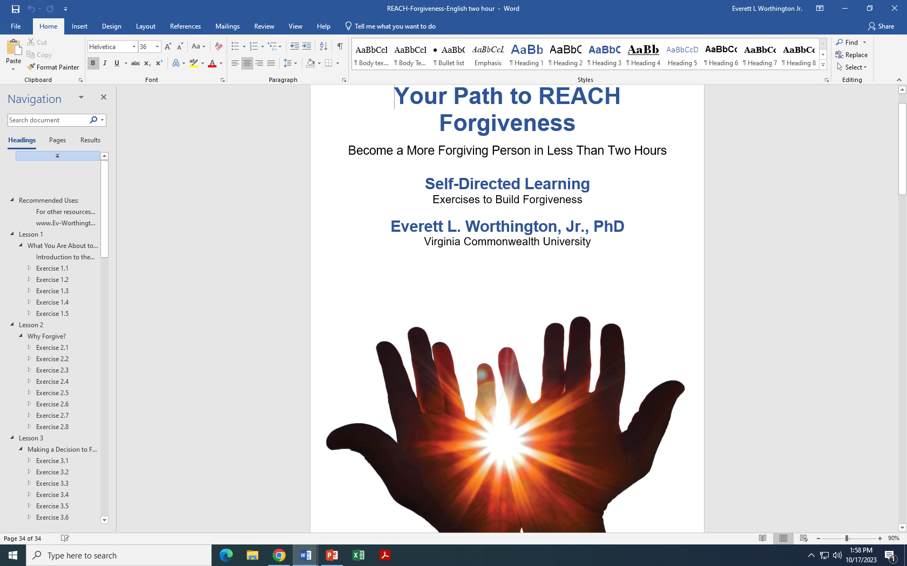
3-Hour DIY Workbook

Slide 33
Putting the Lessons to Work (A Project Funded by the Templeton World Charity Foundation [TWCF]; HO Man Yee, PI)
Hong Kong—an entire (secular) university
Indonesia—a large Christian church that had been razed by religious opponents in the past
Ukraine (two sites)—one near the Russian-Ukrainian conflict, one in a large church in Kyiv
Colombia (two projects)—war survivors; in a (secular) college
South Africa (an entire geographical section of the country, about 1/5 of the population)

Slide 34
Wade et al. (2014) vs HO et al. (2023)
Our Study
6 sites at >500 per site; most people are retained at follow-up; total N = 4,598
N ~ 2300 all studies up to 2013 and N = 1800 all studies 2013-2020.
“Dose” = 3.34 hours (depending on reading level)
All Randomized controlled trials from the beginning to 2013
53 studies (N = 2,323) at post-test
41 studies (N = 1,716) at follow-up
(“Dose” = 1 hour to 60 hours)

Slide 35
We have posted, on a central website, all translations of the workbook (without cost) https://reach.discoverforgiveness.org
Thus, REACH Forgiveness brief DIY Workbooks is available to about 2/3 of the world in their first language without cost:
  English
  Spanish
  Mandarin
  Ukrainian
  Indonesian
  Portuguese

Slide 36
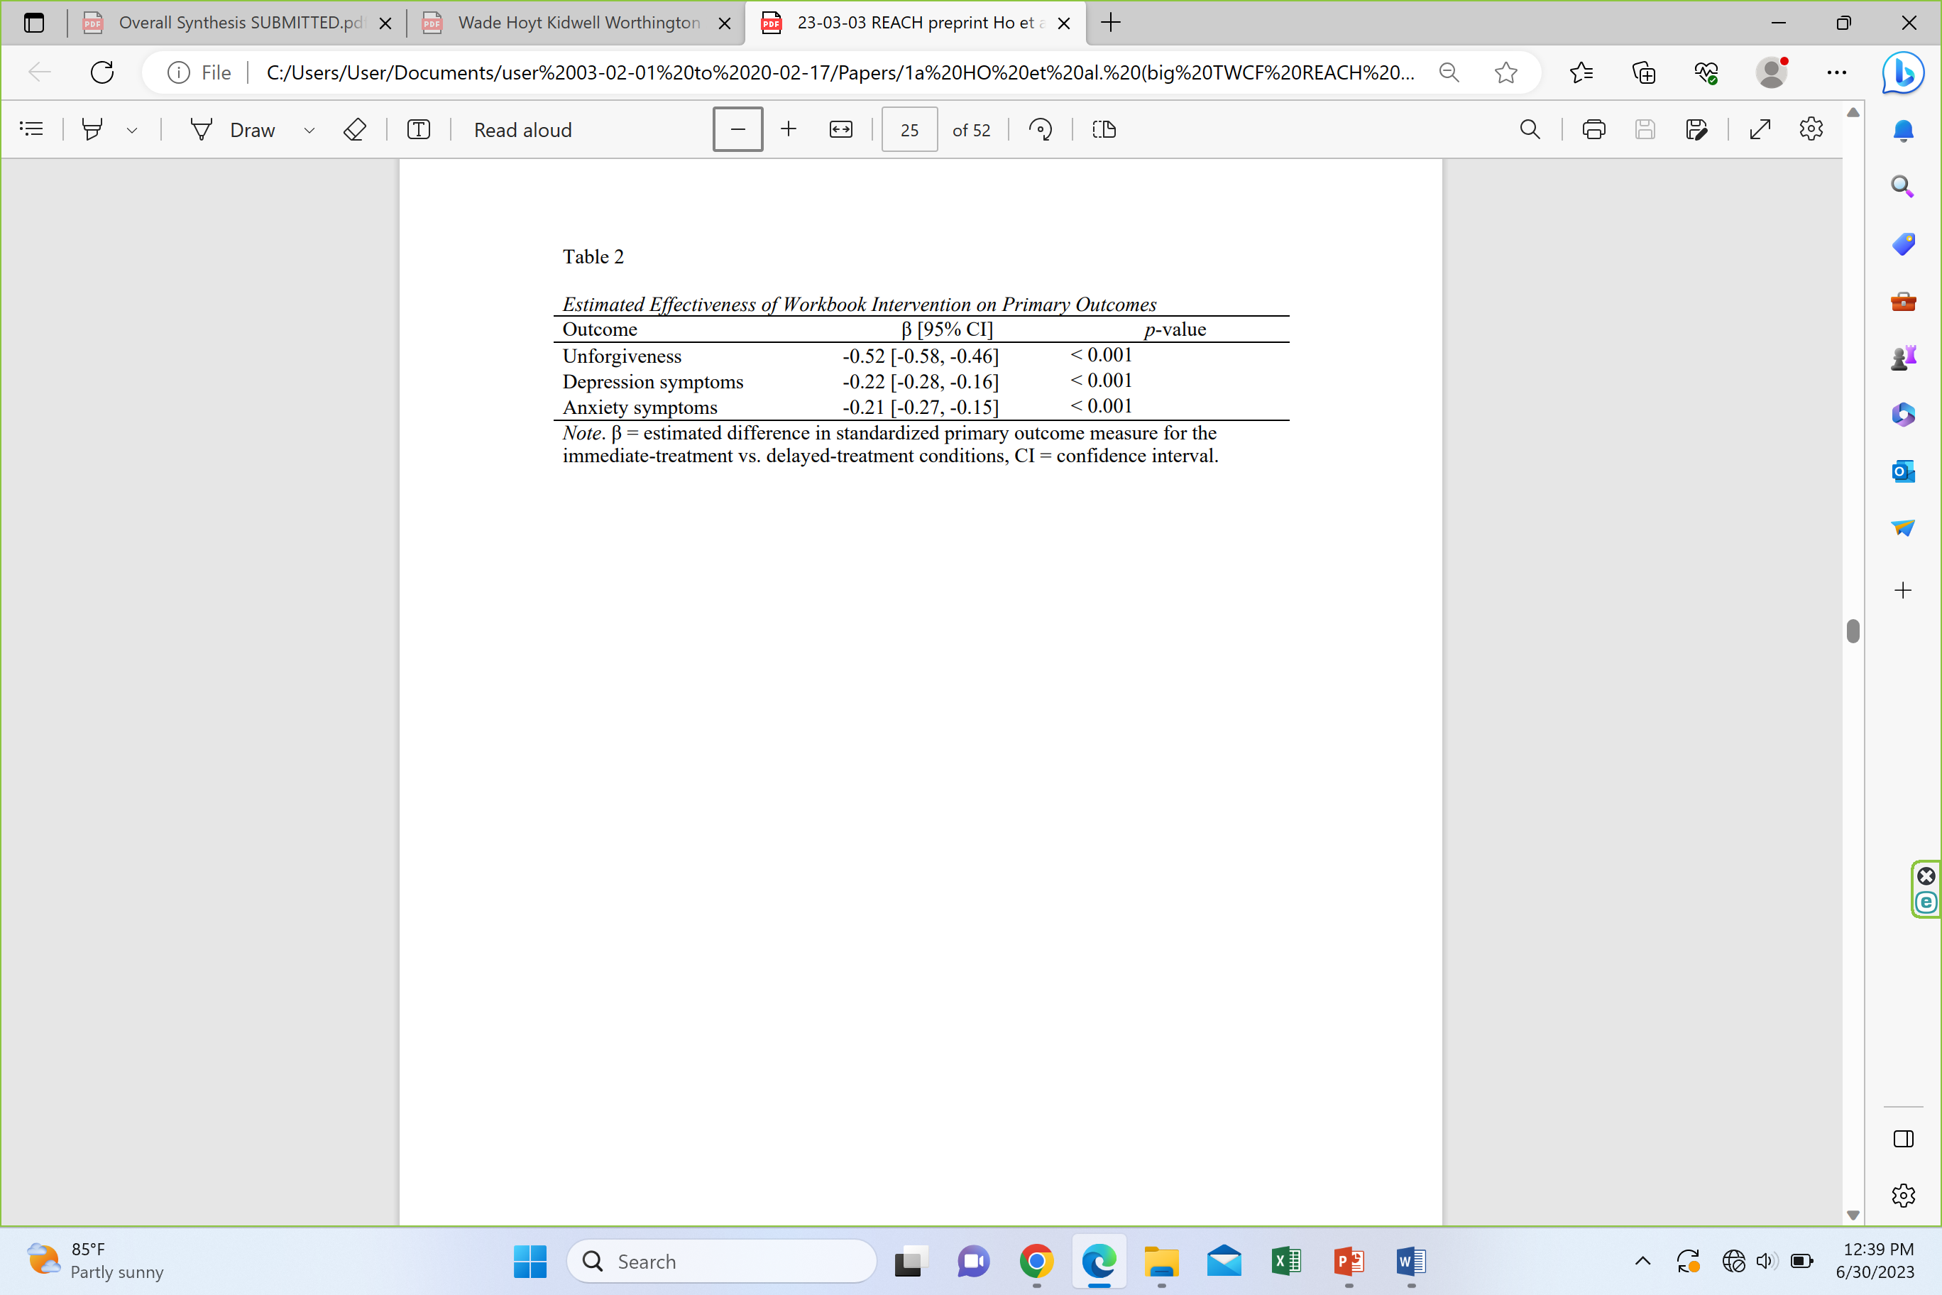
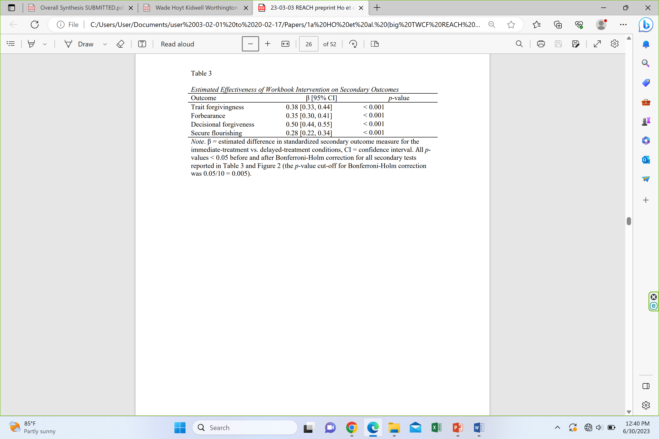
Results of HO et al. (2023) Study
Remember: 26 hrs of CBT for depression, d = 1.26. This is 2.5 hrs of forgive treatment, yet for depression, d = 0.22.
Take home: Completing a two- to three-hour DIY workbook yields increases in forgiveness, disposition to forgive, forbearance, and flourishing. ALSO decreases in unforgiving motives, depression, and anxiety.

Slide 37
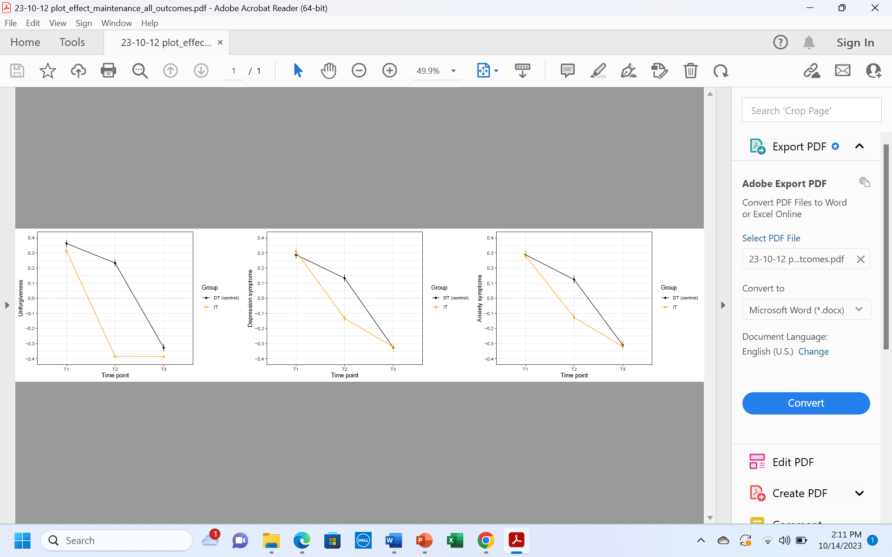
Omnibus Means over Time for Unforgiveness, Depression, and Anxiety
Unforgiveness Depression Anxiety
Take home: Immediate treatment forgave better (forgave immediately and maintained). They reduced depression and anxiety and it kept improving over time. Delayed treatment mirrored performance of IT (of course without follow-up).

Slide 38
Advances
We have pulled out Christians from the Indonesian and Colombian (war survivors) samples and found that the 3.34-hour secular DIY worked with Christians.
We have pulled out Muslims from the Indonesian sample. It works there.
Mohammed Abu-Nimer and Illham Nasser are testing it on a grant-funded project on an Arab sample from multiple sites in two (or three) Arab countries.

Slide 39
Effective vs Efficient
Which is more effective—a 6-hour REACH Forgiveness group or a 3.34-hour REACH Forgiveness DIY workbook?
  Group d = 0.546; DIY d = 0.52
  Conclusion: Equally effective
Which is more efficient—a 6-hour REACH Forgiveness group or a 3.34-hour DIY workbook?
  Group d/hr = 0.091; DIY workbook d/hr = 0.16
  Conclusion: DIY is about twice as efficient

Slide 40
Enright’s Process Model
Two Major Uses
  Forgiveness Therapy: Almost all of his demonstration studies are relatively small N studies with one-to-one treatment of a person with a clinically relevant problem
  Forgiveness Education: 9 studies with the process model (9 studies on his story-based model); process model is much more effective and efficient

Slide 41
Enright’s Process Model (20 total units making up 4 phases)
(Uncovering Phase—Units 1-8)
In the uncovering phase, the person explores the transgression, admits to being hurt, and expresses feelings related to the transgression.
Unit 1: The person recalls and faces the offense. Defensiveness is foresworn as no longer potentially adaptive.
Unit 2: Anger is faced, admitted, and expressed.
Unit 3: Feelings of shame or guilt are addressed.
Units 4 and 5: People seek a healthy balance between the pain of the injury and understanding of the event.
Unit 6: The person considers how people usually compare themselves to an offender who is better off than they.
Unit 7: The person considers potentially permanent changes from the offense. Negative changes are admitted, but the potential for perceiving things more positively is offered.
Unit 8, the person considers their worldview and is encouraged to consider that it might change with time.

Slide 42
Enright’s Process Model (Decision Phase—Units 9-11)
The decision phase consists of units 9 to 11.
Unit 9, frank admission is encouraged that old strategies are not working.
Unit 10, the person considers forgiveness as an option; The definition of forgiveness and what it is not are considered.
Unit 11, the person commits to forgive the offender even though the person may not feel like forgiving.

Slide 43
Enright’s Process Model (Work Phase—Units 12-15)
The third phase is the work phase, in which there are four units.
Unit 12: The person seeks to understand the offender, including speculating about the person’s imperfections. This helps reframe the understanding of the offender.
Unit 13: Reframing is continued to promote empathy.
Unit 14: Reframing is continued to promote compassion.
Both are acknowledged as challenging to maintain.
Unit 15, The person is encouraged to accept and bear the pain of the injury.

Slide 44
Enright’s Process Model (Deepening Phase—Units 16-20)
Gaining a wider perspective
Unit 16: Meaning is sought in suffering and forgiving.
Unit 17: The person reflects on his or her own need for forgiveness in the past.
Unit 18: The person learns he or she is not alone in suffering.
Unit 19: The person reconsiders his or her purpose in life, hoping to find a newpurpose.
Unit 20: the person reflects on decreased negative and increased positive affect.

Slide 45
Effectiveness and Efficiency of Enright’s Process Model—Forgiveness Therapy and Classroom Studies
“Forgiveness Therapy” studies
Almost all are one-on-one multiple sessions studies (cf. early group studies; Hebl & Enright, 1993; Al-Mabuk et al., 1995).
The individual therapy (“forgiveness therapy”) studies are typically long (12 to 60 sessions; recommended at least 20 sessions). Effect sizes are strong (i.e., high effectiveness) but effect size per hour is modest (d/hr ~ 0.05).
Forgiveness therapy has tackled serious mental health and physical health issues.
Forgiveness therapy is flexible. It is aimed at “success” at forgiving, so treatment is extended in to the number of sessions individuals are willing to attend for the outcomes they desire.

Slide 46
Effectiveness and Efficiency of Enright’s Process Model—Forgiveness Therapy and Classroom Studies
Classroom studies (later in Rapp et al., 2023, meta-analysis)—very international (Ireland, Turkey, S. Korea, Pakistan)
Elementary School Children in Belfast, Northern Ireland (3 studies) 17 weekly 45-minutes classes = 12 hours 45 minutes
Elementary School Children in Milwaukee, Wisconsin (17 weekly 45-minute classes) 12 hours 45 minutes
Impoverished Fourth-Grade Students in Turkey
Academically At-Risk Adolescents in the Midwestern United States (aged 12-14) (15 weeks)
Female Adolescent Aggressive Victims in South Korea 12 weeks
At-Risk Adolescents in the Midwestern United States (15 to 19) 23 hours
Abused Adolescents in Pakistan 2x per week for four months (32 hours)

Slide 47
Classroom interventions (Bob Enright and Suzanne Freedman): Effectiveness versus efficiency [k=# studies; g=effect size]
Process model: k = 9; g = 0.66
Story-based model: k = 9; g = 0.27
Time see previous slide: (12 h 45 m, 12 h 45 m, 15 h, 12 h, 23h, 32h) Mean t = 17.92 hours
d/hr process model: 0.66/18 = 0.036
d/hr story-based model: ~ 0.012

Slide 48
Forgiveness with school-aged children (Rapp et al., 2022)
g is effect size (number of SDs changed);
* statistical significance (note, some comparisons can be not significant merely because few studies or very unstable results of studies)
Meta-analyzed 20 studies in educational settings with children first grade (age 6) to 12th grade (age 18)
Outcomes: [Forgiveness + anger]* (g = 0.41; k = 20); Hope (g = 1.70, k = 5); Depression (g = 0.11, k = 7)
Moderators (i.e., predictors of outcomes): Age (older is better*); Grades: 1-3 (g = 0.03; k = 4), 4-6* (g = 0.45, k = 5), 6-8* (g = 0.58, k = 8), 9-12* (g = 0.44, k = 3); Program: Enright process model* (g = 0.66; k = 9); Enright story-based* (g = 0.27; k = 9); REACH (g = 0.29; k = 2); No. sessions (more is better*)

Slide 49
Additional Forgiveness Interventions

Slide 50
Luskin’s Forgive for Good Model (CBT)
Luskin’s (2001) model is a cognitive-behavioral approach to promoting forgiveness, used mostly to reduce anger, resentment, which put people at risk for cardiovascular malfunction. FFG suggests that forgiveness is ultimately beneficial for the person holding onto the anger.
People are helped to understand the hurt, empathize with the offender, reframe provocative situations by replacing negative with more adaptive interpretations, make a conscious decision to forgive, and use cognitive and behavioral methods to change unwanted cognition and emotion.

Slide 51
Luskin’s Forgive for Good Model (CBT)
A few studies have supported its effectiveness.
Harris, A. H. S., Luskin, F., Norman, S. B., Standard, S., Bruning, J., Evans, S., & Thoresen, C. E. (2006). Effects of a group forgiveness intervention on forgiveness, perceived stress, and trait-anger. Journal of Clinical Psychology, 62(6), 715-733.
Luskin, F. M. (2001). Forgive for good: A proven prescription for health and happiness. San Francisco, CA: HarperCollins.
Luskin, F., Ginzberg, K., & Thoresen, C. E. (2005). The efficacy of forgiveness intervention in college age adults: Randomized controlled study. Humboldt Journal of Social Relations, 29, 163–184.
Toussaint, L. L., Griffin, B. J., Worthington, E. L., Jr., Zoelzer, M., & Luskin, F. (2020). Promoting forgiveness at a Christian college: A comparison of REACH Forgiveness and Forgive for Good methods. Journal of Psychology and Theology, 48(2), 154-165.

Slide 52
Wade’s Yalom-Based Group Process Model
This is an interpersonal group therapy model.
Participants were not exposed to any specific techniques for promoting forgiveness, although it was clear that forgiveness was of interest because the group is about dealing with transgressions.

Slide 53
Theory of Wade’s Yalom-Based Group Process Model
Healing occurs from therapeutic factors as the group bonds and members share themselves, struggles, and experiences with others (Yalom & Lescsz, 2005).
Group-related healing factors: universality (i.e., one is not alone in suffering), interpersonal learning, instillation of hope, imparting information, and cohesiveness.
By focusing on the group members’ experiences, the facilitators attempt to activate these therapeutic factors to help the members with their concerns.
When forgiveness arises in the group, treat as any other topic. Emphasize universality, interpersonal learning from it, hope, and cohesiveness from shared experiences.

Slide 54
Wade’s Yalom-Based Group Process Model
Wade, N. G., Cornish, M. A., Tucker, J. R., Worthington, E. L., Jr., Sandage, S. J., & Rye, M. S. (2018). Promoting forgiveness: Characteristics of the treatment, the clients, and their interaction. Journal of Counseling Psychology, 65(3), 358-371.
Wade, N. G., & Meyer, J. E. (2009). Comparison of brief group interventions to promote forgiveness: A pilot outcome study. International Journal of Group Psychotherapy, Vol 59(2), 199-220. doi: 10.1521/ijgp.2009.59.2.199
Wade, N. G., Worthington, E. L., Jr., & Haake, S. (2009). Promoting forgiveness: Comparison of explicit forgiveness interventions with an alternative treatment. Journal of Counseling and Development, 87,143-151.

Slide 55
Wade’s Yalom-Based Group Process Model for Therayp: How effective and how efficient vs REACH Forgiveness?
Wade, N. G., Cornish, M. A., Tucker, J. R., Worthington, E. L., Jr., Sandage, S. J., & Rye, M. S. (2018). Promoting forgiveness: Characteristics of the treatment, the clients, and their interaction. Journal of Counseling Psychology, 65(3), 358-371.
When compared directly with Yalom-based group therapy, REACH Forgiveness reduced rumination more, but did not differ in the other four measures.
For REACH Forgiveness groups, for pooled measures of forgiveness—revenge and benevolence—d = 0.720 at post-test (d/hr per hour = 0.060) and d = 0.43 at follow-up.
Process group therapy d = 0.53 at post-test (d/hr per hour = 0.045) and d = 0.41 at follow-up.

Slide 56
Couples

Slide 57
Greenberg’s Emotion-Focused Couple Therapy for Forgiveness
Greenberg's EFT approach to forgiveness stresses confronting emotions attending offenses and hurts (Greenberg & Meneses, 2020).
The participant seeks to transform emotions from anger and hate to acceptance and compassion. Those are thought to eventually lead to forgiveness.
Relevant to the name of the intervention, emotional focus—processing and transforming emotions—is key.

Slide 58
Greenberg’s Emotion-Focused Couple Therapy for Forgiveness
EFT may be used in couple therapy or in individual therapy. The most important tool in EFT for forgiveness is the empty chair technique. Participants express their feelings to a chair that they imagine to be occupied by the transgressor. This has been found, in itself, to produce some forgiveness (Greenberg et al., 2008).
This has been supported by two studies and a book.
  Greenberg, L. S., & Meneses, C. W. (2020). Forgiveness and letting go in emotion-focused therapy. American Psychological Association.
  Greenberg, L. S., Warwar, S., Malcolm, W. (2008). Differential effects of emotion-focused therapy and psychoeducation in facilitating forgivenes and letting go of emotional injuries. Journal of Counseling Psychology, 55(2), 185-196. doi: 10.1037/0022-0167.55.2.185
  Greenberg, L. S., Warwar, S., Malcolm, W. (2010). Emotion-focused couples therapy and the facilitation of forgiveness. Journal of Marital and Family Therapy, 36(1), 28-42. doi: 10.1111/j.1752-0606.2009.00185.x

Slide 59
Baucom, Snyder, and Gordon Treatment of Unforgiveness after Affairs
Baucom et al. (2009) have sought to develop an approach to help troubled couples in therapy who are dealing with a sexual infidelity.
Their approach integrates CBT and psychodynamic principles.

Slide 60
Baucom, Snyder, and Gordon Treatment of Unforgiveness after Affairs
There are three phases to the therapy.
  1. Dealing with the initial impact of the affair. Most attention to reducing enormous emotional impacts of both faithful and unfaithful partner, to weather the crisis and keep talking.
  2. Exploring contributing factors and finding meaning. Most of this draws on CBT methods to understand and contextualize the affair within the relationship.
  3. Reaching an informed decision about how to move ahead—whether apart or together. Methods are from insight-oriented and psychodynamic approaches. Insights into the conscious and unconscious aspects of the couple’s behavior are explored. Forgiveness comes into play in phase 3.

Slide 61
Explicitly Christian Accommodated

Slide 62
Christian-Accommodated REACH Forgiveness: What Were the Accommodations?
(Note: “Christian accommodated tells us little. Lots or little accommodation? What specific changes were made? Will the Christian beliefs, values, and practices resonate with the user?)
The treatment is entitled as explicitly Christian.
The REACH acronym is explained as a metaphor for forms that create the shape of a mold. The real work of forgiveness is internal, like filling the form with concrete for permanent change. The six forms (REACH and DF) can be used repeatedly.
The lectio divina reflections use Scriptures. Scriptures can help us understand forgiveness.
When forgiveness is defined as decisional and emotional, reference is made to Mt 6:12, 14-5, and it is asserted that decisional forgiveness is Scripture “required” and emotional forgiveness is God-desired.

Slide 63
Christian-Accommodated REACH Forgiveness: What Were the Accommodations?
  Spiritual benefits are explicit
  Humble forgiveness, looking to others, is emphasized. Part of the humility is (1) looking to God in prayer for empowering forgiveness and (2) praying for the one who offended you.
  Altruistic forgiveness is other-oriented, Christian undeserved (grace-motivated) forgiveness
  Commitment is needed, like commitment is needed to solidify God’s forgiveness in our lives.
  Maintenance can be aided by prayer.
  The 12-steps are aimed at character change through the work of the Holy Spirit working, again, through the “forms” of the 12 “steps” in which REACH is applied repeatedly.

Slide 64
Christian-Accommodated REACH Forgiveness: What Were the Outcomes?
What did we find in reviewing all: For Christians?
  REACH-Christian groups (d/hr = 0.091, k = 7) vs REACH-secular groups (d/hr = 0.093, k = 12)

Slide 65
Generalizations from Comparing the Content of the Various Interventions
Almost all forgiveness treatments share more in common than they differ. Almost all use most of the same principles.

Slide 66
Similarities That All (or Most) Share—Based on Narrative Review of 14 Secular Forgiveness Interventions
First, they motivate forgiving by recounting psychological, physical, relational, and (perhaps) spiritual benefits of forgiving to the forgiver.
Second, they typically have people work on forgiving a specific hurt or offense rather than forgiving more in general.
Third, they all guide people to recall and process the hurt—though they differ starkly in how much of the treatment is devoted to that.
Fourth, they invite the potential forgiver to take the perspective—cognitively, and especially, empathically—of the offender and extend compassion.
Fifth, they invite the potential forgiver to take an inventory of his or her own life and embrace a humble acceptance that they too have offended and to do so is a shared human failing calling for a generous response.
Sixth, they encourage forgiveness but all treat it as choice rather than duty.

Slide 67
10 Similarities Shared by Some But Not by Others (but we aren’t going to cover these)
Seventh, they encourage decisional or emotional forgiveness, or both.
Eighth, most attempt to place struggles in some larger perspective.
Ninth, they encourage a long-term commitment to forgiving.
Tenth, some explicitly instruct in ways to maintain gains.
Eleventh, some seek to broaden forgiveness beyond forgiving an offense to forgivingness.
Twelfth, most encourage reflection on the gains made through the intervention.
Thirteenth, some encourage some deeper insight into subtle unconscious or contextual factors pushing people towards forgiveness or unforgiveness.
Fourteenth, some direct explicit attention to things that the offender can do to make forgiveness easier or more difficult.
Fifteenth, some refer to forgiveness as a way of restoring hope (personally or relationally), easing depression and anxiety, and promoting well-being and flourishing.
Sixteenth, some make the application specific to a particular harm (i.e., incest, couple conflict) or clientele (i.e., people in some non-US country, Christians).

Slide 68
Comparing All
Overall, looking at each of the principles, no single intervention employs all 16 of these. However, most of the interventions use most of the principles.

Slide 69
Putting All of These Together
Biblical Theology
Practical Theology
Basic Science
Secular Intervention Science
REACH Forgiveness

Slide 70
Review: Content of Christian Practical Theology Interventions
Pray: for the offender, for God’s help in your forgiveness efforts, for God’s power in forgiving, for justice, for divine justice, for discernment, for the intervention of the Holy Spirit
Seek: Scripture, models from local congregation, people you know, Scripture, history
Restraint: Relinquish the offense to God, tolerate the injustice, forbear, accept and move on
Count your blessings: Find benefits to you for forgiving
Encourage: God forgives us first, Tell or imply that God requires decisional forgiveness from us (so that God will forgive us)
Use God’s general revelation (science, philosophy, clinical science, arts, humanities)

Slide 71
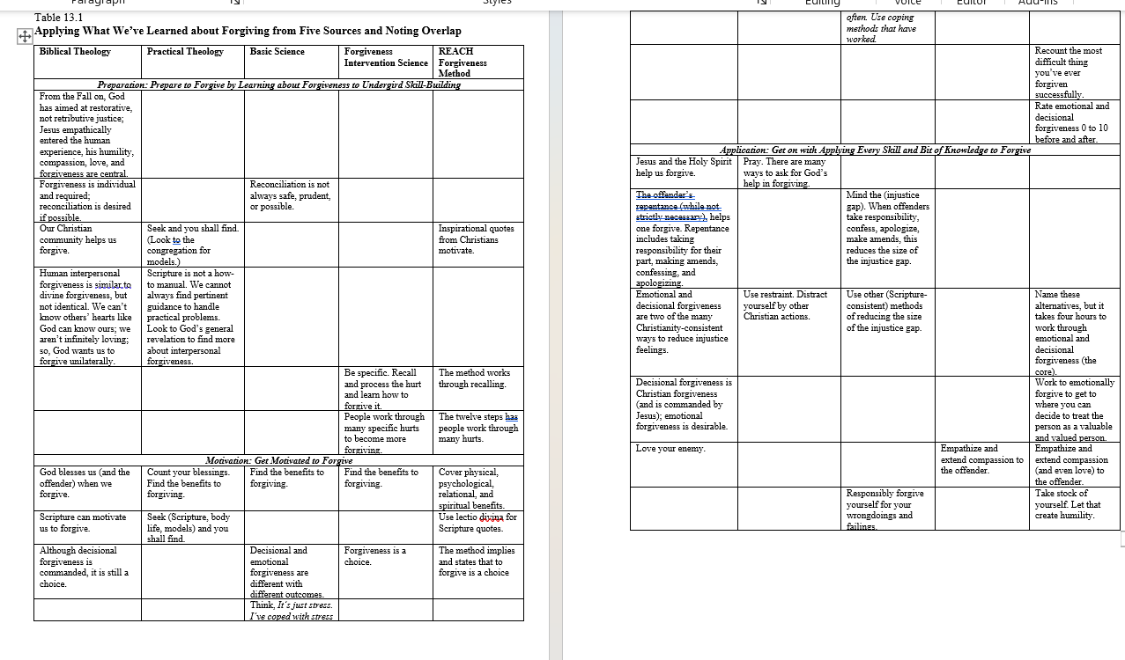
Where do we get the interventions?
Prep: Theology; Motivation: Fairly Equal; Application: Practical Theology and Secular Interventions

Slide 72
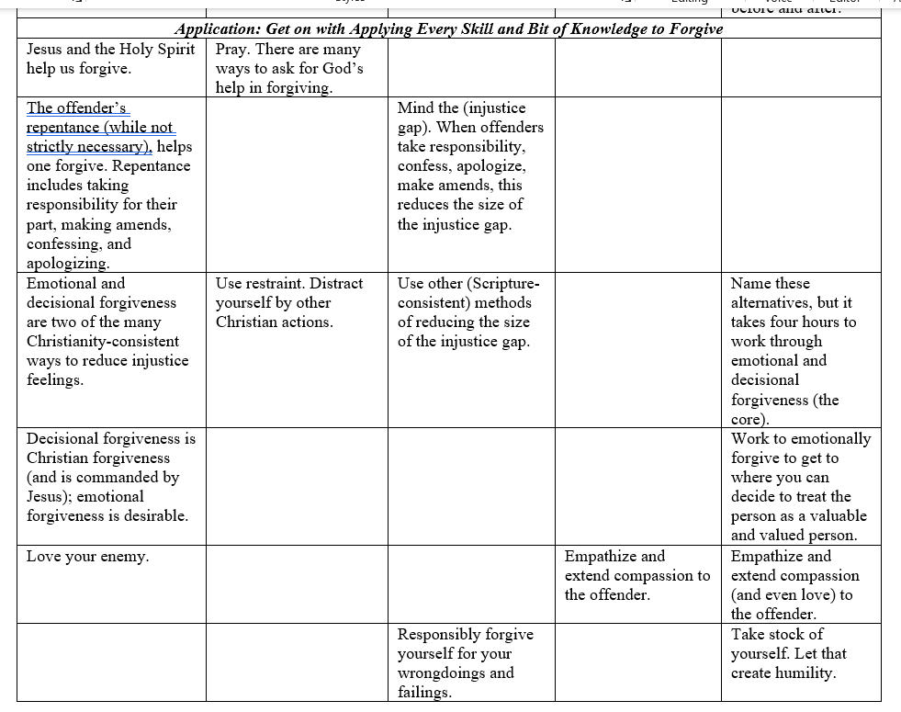
Let’s Look at the Practical Applications

Slide 73
To Preach (or Speak) Effectively about Forgiveness
Three things make sermons more effective:
(1) recount benefits of forgiving to you and your offender;
(2) direct people to DIY workbooks or groups;
(3) discuss prayer, empowerment by God, visualizing, relying on God.

Slide 74
Conclusion
The field of forgiveness studies is well-developed but still has lots of interesting unanswered questions.
You can promote forgiveness in clients and more broadly (contributing to public mental health). Use:
REACH Forgiveness model or Enright’s process-based model.
Or, adapt either of those.
Adapt your favorite approach by including shared principles from secular interventions, Biblical theology and practical theology.

Slide 75
Objectives of the Talk
By the end of this preconference workshop, the attendee will be able to:
Use at least some major approaches that can be used in therapy or as adjuncts to it;
Identify six evidence-based principles abstracted from 14 evidence-based secular forgiveness interventions;
Employ knowledge of five categories of forgiveness methods used by Christian churches to help people forgive to effectively plan treatments.

Slide 76
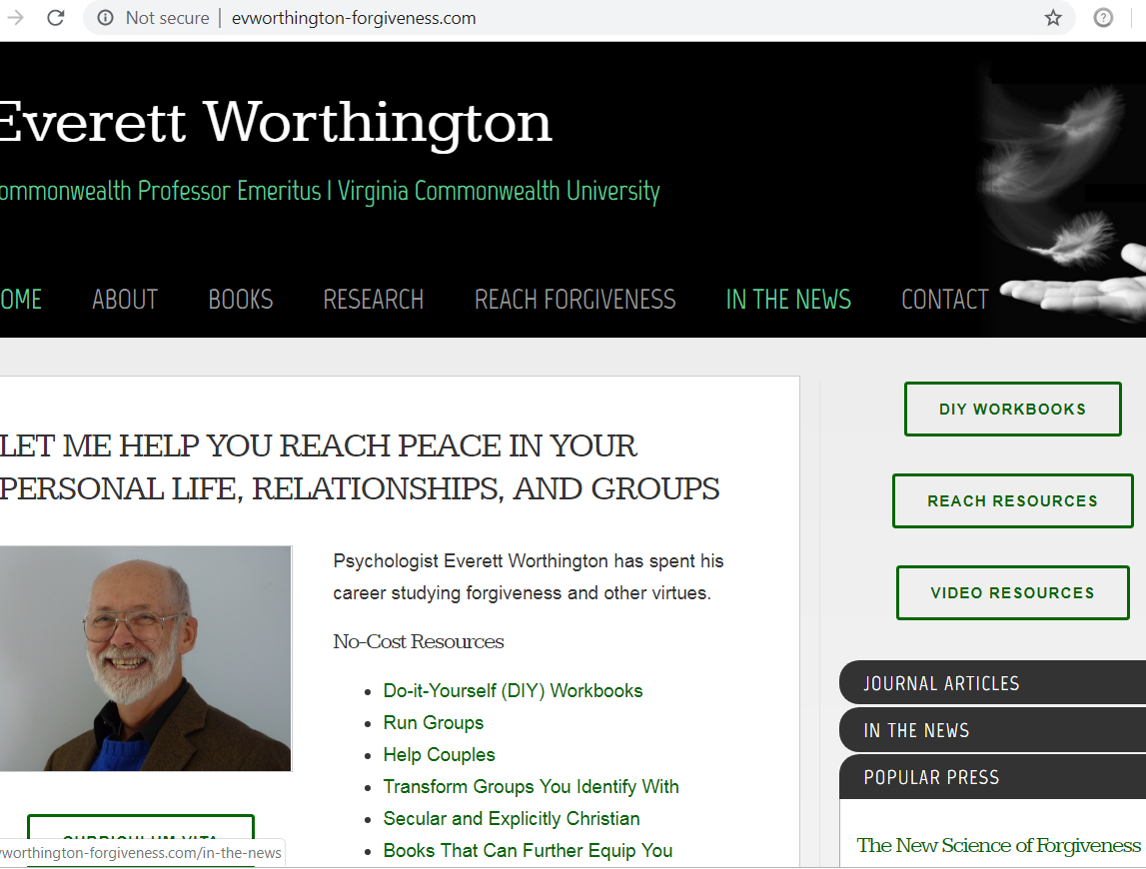
Group Manuals and DIY Workbooks Are Free
Group and couple manuals →
←

Slide 77
Free Resources
www.EvWorthington-forgiveness.com
  DIY Workbooks
    In other languages: https://reach.discoverforgiveness.org
  Group Protocols (leader and participant manuals): www.EvWorthington-forgiveness.com
  Advice about running campaigns at churches or other organizations
  Other workbooks—humility, patience, self-forgiveness, positivity
Link to couples resources: www.hopecouples.com
Contact information: eworth@vcu.edu

Slide 78
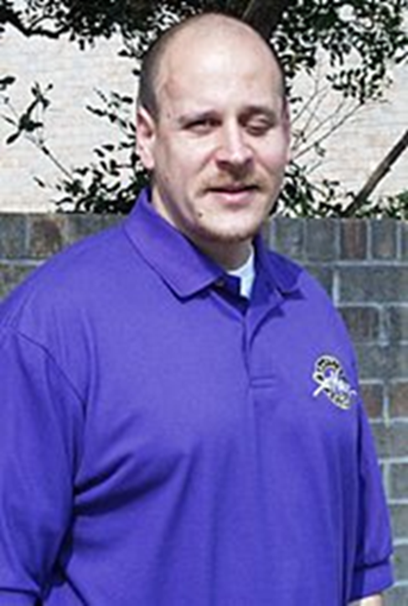
A Thought to End

Slide 79

Questions and Answers

Slide 80
Appendix 1 Assessment Materials

Slide 81
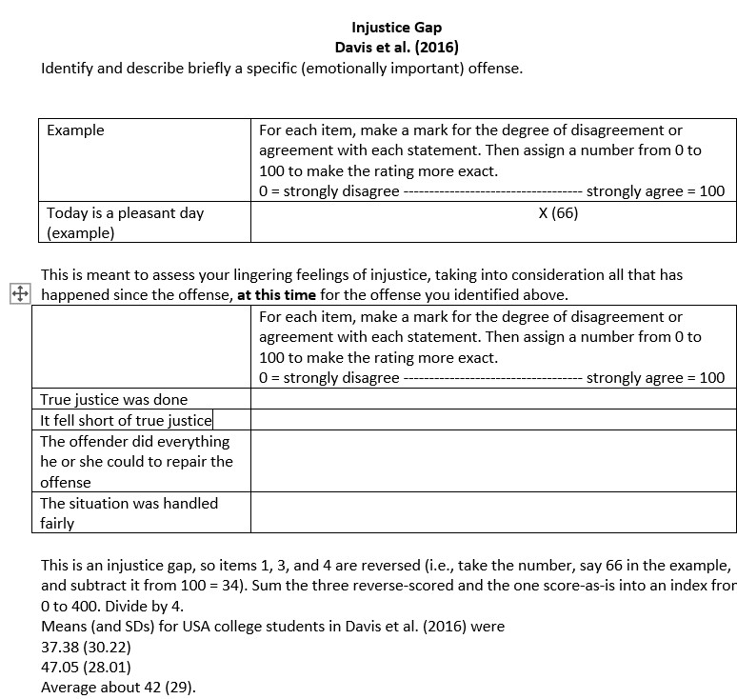
Appraisal
Injustice Gap
Davis, D. E., Yang, X., DeBlaere, C., McElroy, S. E., Van Tongeren, D. R., Hook, J. N., Worthington, E. L., Jr. (2016). The injustice gap. Psychology of Religion and Spirituality, 8(3), 175-184.

Slide 82
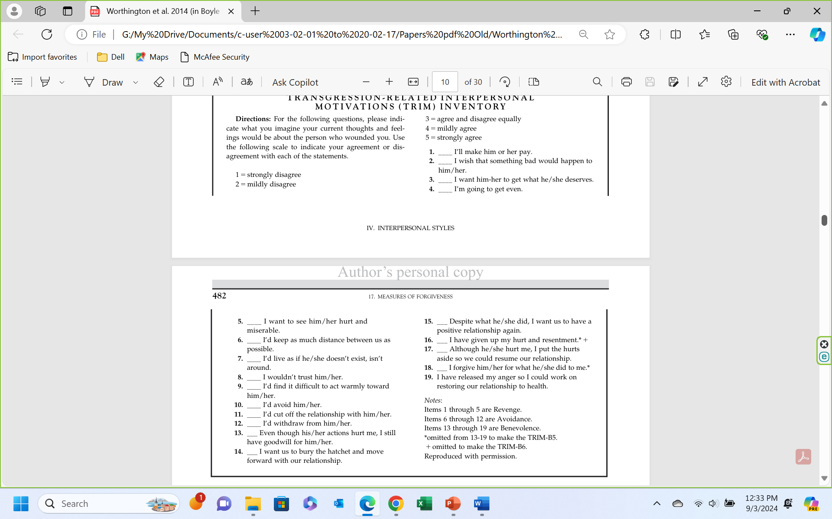
Assessing Forgiveness
Forgiveness = Benevolent motives – Revenge motives – Avoidance motives
McCullough, M. E., Rachal, K. C., Sandage, S. J., Worthington, E. L., Jr., Brown, S. W., & Hight, T. L. (1998). Interpersonal forgiveness in close relationships II: Theoretical elaboration and measurement. Journal of Personality and Social Psychology, 75, 1586-1603.

Slide 83
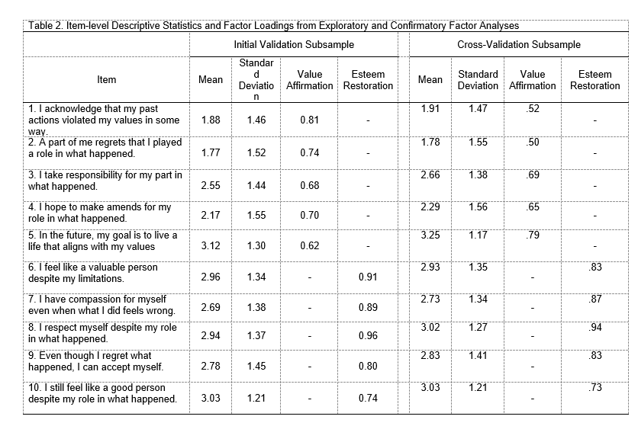
Assessing Self-Forgiveness: The Dual Process Self-Forgiveness Scale--Revised
Griffin, B. J., Norman, S. B., Weber, M., Hinkson, K. D., Jendro, A. M., Pyne, J. M., Worthington, E. L., Jr., & Maguen, S. (2024). Properties of the modified Self-Forgiveness Dual-Process Scale in populations at risk for moral injury. Stress and Health, in press.

Slide 84
Appendix 2: Bonus Material on Self-Forgiveness

Slide 85
Self-Forgiveness
You’ll note that intentionally I did not include self-forgiveness interventions in my learning objectives. That’s because I don’t know how long we’ll spend on our Make-Your-Own-Adventure model-making. So, if we have time, we’ll do this.
Two therapeutic models
Cornish and Wade’s 4-F model for use in psychotherapy
Griffin et al.’s psychoeducational model to treat self-condemnation and moral injury

Slide 86
There are TWO established evidence-based treatments for self-condemnation
Cornish and Wade’s 4-R Model for Self-forgiveness in Psychotherapy
Worthington’s (2013) and Griffin et al.’s (2015) Six Steps to Self-Forgiveness (psychoeducational model used as DIY workbook or group in the VAMC system)
Brandon.griffin2@va.gov

Slide 87
Cornish and Wade (2015)
The Four-R Method of Self-Forgiveness
Responsibility
Own the hurt to others; recognize pain others felt; avoid minimizing or explaining away
Remorse
Often comes naturally as the person accepts responsibility
Restoration
Person tries to repair the damage and reconnect with one’s values one violated by the offense
Renewal
Release self-condemnation; replace it by renewed self-respect, self-compassion, and self-acceptance

Slide 88
We did a couple of intervention studies—pre-six-step model—in the mid-2000s
Scherer et al. with inpatients for alcohol misuse.
Scherer, M., Worthington, E. L., Jr., Hook, J. N., & Campana, K. L. (2011). Forgiveness and the bottle: Promoting self-forgiveness in individuals who abuse alcohol. Journal of Addictive Diseases, 30, 382–395.
(Four-hour group treatment with in-patients.)
Campana with women who experienced a romantic relationship dissolution.
Campana, K. (2010). Self-forgiveness interventions for women experiencing a breakup. Unpublished Doctoral Dissertation, Virginia Commonwealth University.
(A hurried dissertation using a DIY workbook, but with inadequate post-treatment sample-size)

Slide 89
I created a Stress-and-Coping-Theory-based intervention to help people REACH self-forgiveness. The intervention developed slowly.
First, I wrote a Christian book outlining the model
Worthington, E. L., Jr. (2013). Moving forward: Six steps to forgiving yourself and breaking free from the past. WaterBrook/Multnomah.
Then Brandon Griffin and I created a DIY workbook intervention (6- to 7-hr) to convert the 2013 model into an intervention
Griffin, B. J., Worthington, E. L., Jr., Lavelock, C. R., Greer, C. L., Lin, ., Davis, D. E., & Hook, J. N. (2015). Efficacy of a self-forgiveness workbook: A randomized controlled trial with interpersonal offenders. Journal of Counseling Psychology, 62(2), 124-136.
Here’s another stress-and-coping based model: self-forgiveness and health: Toussaint, L. L., Webb, J. R., & Hirsch, J. K. (2017). Self-forgiveness and health: A stress-and-coping model. In L. Woodyatt, E. L. Worthington, Jr., M. Wenzel, & B. J. Griffin (Eds.), Handbook of the psychology of self-forgiveness (pp. 87-100). Springer.

Slide 90
Six Steps to Self-Forgiveness and Decisional Plus Emotional Self-Forgiveness: Dual Process Model
Worthington, E. L., Jr. (2013). Moving Forward: Six Steps to Self-Forgiveness and Breaking Free from the Past. WaterBrook/Multnomah.
Griffin, B. J., Worthington, E. L., Jr., Lavelock, C. R., Greer, C. L., Lin, ., Davis, D. E., & Hook, J. N. (2015). Efficacy of a self-forgiveness workbook: A randomized controlled trial with interpersonal offenders. Journal of Counseling Psychology, 62(2), 124-136.
Responsibility
  Step 1: Receive God’s Forgiveness (or Humanity, or Nature)—Moral repair (Decisional)
  Step 2: Repair Relationships—Moral repair (Decisional)
  Step 3: Reduce Rumination (Rumination, Expectations, Standards)—Internal condemnation (Emotional)
REACH Emotional Self-Forgiveness
  Step 4: Explicit Decision plus REACH Emotional Self-forgiveness)—Moral Repair (Decisional) plus Internal condemnation (Emotional)
Repair of Self
  Step 5: Realize Self-Acceptance—Internal condemnation (Emotional)
  Step 6: Resolve to Live Virtuously—Moral Repair (Decisional)
Davis, D. E., Ho, M. Y., Griffin, B. J., Bell, C., Hook, J. N., Van Tongeren, D. R., Worthington, E. L., Jr.. DeBlaere, C., & Westbrook, C. (2015). Forgiving the self and physical and mental health correlates: A meta-analytic review. Journal of Counseling Psychology, 62(2), 329-335.

Slide 91
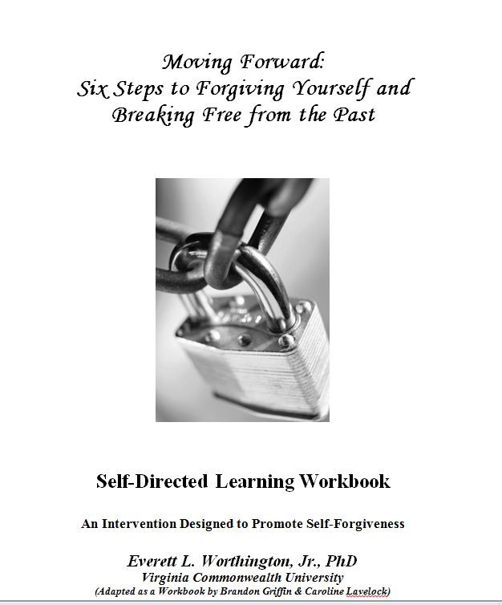
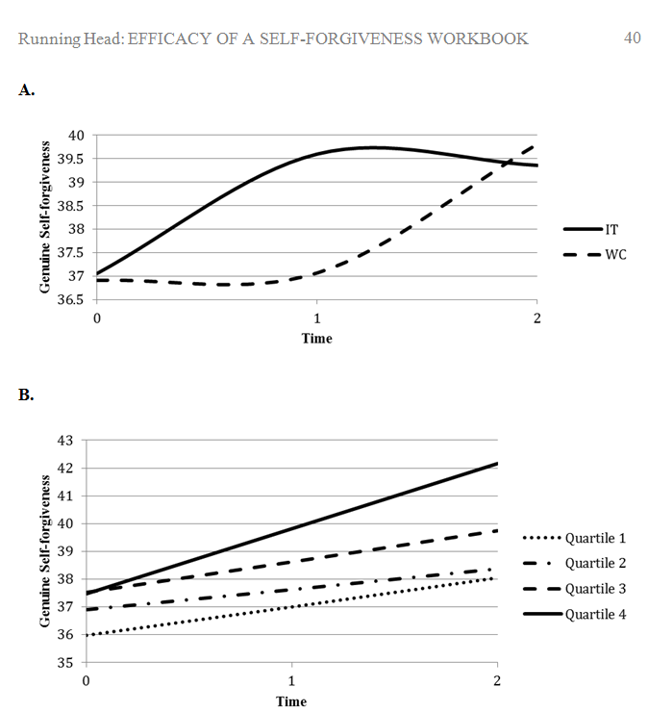
We Tested in a RCT, a Workbook to Promote Self-Forgiveness

Slide 92
Questions and Answers

Slide 93
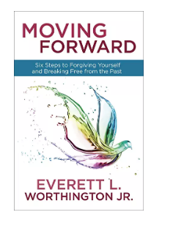
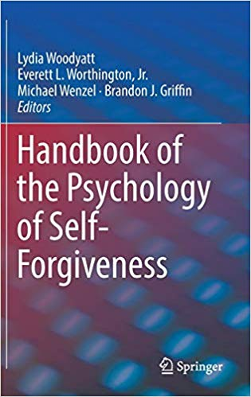
Books and Workbook
www.forgiveself.com
Worthington, E. L., Jr. (2013). Moving forward: Six steps to forgiving yourself and breaking free from the past. WaterBrook/Multnomah.
Woodyatt, L., Worthington, E. L., Jr., Wenzel, M., & Griffin, B. J. (Eds.). (2017). Handbook of the psychology of self-forgiveness. Springer Nature.
Griffin, B. J., Worthington, E. L., Jr., Lavelock, C. R., Greer, C. L., Lin, Y., Davis, D. E., & Hook, J. N. (2015). Efficacy of a self-forgiveness workbook: A randomized controlled trial with interpersonal offenders. Journal of Counseling Psychology, 62(2), 124-136.
  Get the workbook free at www.EvWorthington-forgiveness.com (DIY Workbooks)
Griffin, B. J., Cornish, M. A., Maguen, S., & Worthington, E. L., Jr. (2021). Forgiveness as a mechanism of recovery from moral injury. In Currier, J. M., Drescher, K. D., & Nieuwsma, J. (Eds.), Addressing moral injury in clinical practice (pp. 71-86). Washington, DC: American Psychological Association.
Forthcoming: John M. McConnell & Everett L. Worthington, Jr. (2025, under contract, in process of revising). Promoting Self-Forgiveness in Mental Health Practice: A Principle-Driven, Patient-Responsive, Science-Supported Clinical Approach. Oxford University Press.

